Slide 1
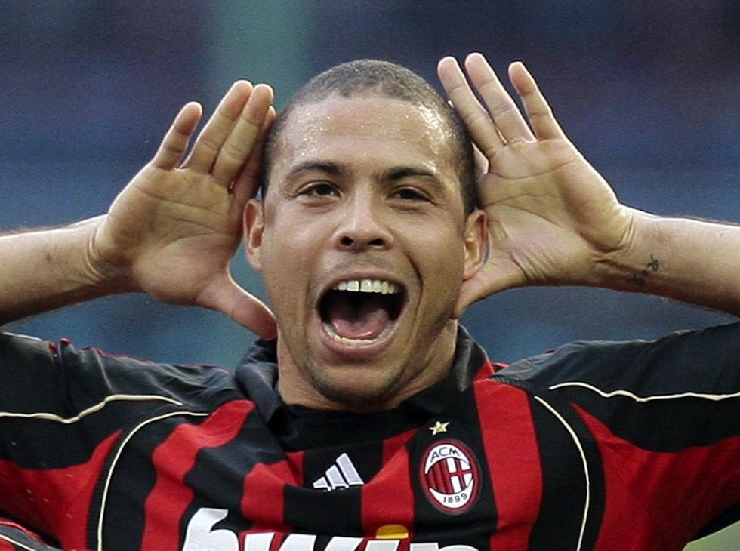
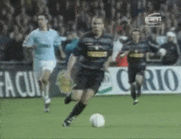
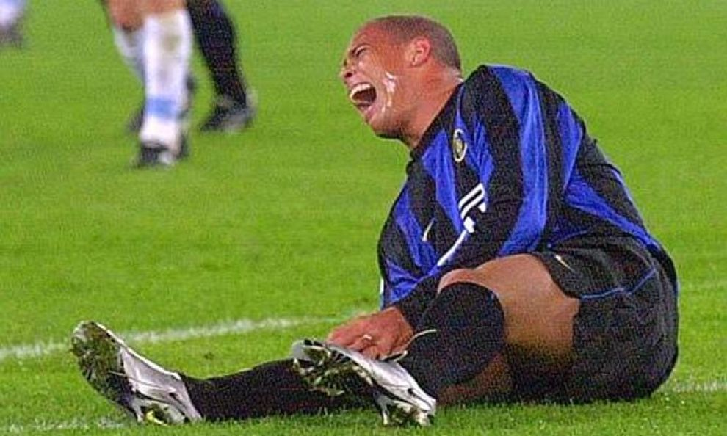
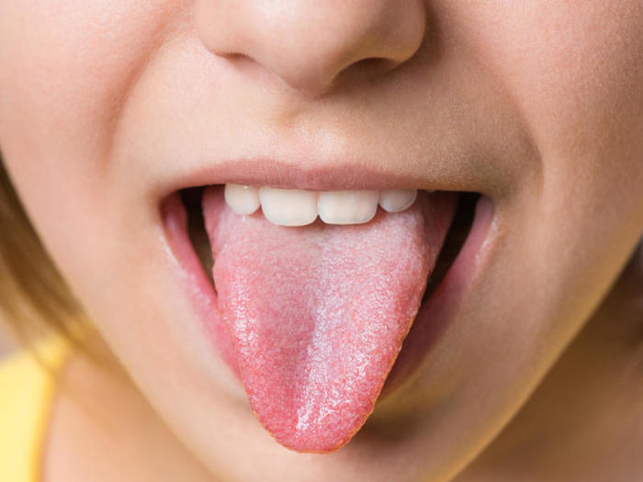
NONVISUAL SENSATION AND PERCEPTION
Outline of the lesson
Audition
Body senses
The vestibular system
Touch
Pain
The Chemical senses
Olfaction
Gustation

Slide 2
NONVISUAL SENSATION AND PERCEPTION
Vestibular system
Information about the position and movements of our heads, which contribute to our sense of balance.

Slide 3
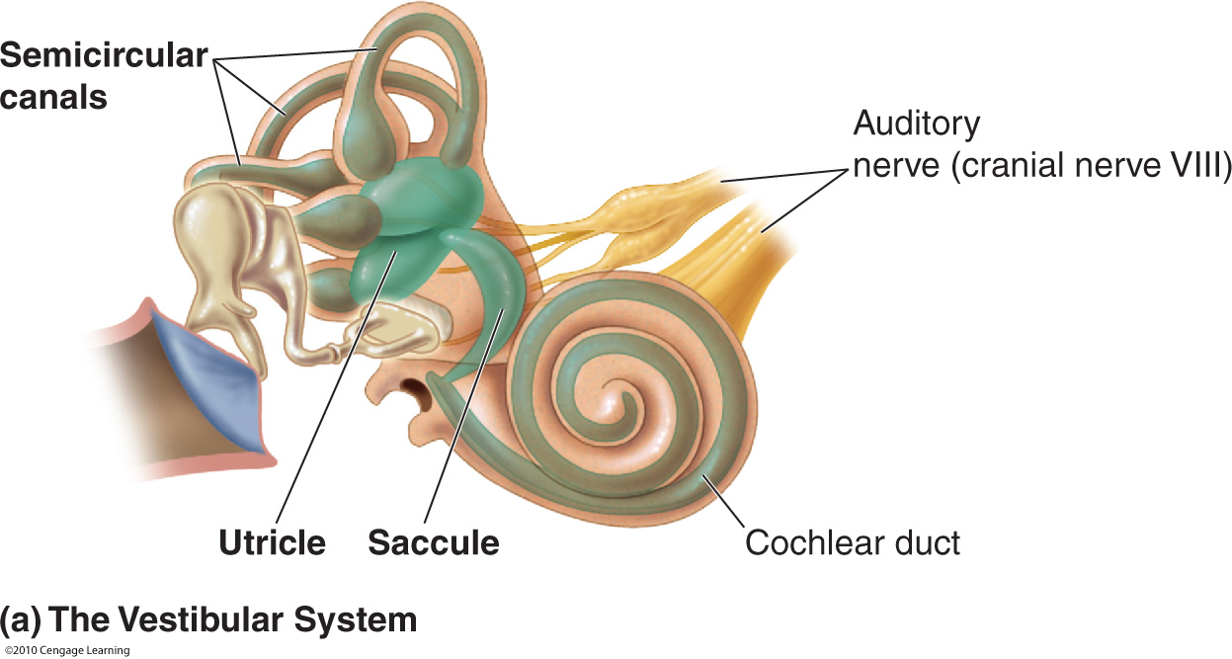
NONVISUAL SENSATION AND PERCEPTION
Vestibular system
The sensory organs of the vestibular system are found in the inner ear, adjacent to the structures responsible for audition
The vestibular structures may be divided into 2 types:
1) the otolith organs
2) the semicircular canals
Otolith organs
Information about the angle of the head relative to the ground, as well as information about linear acceleration.

Slide 4
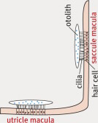
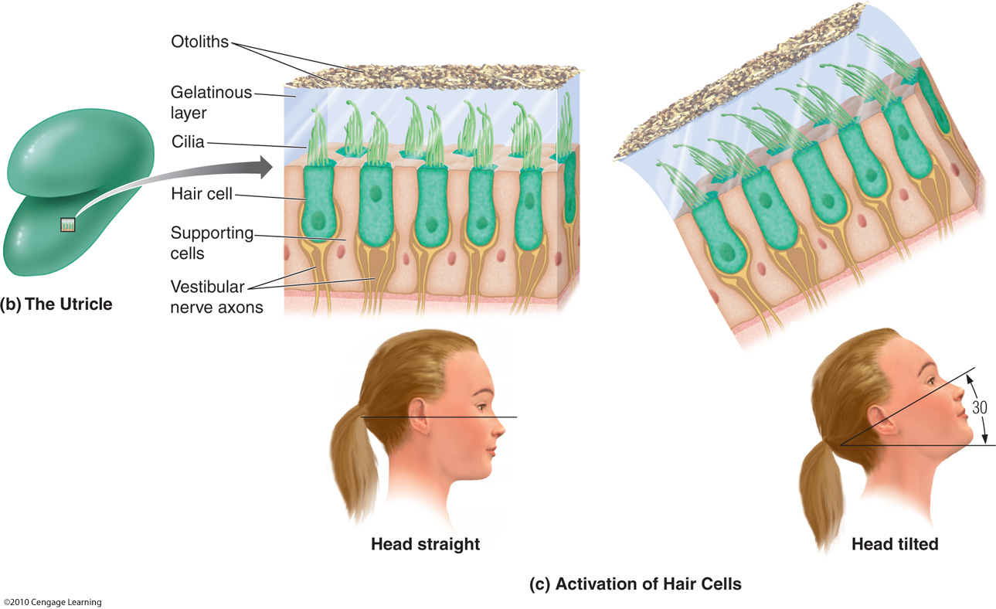
NONVISUAL SENSATION AND PERCEPTION
Vestibular system
The hair cells in the saccule are arranged along a vertical membrane, whereas the hair cells in the utricle are arranged along a horizontal membrane.
Cilia extend from each hair cell into a gelatinous layer.
Covering the gelatinous layer are otoliths, which are stones made of calcium carbonate.
When the otoliths move due to the acceleration of the head, force is exerted on the hair cells.
The hair cells either depolarize or hyperpolarize in response to this force, which in turn affects the firing rates of fibers in the auditory nerve (cranial nerve VIII).

Slide 5
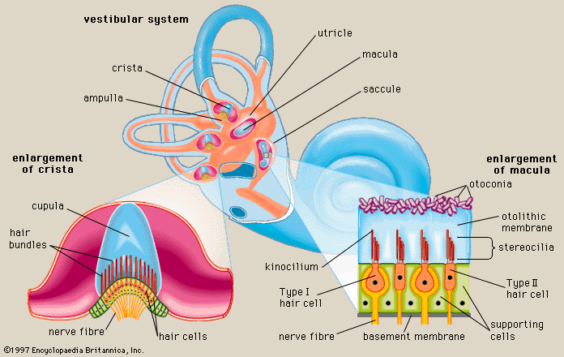
NONVISUAL SENSATION AND PERCEPTION
Vestibular system
The semicircular canals consist of 3 looping chambers.
These structures respond to rotational movements of the head and contribute to our ability to walk upright.
Rotating the head causes the endolymph within the canals to bend hair cells.
When extensive movement stops (perhaps at the end of an amusement park ride), the endolymph reverses its course, and you may have the odd fleeting sensation that your head is moving now in the opposite direction.

Slide 6
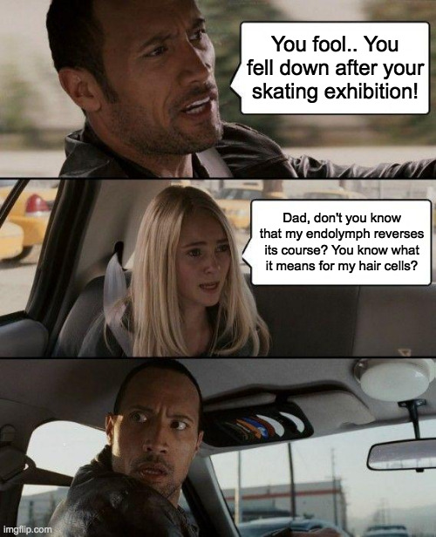
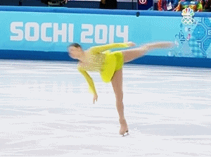
NONVISUAL SENSATION AND PERCEPTION

Slide 7
NONVISUAL SENSATION AND PERCEPTION
Vestibular system

Slide 8
NONVISUAL SENSATION AND PERCEPTION
Vestibular system

Slide 9
NONVISUAL SENSATION AND PERCEPTION
Outline of the lesson
Audition
Body senses
The vestibular system
Touch
Pain
The Chemical senses
Olfaction
Gustation

Slide 10
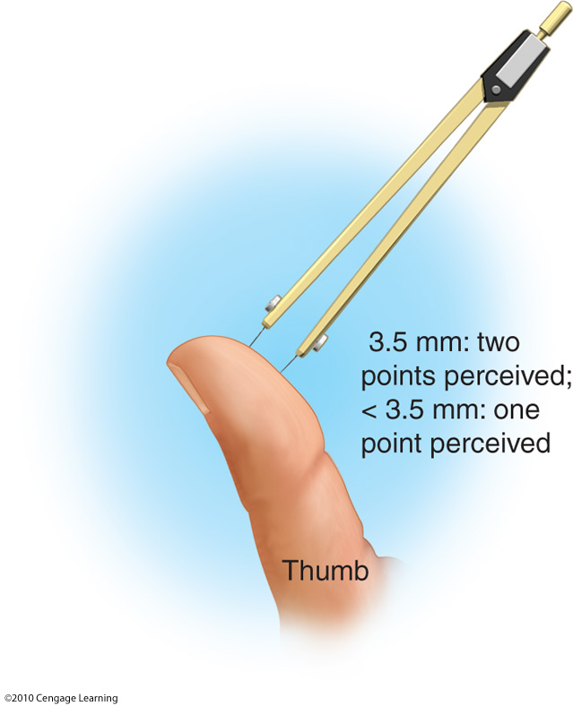
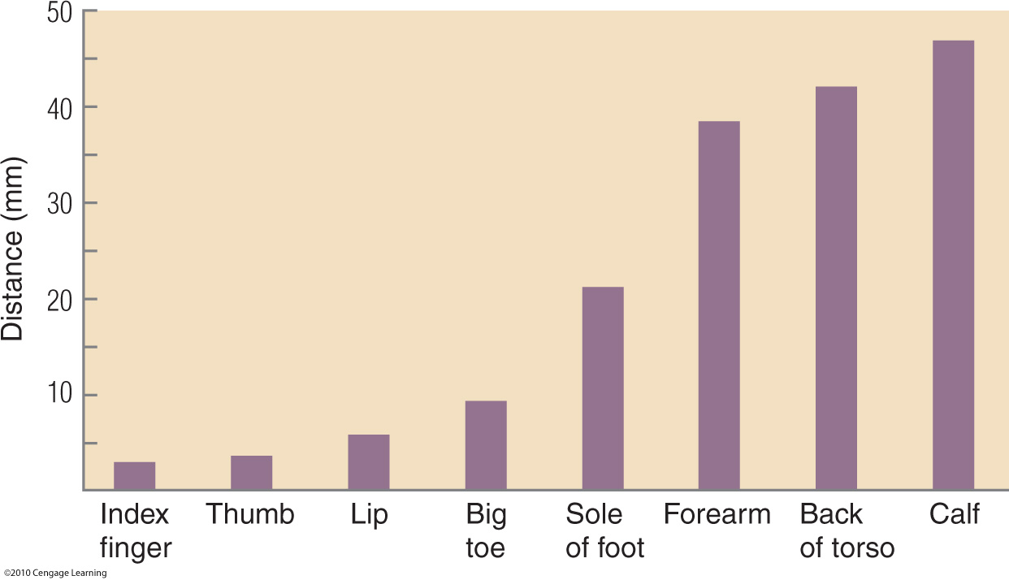
NONVISUAL SENSATION AND PERCEPTION
Touch
Fingers and lips have a greater density of mechanoreceptors overall than other areas of the body

Slide 11
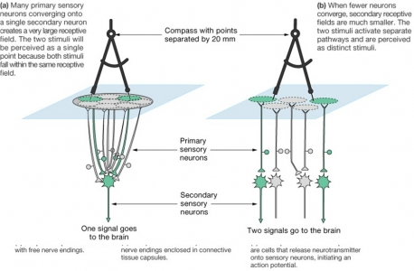
NONVISUAL SENSATION AND PERCEPTION
Touch
Fingers and lips have a greater density of mechanoreceptors overall than other areas of the body
It depends on:
Density of mechanoreceptors
Receptive fields

Slide 12
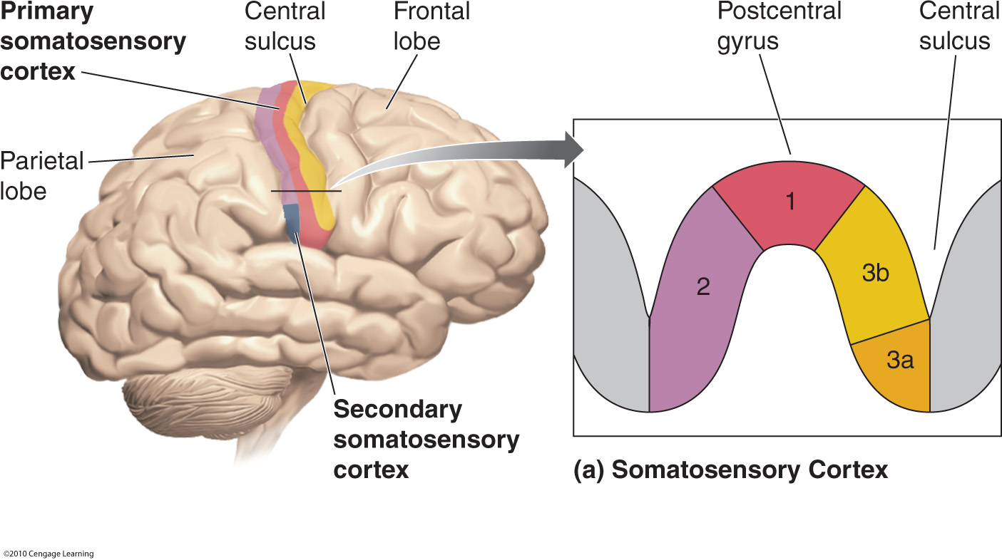
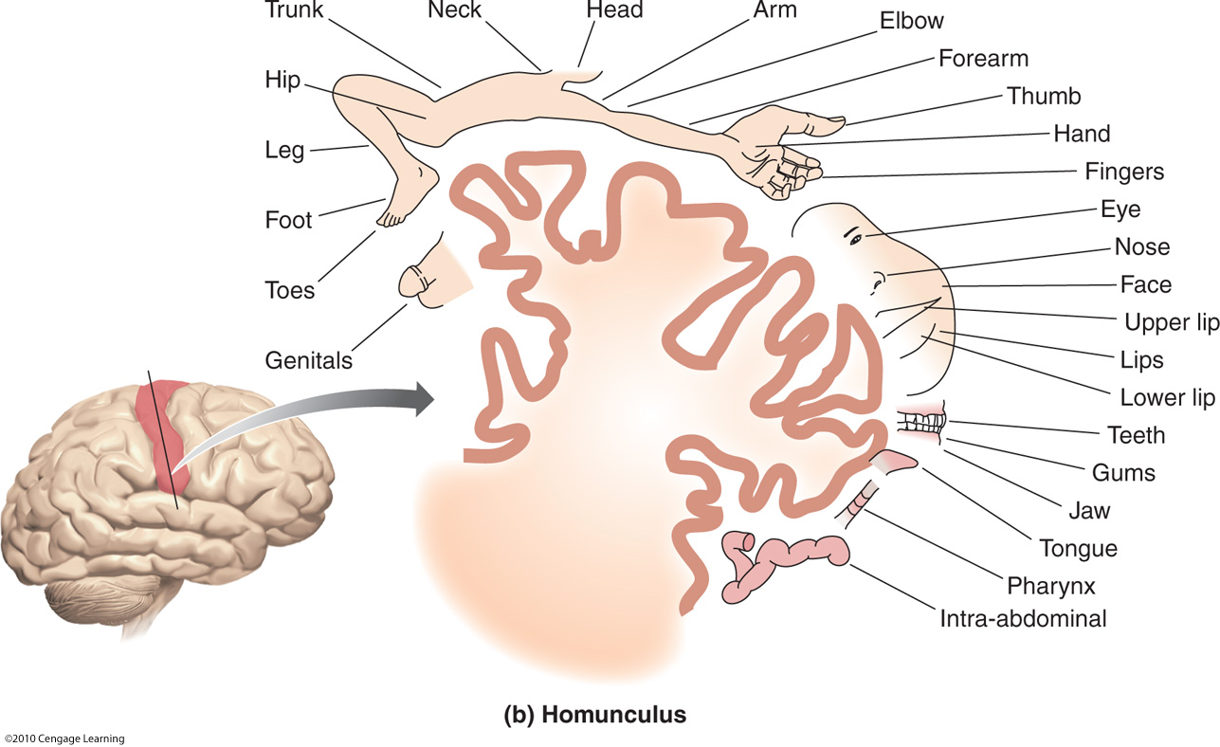
NONVISUAL SENSATION AND PERCEPTION
Touch
This is also reflected by the cortical representation of human body: the homunculus !

Slide 13
Why do we kiss and pamper with hands?

Slide 14
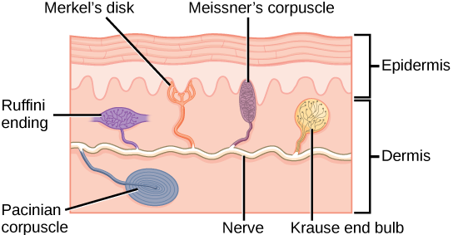
NONVISUAL SENSATION AND PERCEPTION
Touch

Slide 15
NONVISUAL SENSATION AND PERCEPTION
Touch
Adaptation: length of time it will continue to respond to unchanging stimuli.
A receptor that adapts rapidly will respond vigorously when stimulation begins or ends but will remain rather inactive while the stimulus is applied continuously
ENCAPSULATED: A receptor in which the axon terminal is surrounded by a fluid-filled capsule formed of connective tissue.
A receptive field describes the area of skin or other tissue that provides information to a particular receptor

Slide 17
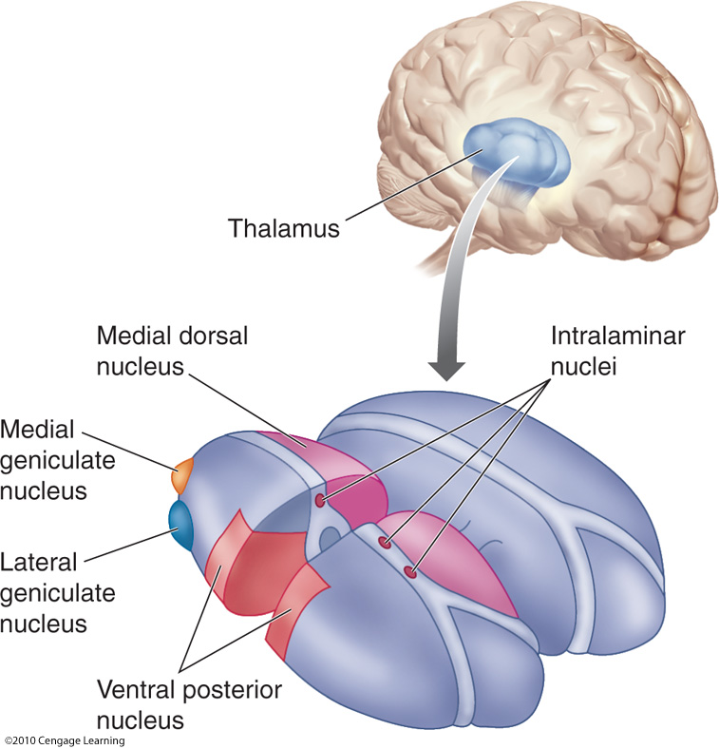
NONVISUAL SENSATION AND PERCEPTION
Touch

Slide 18
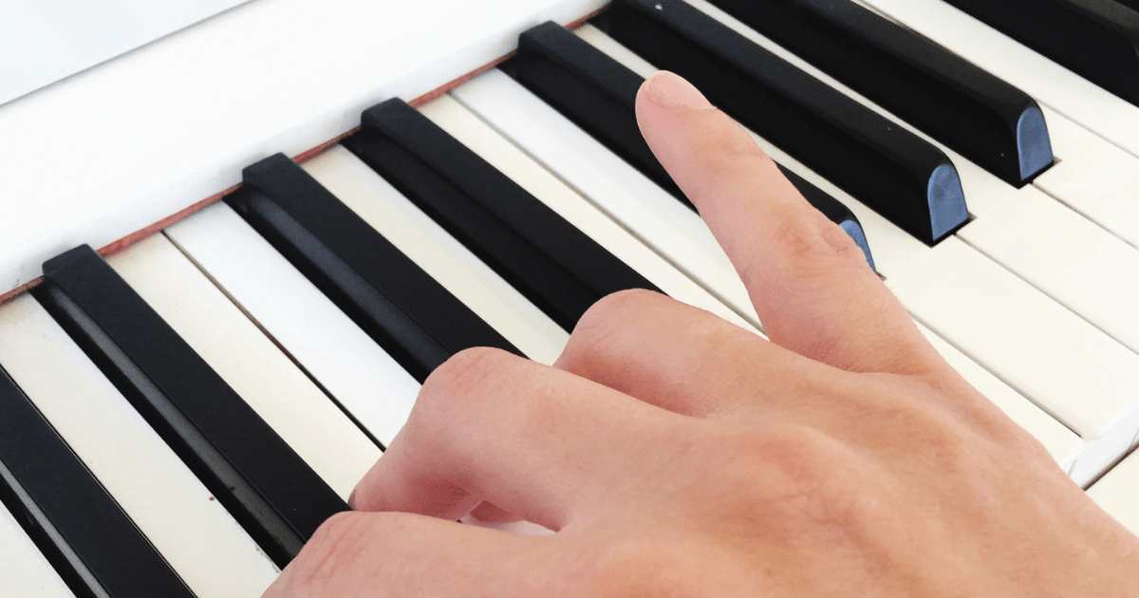
NONVISUAL SENSATION AND PERCEPTION
Touch
Plasticity
Ring finger and little finger
Focal dystonia
Little finger
Ring finger
Medium finger
Index finger
Thumb

Slide 19
NONVISUAL SENSATION AND PERCEPTION
Outline of the lesson
Audition
Body senses
The vestibular system
Touch
Pain
The Chemical senses
Olfaction
Gustation

Slide 20
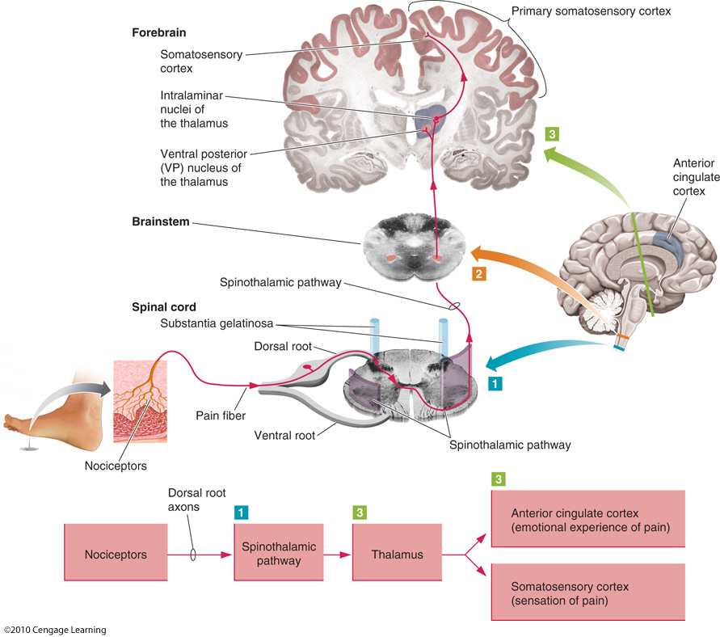
NONVISUAL SENSATION AND PERCEPTION
Pain
Nociceptors respond (opening ion channels, hence action potentials) to:
ASCENDING PATHWAY
Mechanic stimulation
Temperature
Chemicals

Slide 21
NONVISUAL SENSATION AND PERCEPTION
Pain
And pain from the face?!?
This information travels first along the trigeminal nerve, which synapses in the spinal trigeminal nucleus of the brainstem.
Fibers from the spinal trigeminal nucleus form the trigeminal lemniscus, which terminates in the thalamus.

Slide 22
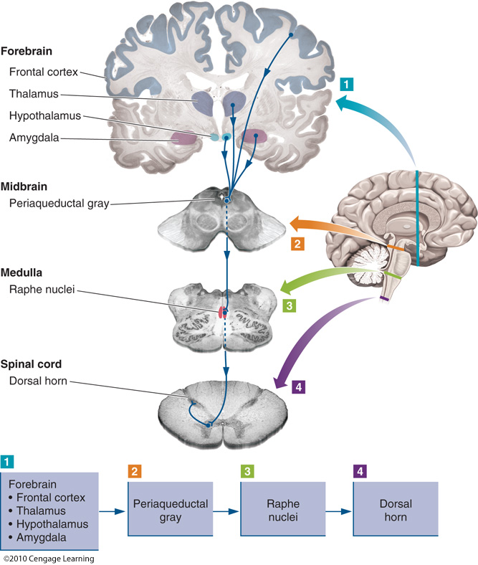
NONVISUAL SENSATION AND PERCEPTION
Pain
DESCENDING MESSAGES INFLUENCE PAIN PERCEPTION
Many higher-level structures of the brain form connections with the periaqueductal gray (PAG) of the midbrain, a major locus for endogenous opioid activity.
The PAG in turn forms connections with the raphe nuclei in the medulla and neurons in the spinal cord that can modulate incoming pain information (opioids in the spinal cord)

Slide 23
NONVISUAL SENSATION AND PERCEPTION
Outline of the lesson
Audition
Body senses
The vestibular system
Touch
Pain
The Chemical senses
Olfaction
Gustation

Slide 24
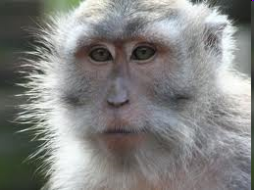
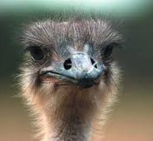
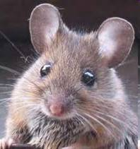
NONVISUAL SENSATION AND PERCEPTION
Olfaction
Mammals can have approximately 1,000 types of receptor cells to accomplish this task, although human beings have only about 350 to 400
Primates and birds are microsmatic
(poor sense of smell)
Other mammals instead are macrosmatici
(high sense of smell)

Slide 25
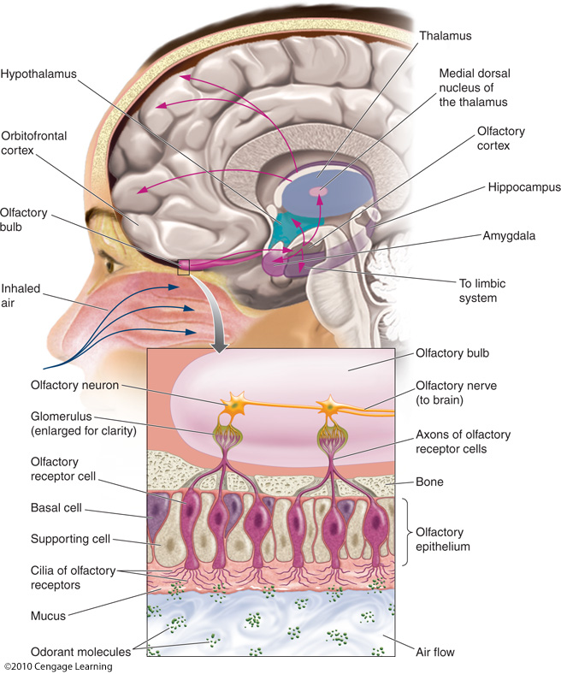
NONVISUAL SENSATION AND PERCEPTION
Olfaction
The neural receptors for olfaction regularly die and are replaced in a cycle lasting approximately four to six weeks
Why do olfactory stimuli are full of emotional values?
There is a strict connection with the lymbic system!
Glia-type cells that produce mucus

Slide 26
NONVISUAL SENSATION AND PERCEPTION
How do such a small number of receptors encode information about a wide array of odorants?
HYPOTHESIS 1
A shape-pattern theory suggests that odorant molecules interact with receptors like keys fitting into locks.

Slide 27
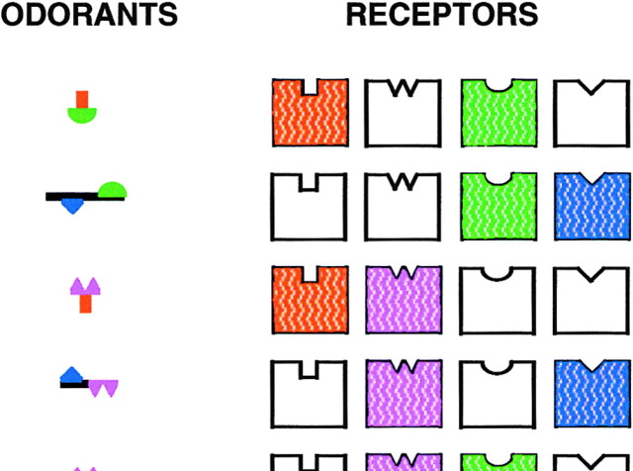
NONVISUAL SENSATION AND PERCEPTION
How do such a small number of receptors encode information about a wide array of odorants?
HYPOTHESIS 1
A shape-pattern theory suggests that odorant molecules interact with receptors like keys fitting into locks.
HYPOTHESIS 2
A modification of this approach suggests that odorants can activate specific combinations of receptors. Overall patterns of receptor activity, as opposed to the response of a single type, could distinguish among many separate odorants.

Slide 28
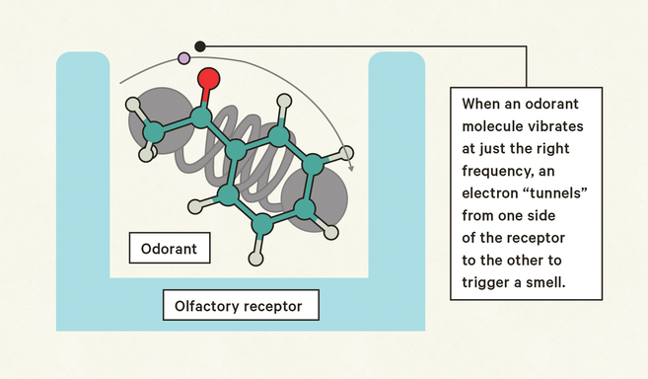
NONVISUAL SENSATION AND PERCEPTION
How do such a small number of receptors encode information about a wide array of odorants?
HYPOTHESIS 1
A shape-pattern theory suggests that odorant molecules interact with receptors like keys fitting into locks.
HYPOTHESIS 2
A modification of this approach suggests that odorants can activate specific combinations of receptors. Overall patterns of receptor activity, as opposed to the response of a single type, could distinguish among many separate odorants.
HYPOTHESIS 3
Other researchers believe that the olfactory system responds to the vibration of odorant molecules rather than to their shapes

Slide 29
NONVISUAL SENSATION AND PERCEPTION
Olfactory cortex

Slide 30
NONVISUAL SENSATION AND PERCEPTION
Olfactory cortex

Slide 31
NONVISUAL SENSATION AND PERCEPTION
Olfactory cortex

Slide 32
NONVISUAL SENSATION AND PERCEPTION
Outline of the lesson
Audition
Body senses
The vestibular system
Touch
Pain
The Chemical senses
Olfaction
Gustation

Slide 33
The Taste Receptors
NONVISUAL SENSATION AND PERCEPTION
(Structures that contain taste receptors)

Slide 34
Taste Pathways to the Brain
NONVISUAL SENSATION AND PERCEPTION

Slide 35
Taste Pathways to the Brain
NONVISUAL SENSATION AND PERCEPTION

Slide 36
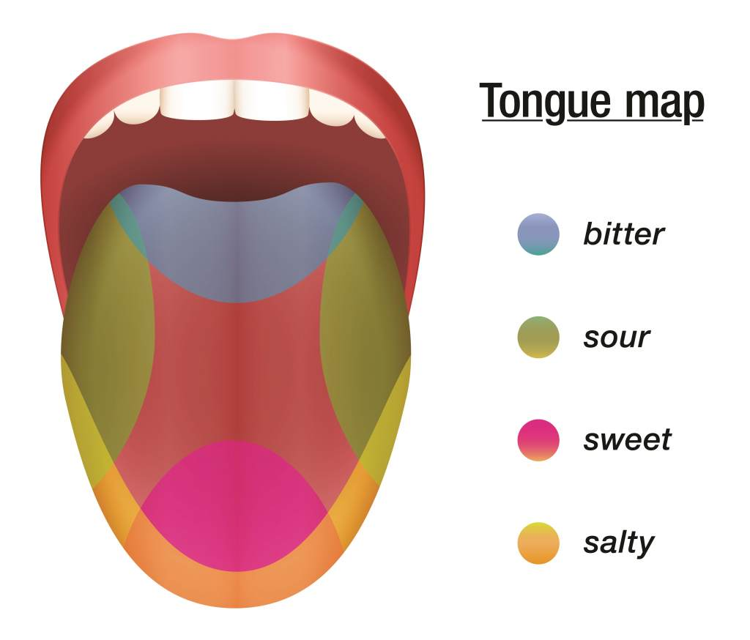
NONVISUAL SENSATION AND PERCEPTION
Regardless of what Laura Freberg claims in the textbook !

Slide 37
NONVISUAL SENSATION AND PERCEPTION

