Slide 1
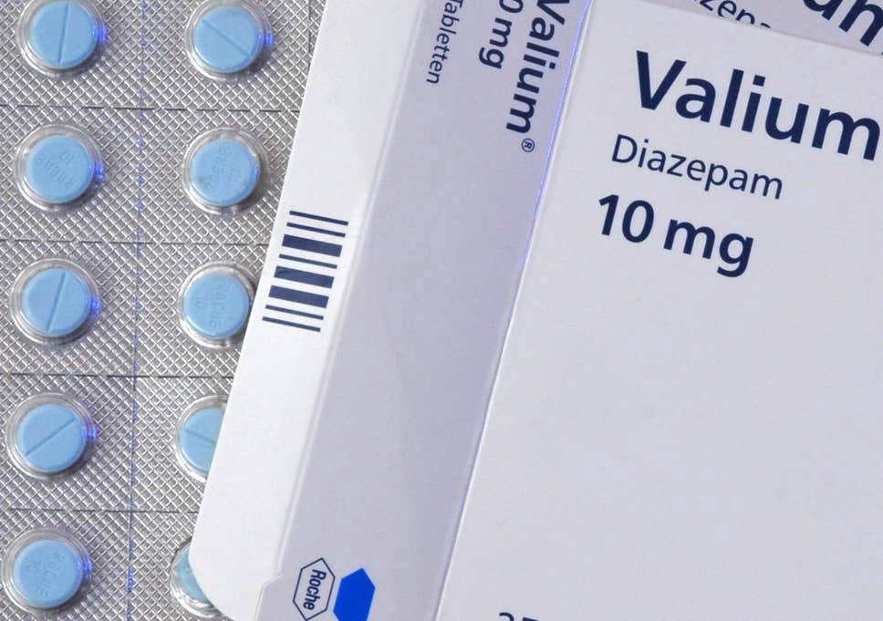
Psychopharmacology

Slide 2
Psychopharmacology
Administration of drugs
INTER-INDIVIDUAL VARIABILITY
Larger bodies have more blood than smaller bodies and therefore require larger quantities of a drug to reach an equivalent concentration
Gender influences the effects of alcohol, which is diluted by the water in muscle tissue.
Because males typically have more muscle than females of the same weight, the concentration of alcohol in a male's blood will be lower than in a female's after consuming the same amount of alcohol

Slide 3
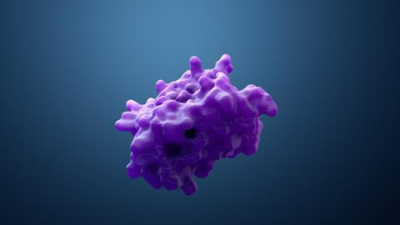
Psychopharmacology
Administration of drugs
INTER-INDIVIDUAL VARIABILITY
Genetic differences affect a liver enzyme, aldehyde dehydrogenase (ALDH), which participates in the metabolism of alcohol.
With low levels of ALDH, alcohol byproducts build up and produce flushing, rapid heartbeat, muscle weakness, and dizziness.
Many Asians lack genes for one type of ALDH and therefore experience more unpleasant symptoms associated with drinking

Slide 4
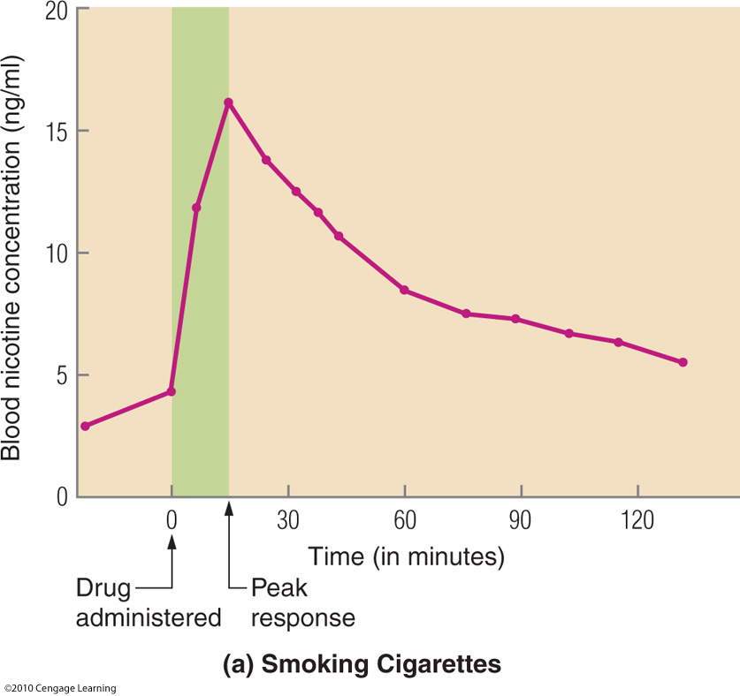
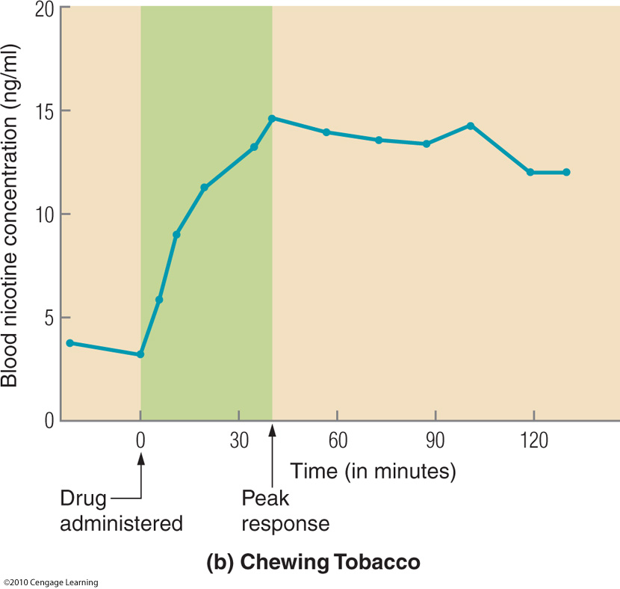
Concentration of a Drug in the Blood Supply Depends on the Method of Administration
Psychopharmacology

Slide 5
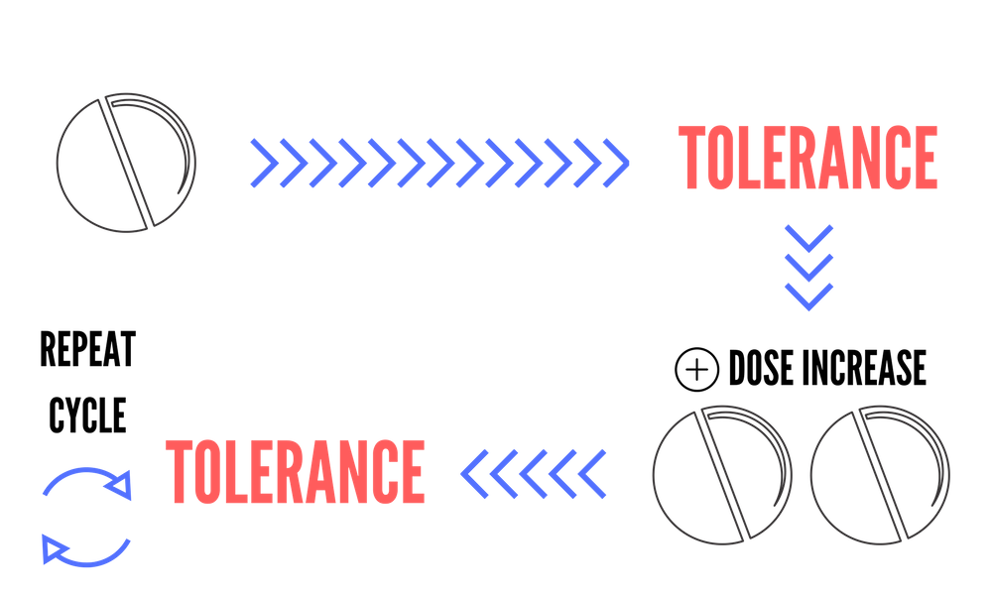
Psychopharmacology
Administration of drugs
TOLERANCE The process in which more of a drug is needed to produce the same effect
Tolerance effects can occur due to changes in enzymes and/or in receptor density.

Slide 6
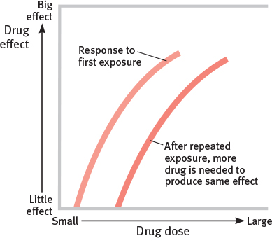
Psychopharmacology
Administration of drugs
TOLERANCE

Slide 7
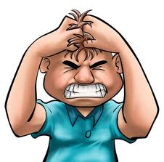
Psychopharmacology
Administration of drugs
WITHDRAWAL The symptoms that occur when certain drugs are no longer administered or are administered in smaller quantities.
Withdrawal effects are the opposite of the effects caused by the discontinued drug.
A person in withdrawal from a sedative will become agitated, whereas a person in withdrawal from a stimulant will become lethargic.
Sedative
Withdrawal
Stimulant
Withdrawal
It is likely that most characteristics of a withdrawal syndrome reflect the same compensation mechanisms that are responsible for tolerance.

Slide 8
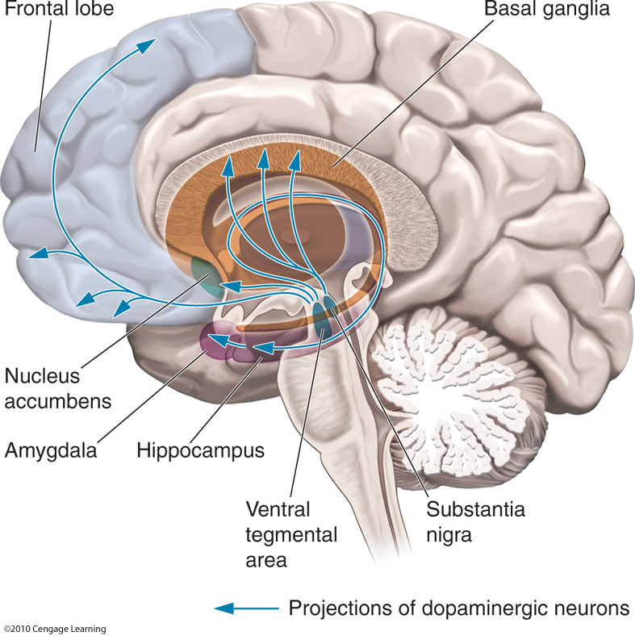
Psychopharmacology
Administration of drugs
ADDICTION A compulsive craving for drug effects or other experience in spite of negative consequences
Neural systems of reward: systems engaged in behaviors that are important either for our personal survival or for the survival of the species.
When we eat due to hunger, drink due to thirst, or engage in sexual behavior, the same reward circuits of the brain are activated.
Mesolimbic pathway
Mesostriatral (nigrostriatral) pathway
These behaviours produce dopamine here !

Slide 9
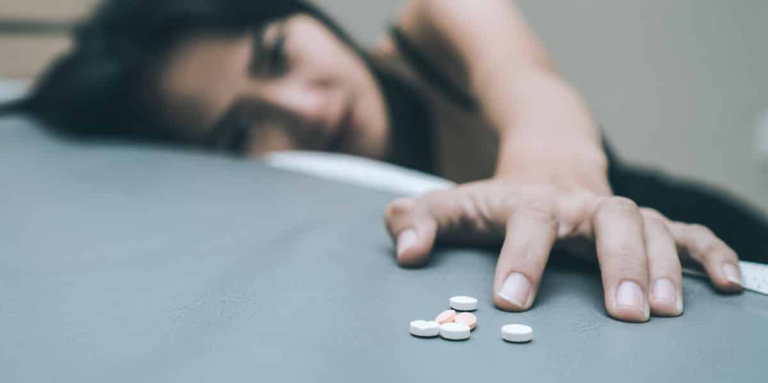
Psychopharmacology
Administration of drugs
ADDICTION A compulsive craving for drug effects or other experience in spite of negative consequences
Drugs produce a variety of behavioral effects, but many share the ability to stimulate more intense and longer-lasting dopamine release than we typically see in response to environmental events.
Drugs that do not influence either dopamine or the nucleus accumbens are often used habitually, but they do not seem to elicit the cravings and compulsive use associated with addiction (e.g., LSD).

Slide 11
PLACEBO and NOCEBO

Slide 12
PLACEBO EFFECT
A beneficial effect produced by a fake treatment.
As this cannot be attributed to the properties of the placebo itself, we assume it is due to the patient's belief in that treatment

Slide 13
PLACEBO EFFECT
HOW IT WORKS?
It mainly works on symptoms modulated by the brain, like the perception of pain, stress-related insomnia, depression, and cancer treatment side effects like fatigue and nausea.
SO WHERE DOES NOT IT WORK?
Lower your cholesterol
Shrink a tumor
Save you from Schizophrenia
Etc..
In short it will not cure you.

Slide 14
PLACEBO EFFECT IS ‘CONTEXT-DEPENDENT’
Assuming a pills could be enough, but placebo effect is enhanced by a specific context..
IT WORKS BETTER IF :
Patients have to go to a clinic at certain times..
2) be examined by medical professionals in white coats..
3) If all the procedure has a certain ‘ritual’..

Slide 15
Placebos often work because people don't know they are getting one. But what happens if you know you are getting a placebo?
Kaptchuk et al (2014):
Group 1 took a migraine drug labeled with the drug's name,
Group 2 took a placebo labeled "placebo"
Group 3 took nothing.
Placebo was 50% as effective as the real drug to reduce pain after a migraine attack

Slide 16
Placebos often work because people don't know they are getting one. But what happens if you know you are getting a placebo?
The researchers speculated that a driving force beyond this reaction was the simple act of taking a pill.
"People associate the ritual of taking medicine as a positive healing effect" says Kaptchuk. "Even if they know it's not medicine, the action itself can stimulate the brain into thinking the body is being healed."

Slide 17
NOCEBO EFFECT?
It’s just the opposite!
Negative expectations of patients regarding a treatment cause the treatment to have more negative effect - in terms of pain perception - than it otherwise would have.

Slide 18
PLACEBO AND NOCEBO EFFECT
IN A GRAPH

Slide 19
MY OWN CONSIDERATION..

Slide 20
To conclude… some examples of psychoactive drugs

Slide 21
Neurophysiology
STIMULANTS
Stimulant drugs share the capacity to increase alertness and mobility
Caffeine
Nicotine
Cocaine and amphetamines
Ecstacy (MDMA)

Slide 22
Neurophysiology
STIMULANTS
Stimulant drugs share the capacity to increase alertness and mobility
Caffeine
Nicotine
Cocaine and amphetamines
Ecstacy (MDMA)

Slide 23
Neurophysiology
Caffeine
Increases blood pressure
Heart rate, improves concentration
Wards off sleepiness

Slide 24
Neurophysiology
Caffeine
Caffeine crosses the placenta easily, and the fetus and breastfed newborn are relatively unable to metabolize caffeine, leading to reduced rates of growth and other complications.

Slide 25
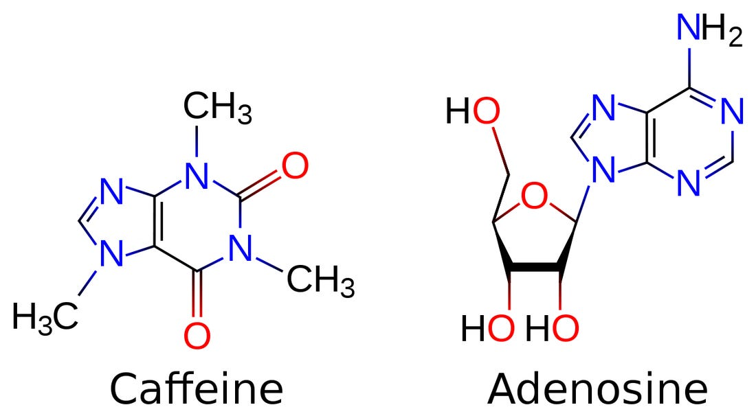
Neurophysiology
Caffeine
It blocks adenosine receptors, reducing the normal inhibitory activity of adenosine

Slide 26
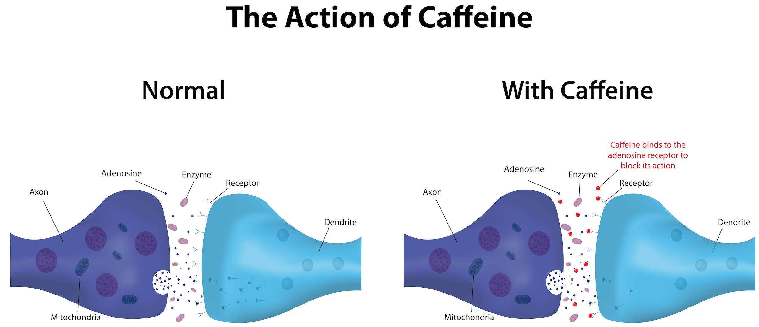
Neurophysiology
Caffeine
It blocks adenosine receptors, reducing the normal inhibitory activity of adenosine

Slide 27
Neurophysiology
Caffeine
Caffeine also leads to increased release of dopamine (a bit of addiction!)

Slide 28
Neurophysiology
STIMULANTS
Stimulant drugs share the capacity to increase alertness and mobility
Caffeine
Nicotine
Cocaine and amphetamines
Ecstacy (MDMA)

Slide 29
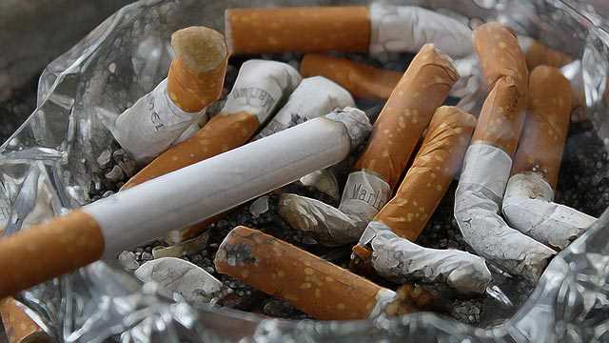
Neurophysiology
Nicotine
Increases heart rate and blood pressure
Promotes the release of adrenaline into the circulation
Reduces fatigue
Heightens cognitive performance
Nicotine produces muscular relaxation (in the PNS)

Slide 30
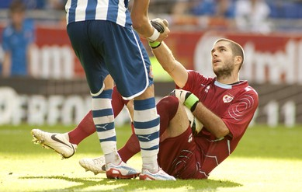
Neurophysiology
Nicotine
Nicotine has its primary effect as an agonist at the nicotinic cholinergic receptor.
These receptors exist not only at the neuromuscular junction but also at several locations in the brain.

Slide 31
Neurophysiology
Nicotine
Nicotine has its primary effect as an agonist at the nicotinic cholinergic receptor.
These receptors exist not only at the neuromuscular junction but also at several locations in the brain.
Nicotine's action on the cholinergic system arising in the basal forebrain is probably responsible for increased alertness and cognitive.
Nicotine stimulates cholinergic receptors in the ventral tegmental area, which in turn results in greater release of dopamine in the nucleus accumbens (addiction).

Slide 32
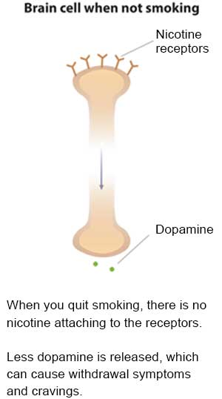
Neurophysiology
Nicotine

Slide 33
Neurophysiology
Nicotine

Slide 34
Neurophysiology
STIMULANTS
Stimulant drugs share the capacity to increase alertness and mobility
Caffeine
Nicotine
Cocaine and amphetamines
Ecstacy (MDMA)

Slide 35
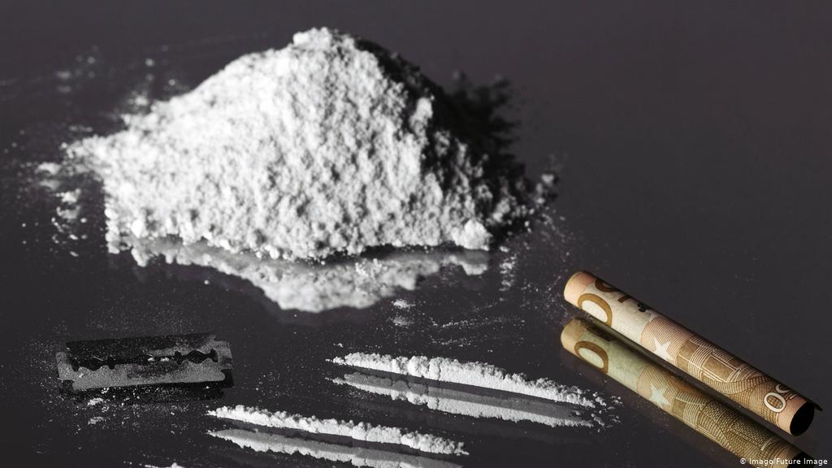
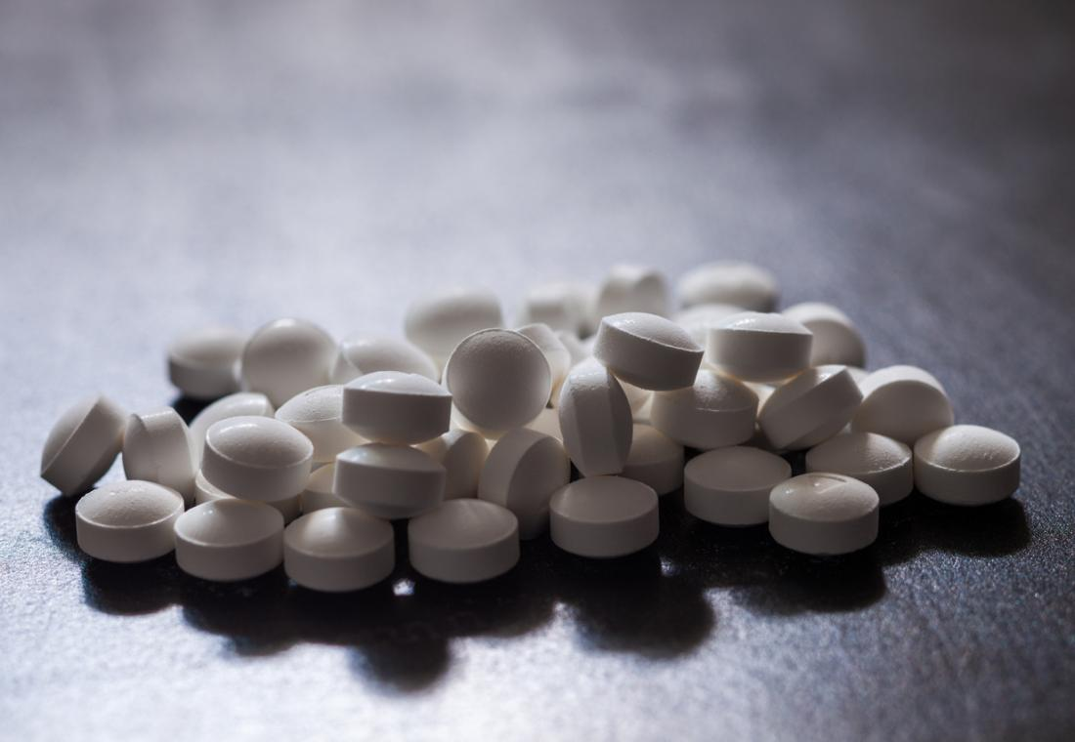
Neurophysiology
Cocaine and amphetamines
Both drugs are powerful dopamine agonists.
These drugs are among the most addictive drugs known. A single recreational dose of cocaine is sufficient to produce addiction in mice !
At lower doses:
They produce alertness, elevated mood, confidence, and a sense of well-being.
At higher doses:
Symptoms that are similar to schizophrenia. Users often experience hallucinations, particularly in the form of tactile sensations such as feeling bugs on the skin.
They frequently suffer from paranoid delusions, thinking that others wish to harm them.

Slide 36
Neurophysiology
Cocaine and amphetamines
Cocaine was originally used by the indigenous people of Peru as a mild stimulant and appetite suppressant.
Sigmund Freud recommended cocaine as an antidepressant in his 1885 book, Ober Coca (On Coca). Freud became disenchanted with the drug after he became aware of its potential for addiction.
Cocaine was used in the original formulation of coca-cola (then substituted with caffeine)

Slide 37
Neurophysiology
Cocaine and amphetamines

Slide 38
Neurophysiology
Cocaine and amphetamines
Different mechanisms
Cocaine blocks the transporters, keeping all previously released dopamine active in the synaptic gap.
Amphetamine mimics dopamine, leading it to be captured and moved across the presynaptic membrane by dopamine transporters.
Once inside the neuron, amphetamine enters synaptic vesicles, pushing the dopamine molecules out into the intracellular fluid of the axon terminal.

Slide 39
Neurophysiology
Cocaine and amphetamines
Different mechanisms
Cocaine blocks the transporters, keeping all previously released dopamine active in the synaptic gap.
The presence of large amounts of dopamine outside of vesicles makes the transporters begin to work in reverse, pushing dopamine out of the cell even in the absence of any action potentials.

Slide 40
Neurophysiology
Cocaine and amphetamines

Slide 41
Neurophysiology
STIMULANTS
Stimulant drugs share the capacity to increase alertness and mobility
Caffeine
Nicotine
Cocaine and amphetamines
Ecstacy (MDMA)

Slide 42
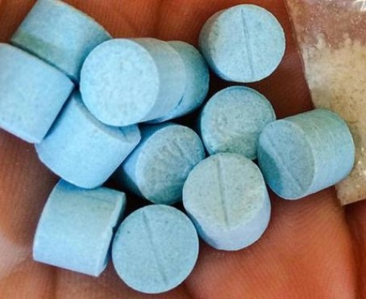
Neurophysiology
Ecstacy (MDMA)
Structurally, MDMA is similar to both methamphetamine and the hallucinogen mescaline.
Increases heart rate
Increase blood pressure
Increase body temperature
for a period of about 3-6 hours.

Slide 43
Neurophysiology
Ecstacy (MDMA)
In some cases, dehydration, exhaustion, hypothermia, convulsions, and death occur.
MDMA appears to produce increased sociability by stimulating the release of serotonin and the neurohormone oxytocin

Slide 44
Neurophysiology
Ecstacy (MDMA)
MDMA influences serotonin (> effects here), norepinephrine, and dopamine transporters in much the same way as we observed in the case of amphetamine (MDMA is taken up by transporters, causing them to reverse their action).
RECEPTORS:
3 metabotropic receptors, known as mu, delta, and kappa receptors, that bind with opioids.
A fourth, opioid receptor like- 1 (ORL 1), was discovered somewhat later.

Slide 45
Neurophysiology
Ecstacy (MDMA)

Slide 46
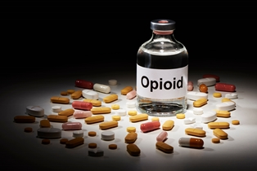
Neurophysiology
OPIOIDS
Substances that interact with endorphin receptors
Morphine, Endorphines (endogenous morphines), Codeine, Oxycontin,

Slide 47
Neurophysiology
OPIOIDS
The term opiate is restricted to substances derived from the sap of the opium poppy (Papaver somniferum), which include morphine and codeine. Heroin is synthesized from morphine.
At lower doses:
Euphoria, pain relief, a lack of anxiety, muscle relaxation, and sleep.
At higher doses:
Tremendous euphoria or rush

Slide 48
Neurophysiology
OPIOIDS
Opioids produce most of their effects by acting presynaptically to inhibit neurotransmitter release.
They do so:
by inhibiting the entry of calcium into the presynaptic terminal;
2) by enhancing the outward movement of potassium, which in turn shortens the duration of action potentials
3) by interacting with normal enzyme cascades within neurons

Slide 49
Neurophysiology
OPIOIDS
Opioids are typically quite addictive, as one of the indirect consequences of their binding to opioid receptors is to increase dopamine activity.
Opioids bind with mu receptors on cells that release GABA in the nucleus accumbens. These cells typically act to inhibit the release of dopamine.
Under the influence of the presynaptic inhibition produced by the opioids, however, these cells release less GABA, which in turn leads to a larger release of dopamine

Slide 50
Neurophysiology
OPIOIDS

Slide 51
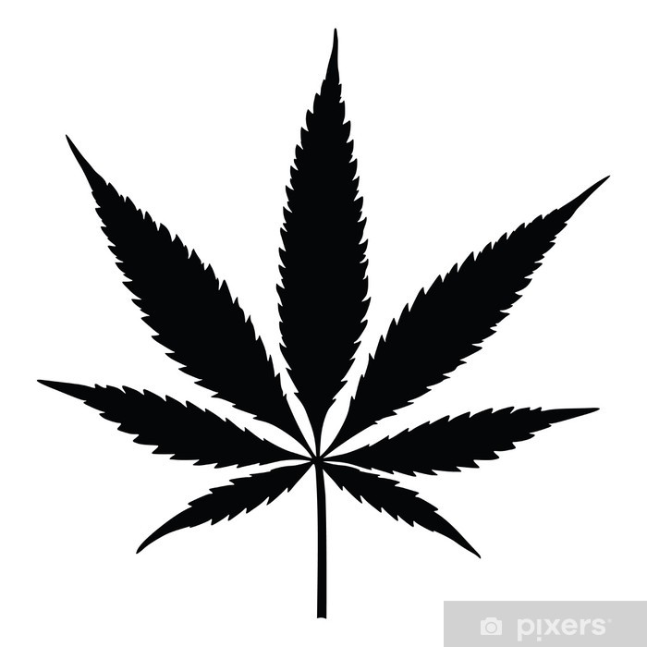
Neurophysiology
Cannabis
The behavioral effects of cannabis are often so subtle that many people report no changes at all in response to its use.
Most individuals experience some excitation and mild euphoria, but others experience depression and social withdrawal.
At higher doses, cannabis produces hallucinations, leading to its classification as a hallucinogen

Slide 52
Neurophysiology
Cannabis
Cannabis contains more than 50 psychoactive compounds, known as cannabinoids.
The most important of the cannabinoids in cannabis is tetrahydrocannabinol {THC). THC produces some of its behavioral effects by serving as an agonist at receptors for endogenous cannabinoids

Slide 53
Neurophysiology
Cannabis
The presence of cannabinoid receptors in the hippocampus and prefrontal cortex might explain why THC appears to have negative effects on memory formation, attention, and working memory.
In addition to directly activating cannabinoid receptors in the hippocampus, THC might also adversely influence hippocampal activity and memory by inhibiting glutamate release.

Slide 54
Neurophysiology
Cannabis

Slide 55
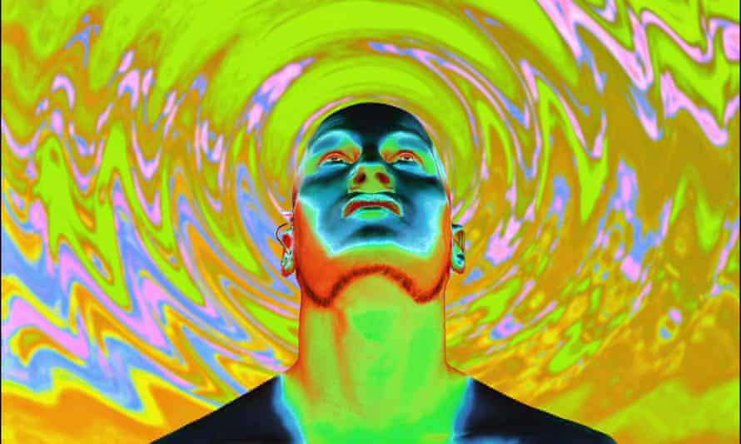
Neurophysiology
LSD (lysergic acid diethylamide)
LSD is chemically similar to serotonin and, along with other hallucinogens, appears to act as an agonist at serotonergic autoreceptors in the prefrontal cortex, locus coeruleus, and the raphe nuclei.
A major but uncommon negative consequence of LSD use is the experience of flashbacks in the form of intrusive and unwanted visual hallucinations, which can continue long after the person has stopped using the substance

Slide 56
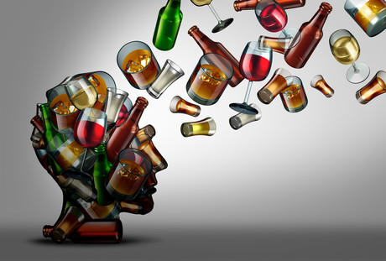
Neurophysiology
Alcohol
One of the earliest drugs used by humans, dating back into our prehistory
At lower doses:
Alcohol dilates blood vessels, providing a warm, flushed feeling. It reduces anxiety, promotes assertiveness, and reduces behavioral inhibitions, causing people's behavior to be "silly" or "fun:
At higher doses:
Assertiveness becomes aggression
Disinhibition can lead to overtly risky behaviors.
Motor coordination drops, leading to alcohol-induced carnage on streets and highways.
At very high doses, coma and death can result from suppression of respiration or aspiration of vomit.

Slide 57
Neurophysiology
Alcohol
Alcohol initiates many changes to neurons. Membranes, ion channels, receptors, and enzymes are all affected.
1) Main effect: agonist of GABA (sedation)
2) Stimulate dopaminergic pathways (euphoric and addictive qualities)
3) Antagonist of NMDA glutamate receptors (memory problems)

Slide 58
Neurophysiology
Alcohol
Alcohol produces rapid tolerance.
One source of tolerance is an increase in the production ofliver enzymes that eliminate alcohol from the system. Another source of tolerance is changes in receptor number and characteristics, especially at the GABA A receptor and the NMDA glutamate receptor.
Alcohol has a number of detrimental effects on health. Chronic use of alcohol damages several areas of the brain, including the frontal lobes, which are responsible for many of our higher-order cognitive functions

Slide 59
Neurophysiology
Alcohol
Alcoholism can lead indirectly to Korsakoff syndrome, in which the ability to form new memories is impaired. The lack of dietary thiamine (vitamin B) common among alcoholics leads to damage to the hippocampus.
Alcohol can also have devastating effects on the developing fetus. Because the adolescent brain is still quite vulnerable to the effects of substances, binge drinking during adolescence is particularly damaging, especially to the white matter of the brain.

