Slide 1
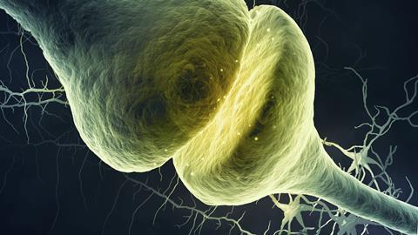
Neurophysiology

Slide 2
Neurophysiology
SYNAPSES
The second half of the story begins when the action potential reaches the axon terminal and the message must cross the synaptic gap to the adjacent postsynaptic neuron..
Two types
GAP JUNCTIONS
(electric synapses)
CHEMICAL SYNAPSES

Slide 3
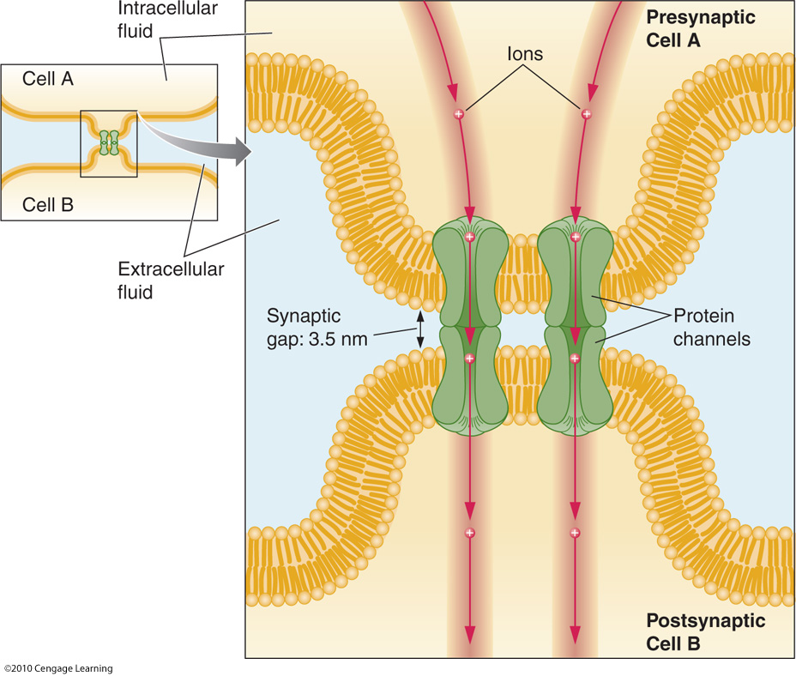
Neurophysiology
SYNAPSES
GAP JUNCTION (= electric synapses)
Channels connecting the two neurons across a synaptic gap of only 3.5 nm allow for the direct
movement of ions from one cell to the other.
Gap junctions have the advantage of nearly instantaneous communication between neurons.

Slide 4
Neurophysiology
SYNAPSES
GAP JUNCTION (= electric synapses)
The only type of message that can be sent at a gap junction between two neurons or muscle cells is an excitatory one.
Excitation means that one cell can tell the next cell to produce an action potential.

Slide 5
Neurophysiology
SYNAPSES
(0:16-)

Slide 6
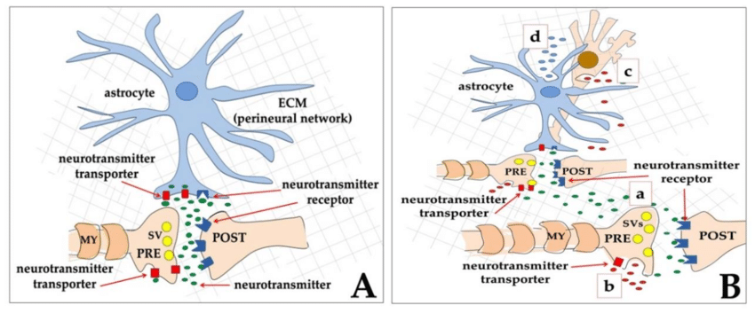
Neurophysiology
SYNAPSES
CHEMICAL SYNAPSES
Wiring Transmission
Chemicals diffuse from one cell to impact an adjacent cell or cells through private, highly localized channels.
Volume Transmission
Neurochemicals diffuse through the extracellular fluid and CSF to influence cells located some distance away from the releasing cell

Slide 7
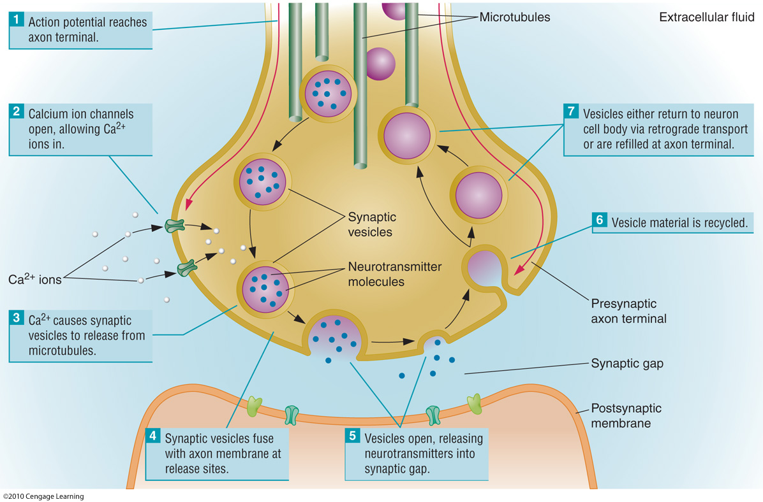
Neurophysiology
SYNAPSES
CHEMICAL SYNAPSES

Slide 8
Neurophysiology
SYNAPSES
CHEMICAL SYNAPSES

Slide 9
Neurophysiology
SYNAPSES
CHEMICAL SYNAPSES

Slide 10
Neurophysiology
SYNAPSES
CHEMICAL SYNAPSES
Exocytosis

Slide 11
Neurophysiology
SYNAPSES
CHEMICAL SYNAPSES

Slide 12
Neurophysiology
SYNAPSES
CHEMICAL SYNAPSES

Slide 13
Neurophysiology
SYNAPSES
CHEMICAL SYNAPSES

Slide 15
Neurophysiology
SYNAPSES
CHEMICAL SYNAPSES
On the postsynaptic side of the synapse, we find new types of proteins embedded in the postsynaptic cell membrane, known as receptors. The receptors are characterized by recognition molecules that respond only to certain types of neurochemicals.
IONOTROPIC
METABOTROPIC

Slide 16
Neurophysiology
SYNAPSES
CHEMICAL SYNAPSES
On the postsynaptic side of the synapse, we find new types of proteins embedded in the postsynaptic cell membrane, known as receptors. The receptors are characterized by recognition molecules that respond only to certain types of neurochemicals.
IONOTROPIC
METABOTROPIC

Slide 17
Neurophysiology
SYNAPSES
CHEMICAL SYNAPSES
On the postsynaptic side of the synapse, we find new types of proteins embedded in the postsynaptic cell membrane, known as receptors. The receptors are characterized by recognition molecules that respond only to certain types of neurochemicals.
IONOTROPIC
METABOTROPIC
Slower but last longer !

Slide 18
Neurophysiology
SYNAPSES
CHEMICAL SYNAPSES

Slide 19
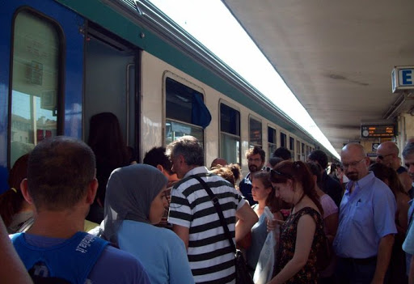
Neurophysiology
SYNAPSES
CHEMICAL SYNAPSES
Before we can make a second phone call, we need to end the first call..
3 Mechanisms
Neurochemicals diffuse away from areas of high concentration to areas of low concentration.

Slide 20
Neurophysiology
SYNAPSES
CHEMICAL SYNAPSES
Before we can make a second phone call, we need to end the first call..
3 Mechanisms
Neurochemical molecules are deactivated by enzymes in the synaptic gap.

Slide 21
Neurophysiology
SYNAPSES
CHEMICAL SYNAPSES
Before we can make a second phone call, we need to end the first call..
3 Mechanisms
Presynaptic membrane uses its own set of receptors known as transporters to recapture molecules of neurochemical and return them to the interior of the axon terminal.
In the terminal, the neurochemicals can be repackaged in vesicles for subsequent release

Slide 22
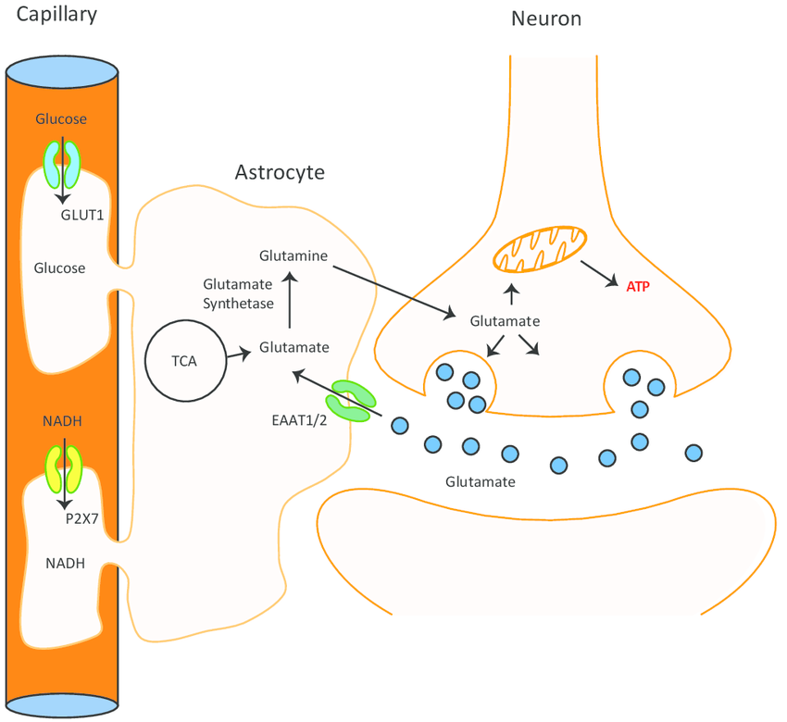
Neurophysiology
SYNAPSES
CHEMICAL SYNAPSES
Before we can make a second phone call, we need to end the first call..
3 Mechanisms “+ 1”…
Astrocytes, remember?

Slide 23
Neurophysiology
SYNAPSES
CHEMICAL SYNAPSES

Slide 24
Neurophysiology
SYNAPSES
CHEMICAL SYNAPSES

Slide 25
Neurophysiology
SYNAPSES

Slide 26
Neurophysiology
POST SYNAPTIC POTENTIALS
When molecules of neurochemical bind to postsynaptic receptors, they can produce one of two outcomes
Excitatory postsynaptic potential
Inhibitory postsynaptic potential
Increases the likelihood that the postsynaptic cell will
generate an action potential
Decreases the likelihood that the postsynaptic cell will
generate an action potential

Slide 27
Neurophysiology
POST SYNAPTIC POTENTIALS
When molecules of neurochemical bind to postsynaptic receptors, they can produce one of two outcomes
Excitatory postsynaptic potential
Inhibitory postsynaptic potential
Opening of ligand-gated sodium channels with inward movement of positive sodium ions produces the slight depolarization of the EPSP.
Opening of ligand-gated channels that allow for the inward movement of chloride (CI-) or the outward movement of potassium (K+).
EPSPs are known as graded potentials, referring to their varying size and shape.
IPSPs are known as graded potentials, referring to their varying size and shape.
Action potentials last about 1 msec, but EPSPs can last up to 5 to 10 msec
Action potentials last about 1 msec, but IPSPs can last up to 5 to 10 msec

Slide 28
Neurophysiology
POST SYNAPTIC POTENTIALS
When molecules of neurochemical bind to postsynaptic receptors, they can produce one of two outcomes
Excitatory postsynaptic potential
Inhibitory postsynaptic potential

Slide 29
Neurophysiology
POST SYNAPTIC POTENTIALS

Slide 30
Neurophysiology
POST SYNAPTIC POTENTIALS
Mnemotechnique!
Adding up all of your friends' votes and following the will of the majority
One particularly persistent (and noisy) friend can definitely influence our decisions

Slide 31
Neurophysiology
Axo-axonic Synapses

