Slide 1
SEXUAL BEHAVIOUR

Slide 2
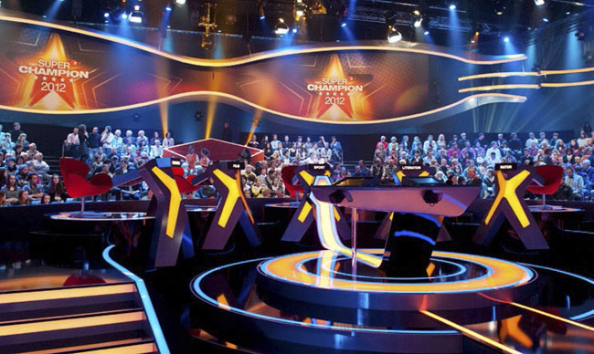
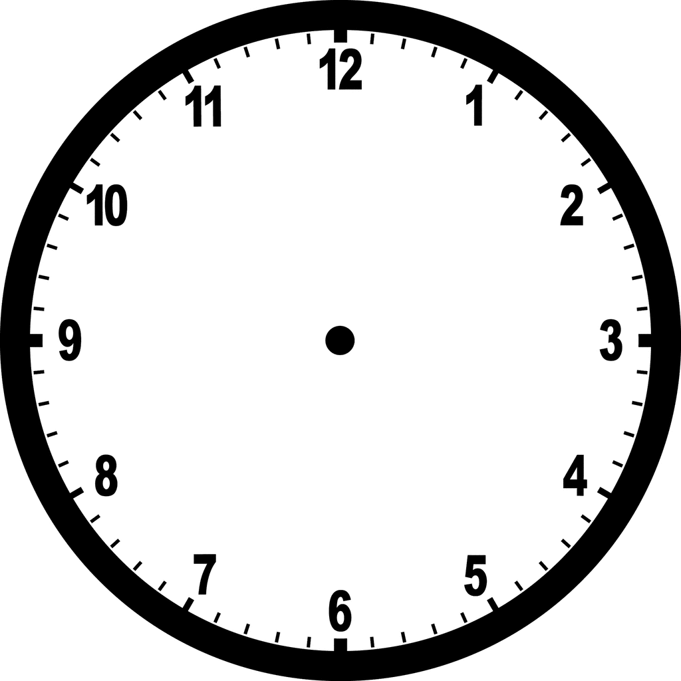
SEXUAL BEHAVIOUR
BET YOUR KEYWORD
Which are the 2 words that appear more frequently in Chapter 10 ?

Slide 3
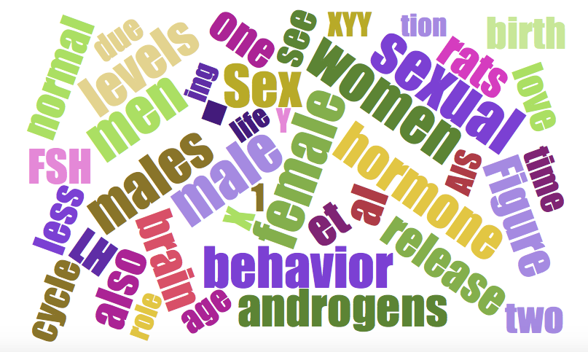
Male / Female; Men / Women
Hormones (androgens / LH / FSH / Cycle)
X / Y (XYY)
Birth
Rats

Slide 4
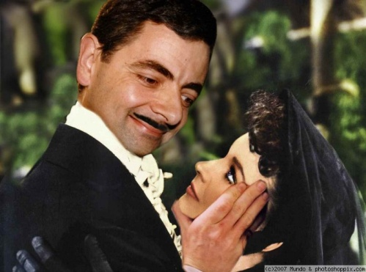
SEXUAL BEHAVIOUR
An evolutionary approach
Sex chromosomes abnormalities
Stages of prenatal development
Development at puberty
Hormones and sexual behaviour
Sex differences in brain and cognitive abilities
Sexual orientation
Attraction
Sexual disfunctions
Notes:
4
However we are not the only “counting species”.
The ability to discriminate 2 groups using numerical information has been reported in apes, monkeys, dolphins, dogs and birds as well.
Unfortunately very different results have been reported in literature. Part of the problem is due to the fact that different studies use different stimuli and procedures, thus making difficult any fine comparison among the species.
To date, we don’t know whether animals have the same numerical systems and, especially, whether they have the same pre-verbal numerical systems reported in humans.

Slide 5
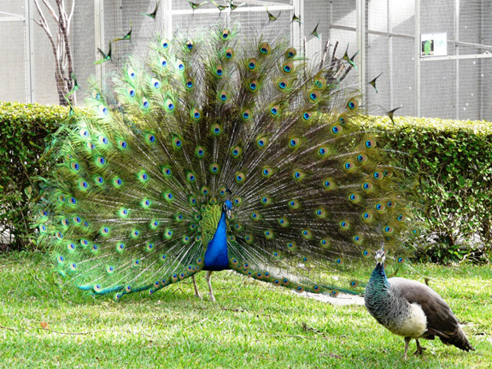
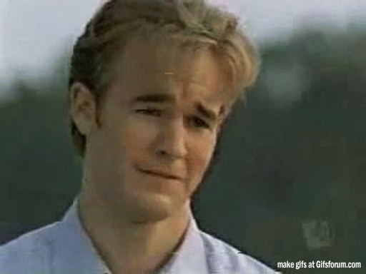
An evolutionary approach
still animals..
Notes:
5
However we are not the only “counting species”.
The ability to discriminate 2 groups using numerical information has been reported in apes, monkeys, dolphins, dogs and birds as well.
Unfortunately very different results have been reported in literature. Part of the problem is due to the fact that different studies use different stimuli and procedures, thus making difficult any fine comparison among the species.
To date, we don’t know whether animals have the same numerical systems and, especially, whether they have the same pre-verbal numerical systems reported in humans.

Slide 6
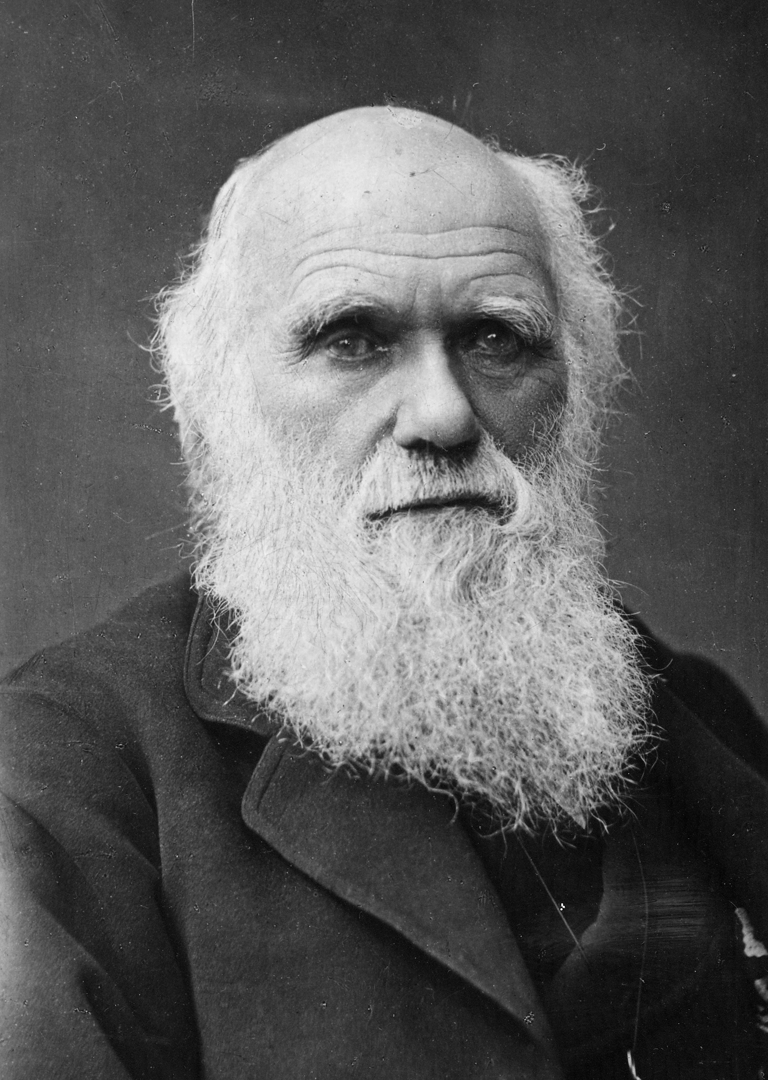
SEXUAL BEHAVIOUR
According to evolutionary biologists, the final goal of organisms consists of spreading their genes into future generations.
This is the only way to survive after body-death.
To achieve this goal, organisms must reproduce themselves.
Notes:
Several studies showed that humans have both verbal and pre-verbal numerical systems.
Verbal systems are stricly related to language and are fundamental for our mathematical skills.
However, we also have pre-verbal numerical systems, such as the ability to quickly estimate which group is larger. These are very ancient systems that permited us to discriminate between quantities in nature, during human evolution. However we still use pre-verbal numerical systems, even today, for instance when we have to select which queue is shorter at the airport.

Slide 7
SEXUAL BEHAVIOUR
Two types of reproduction
1) Asexual
2) Sexual
Notes:
Several studies showed that humans have both verbal and pre-verbal numerical systems.
Verbal systems are stricly related to language and are fundamental for our mathematical skills.
However, we also have pre-verbal numerical systems, such as the ability to quickly estimate which group is larger. These are very ancient systems that permited us to discriminate between quantities in nature, during human evolution. However we still use pre-verbal numerical systems, even today, for instance when we have to select which queue is shorter at the airport.

Slide 8
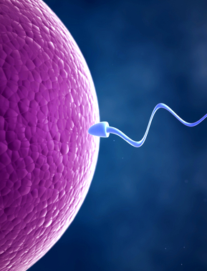
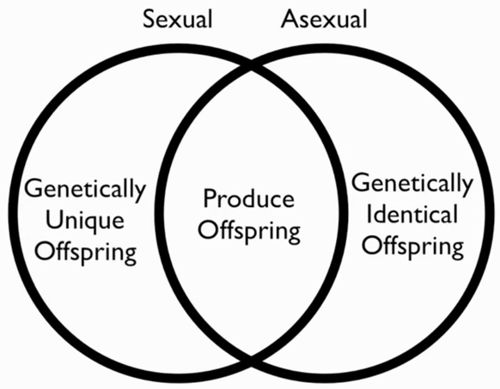
SEXUAL BEHAVIOUR
Sexual vs. Asexual
Pros and Cons
CONS
You need to find a partner
You can get sexual diseases
You may attract predator
New individual may not survive
Notes:
Several studies showed that humans have both verbal and pre-verbal numerical systems.
Verbal systems are stricly related to language and are fundamental for our mathematical skills.
However, we also have pre-verbal numerical systems, such as the ability to quickly estimate which group is larger. These are very ancient systems that permited us to discriminate between quantities in nature, during human evolution. However we still use pre-verbal numerical systems, even today, for instance when we have to select which queue is shorter at the airport.

Slide 9
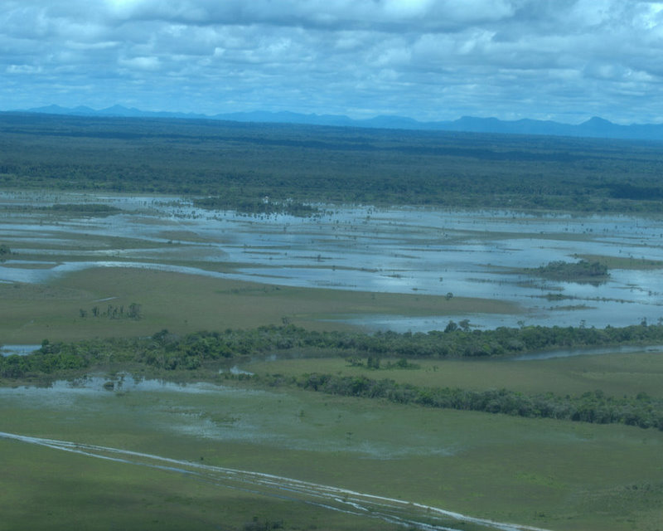
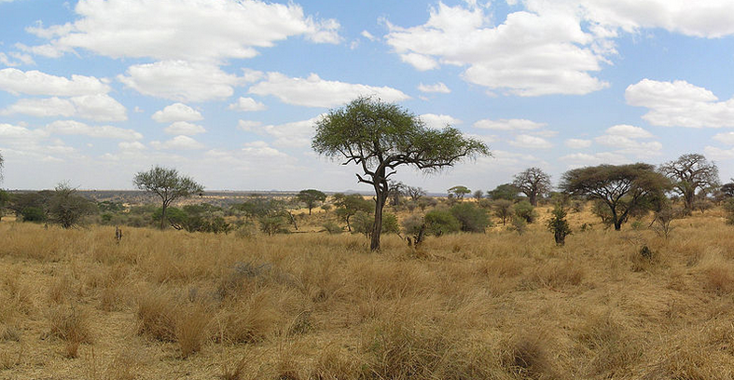
SEXUAL BEHAVIOUR
Sexual vs. Asexual
Pros and Cons
PROS
New individuals are unique and have different features (body, personality etc)
This enhances the probability that, if there is a sudden environmental change, at least some individuals can survive.
Notes:
Several studies showed that humans have both verbal and pre-verbal numerical systems.
Verbal systems are stricly related to language and are fundamental for our mathematical skills.
However, we also have pre-verbal numerical systems, such as the ability to quickly estimate which group is larger. These are very ancient systems that permited us to discriminate between quantities in nature, during human evolution. However we still use pre-verbal numerical systems, even today, for instance when we have to select which queue is shorter at the airport.

Slide 10
SEXUAL BEHAVIOUR
Which sex is typically more selective in partner choice?
Why?

Slide 11
SEXUAL BEHAVIOUR
The sex who makes a greater effort in parental cares is then more selective in partner’s choice.
PARENTAL CARES
SEX CHOICES
Typically, this happens to females…

Slide 12
SEXUAL BEHAVIOUR
Why do parental cares happen more frequently to females ?
(in animals)

Slide 13
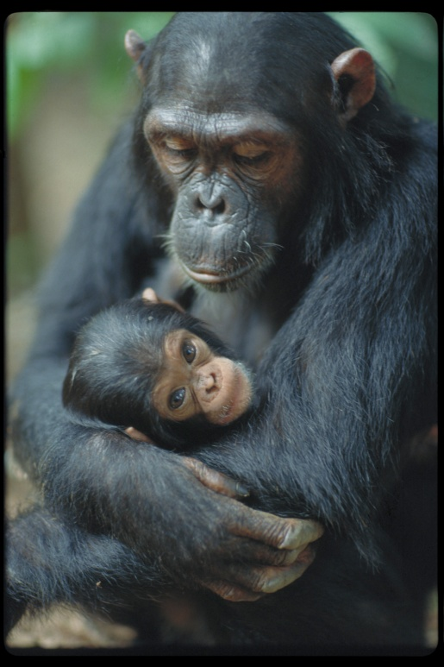
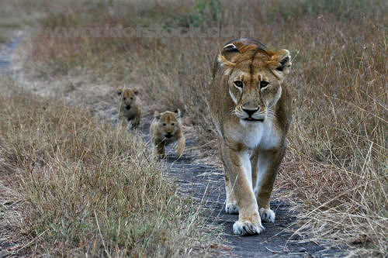
SEXUAL BEHAVIOUR
Why do parental cares happen more frequently to females?
BEFORE BIRTH
Males: Sexual act
Female: Sexual act + gestation
There is a different distribution of parental cares soon after copulation!

Slide 14
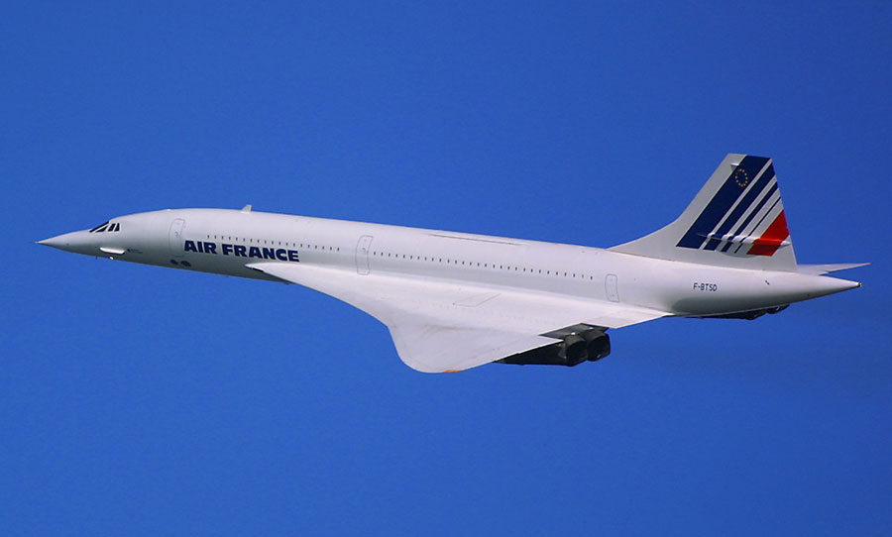
SEXUAL BEHAVIOUR
Why do parental cares happen more frequently to females?
After birth, females often continue to take care of offspring.. why ?
CONCORDE FALLACY
British and French governments continued to fund the aircraft even after it became clear there was no longer a sure economic advantage
You continue to spend money on a project, product, etc. in order not to waste the effort you have already put into it

Slide 15
SEXUAL BEHAVIOUR
Why do parental cares happen more frequently to females?
After birth, females often continue to take care of offspring.. why ?
CONCORDE FALLACY
British and French governments continued to fund the aircraft even after it became clear there was no longer a sure economic advantage
(Females have already spent lots of energies in offspring during gestation, and cannot accept the risk of having waisted all these energies)
You continue to spend money on a project, product, etc. in order not to waste the effort you have already put into it

Slide 16
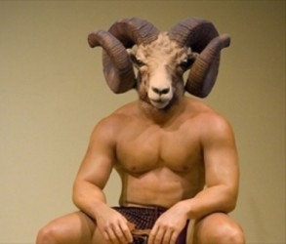
SEXUAL BEHAVIOUR
Why do parental cares happen more frequently to females?
After birth, females often continue to take care of offspring.. why ?
2) CERTAINTY OF PATERNITY
(Males cannot be sure to be the biological father)

Slide 17
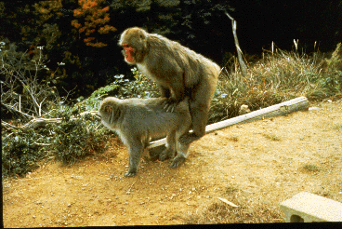
SEXUAL BEHAVIOUR
Why do parental cares happen more frequently to females?
After birth, females often continue to take care of offspring.. why ?
3) SEQUENCE OF SPERM-EGG INTERACTION
Usually males release the sperm into female eggs (internal fecundation), so he often goes away soon after copulation

Slide 18
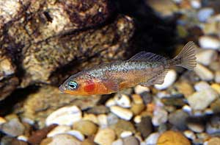
SEXUAL BEHAVIOUR
Why do parental cares happen more frequently to females?
After birth, females often continue to take care of offspring.. why ?
3) SEQUENCE OF SPERM-EGG INTERACTION
Male stickleback fecundate the eggs in the water and then stay in that area to protect them until offspring’s birth.
When females release the egg first and then males fecondate it (external fecundation), we often observed an inversion of parental cares.

Slide 19
SEXUAL BEHAVIOUR
What about humans? Which sex typically take care of children?

Slide 20


SEXUAL BEHAVIOUR
Sexual strategies
+
Parental care
“The sex who makes more effort in parental cares is then more selective in partner’s choice.
IN HUMANS:
Hopefully
10 minutes
10 minutes
BEFORE BIRTH:
9 month gestation
SOON AFTER BIRTH:
Breastfeeding
CULTURAL FACTORS:
You are the mother !!

Slide 21


SEXUAL BEHAVIOUR
Sexual strategies
+
Parental care
“The sex who makes more effort in parental cares is then more selective in partner’s choice.
270 Children in 9 months
1 child in 9 months

Slide 22
SEXUAL BEHAVIOUR
Sexual strategies
+
Parental care
“The sex who makes more effort in parental cares is then more selective in partner’s choice.
This explains why males in several species have been selected to be less selective in partner’s choice.

Slide 23
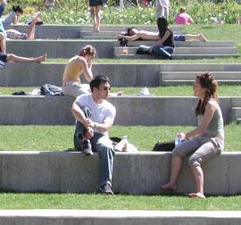
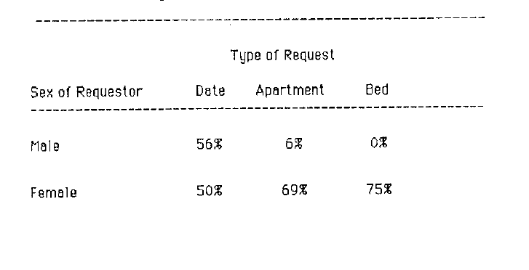
SEXUAL BEHAVIOUR
Clark and Hatfield (1989) made this experiment:
Go to the university campus (male / female collaborators) and ask randomly (to opposite sex):
Will you go out with me?
Come to my appartment?
Have sex with me?
Huge difference between males and females in the last 2 questions:

Slide 24

SEXUAL BEHAVIOUR
Clark and Hatfield (1989) made this experiment:
Go to the university campus (male / female collaborators) and ask randomly (to opposite sex):
Will you go out with me?
Come to my appartment?
Have sex with me?
Huge difference between males and females in the last 2 questions:

Slide 25
SEXUAL BEHAVIOUR
Clark and Hatfield (1989) made this experiment:
Go to the university campus (male / female collaborators) and ask randomly (to opposite sex):
Will you go out with me?
Come to my appartment?
Have sex with me?
Huge difference between males and females in the last 2 questions:

Slide 26
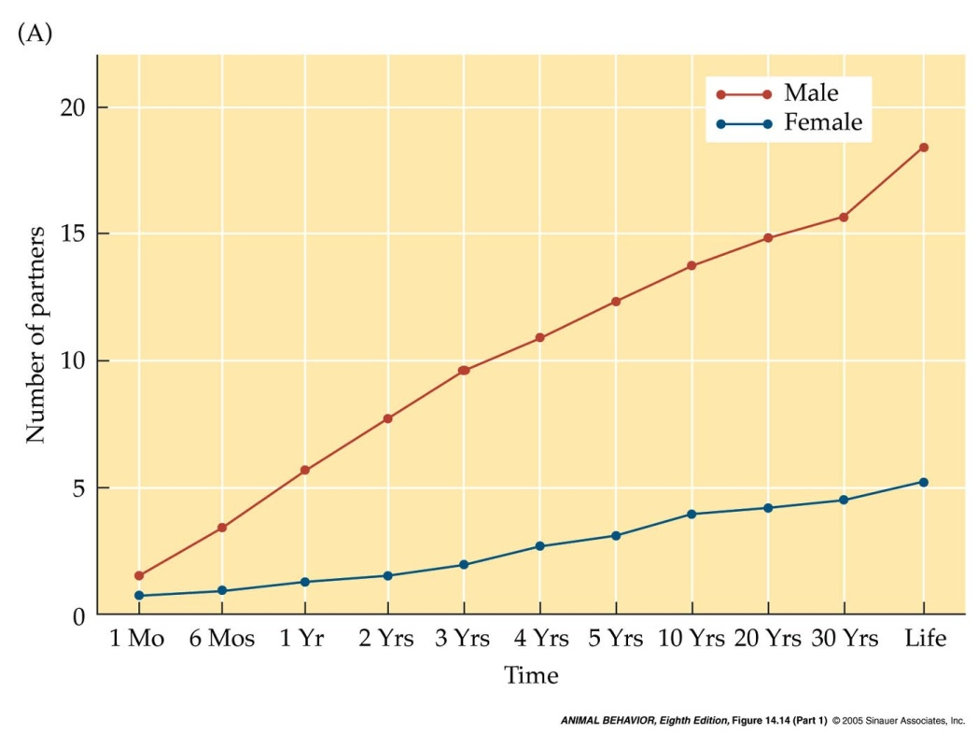
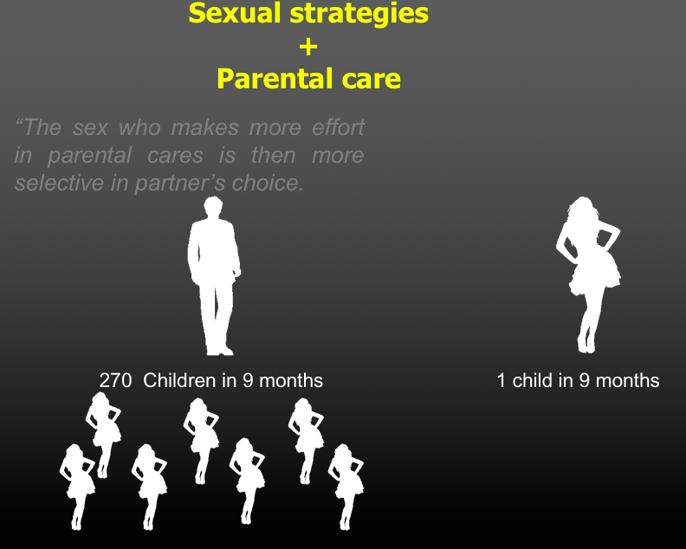
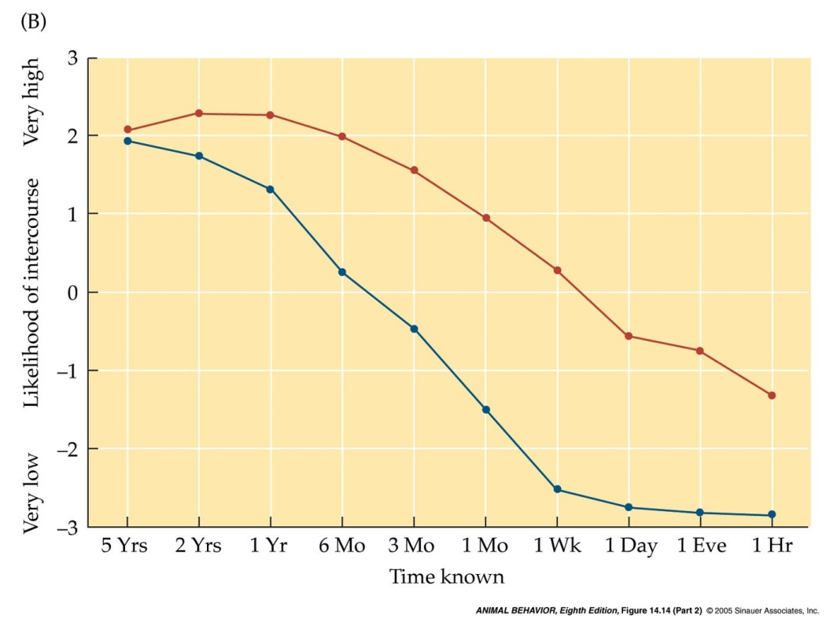
SEXUAL BEHAVIOUR
Males often prefer to have more partners in their life and wish to start to have sexual relationship first (Buss & Schmidt 1993)
Which is the number of partners you would like to have in the next month, 6 months … the whole life?
What are the probability to have sex with a partner that you have just met, or you know since 1 day, 1 year etc ?
N: 73 males and 73 females

Slide 28

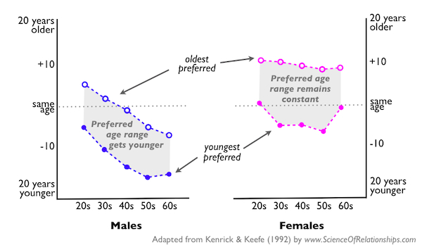
SEXUAL BEHAVIOUR
How do we choose sexual partners ?
Young males are attracted either by younger (+4) or older (-4) females..
Old males are attracted by younger (from -8 to -15) females..

Slide 29

SEXUAL BEHAVIOUR
How do we choose sexual partners ?
Males can have children also when 60 years old, hence nature selected males to be attracted by females with high levels of fertility

Slide 30
SEXUAL BEHAVIOUR
How do we choose sexual partners ?
A bit wiser, probably in a higher rank !
As the possibility to have children decrease when increasing with age, females do not change the strategy.
Similar age (but more often older)

Slide 31
Women desire men who command a high position because social status is a universal cue to the control of resources
Along with status come better food, more abundant territory, and superior health care.

Slide 33
La Cerra (1994) found that women find the man interacting positively with the baby considerably more attractive, suggesting a mate preference for men who display a willingness to invest in children.
Comparable photographs of women, shown either ignoring or interacting positively with a baby, produced no effect on men’s judgments of women’s attractiveness.

Slide 35

The mere presence of an attractive woman causes men to increase their level of risk-taking as well as their level of testosterone.

Slide 36
SEXUAL BEHAVIOUR
LONG TERM / SHORT TERM RELATIONSHIP

Slide 37

SEXUAL BEHAVIOUR
Short-term
(One night stand)
More masculine-looking men (androgens)
Evolutionary ancient selection for these traits
Long-Term relationship
Less masculine-looking men
Less likely to be unfaithfull
More willing to invest in parenting

Slide 38
SEXUAL BEHAVIOUR
Short-term
(One night stand)
Attractive partner
Identifying women of high fertility or reproductive value—women capable
of successfully bearing children.
A large body of evidence suggests that men have evolved standards of attractiveness that embody cues to a woman’s reproductive capacity
Long-Term relationship

Slide 39
SEXUAL BEHAVIOUR
Have sex with someone

Slide 40
SEXUAL BEHAVIOUR
Hey, keep things simple, just hook up
Agree

Slide 41
SEXUAL BEHAVIOUR

Slide 42
SEXUAL BEHAVIOUR
Hey, keep things simple, just hook up
Agree
Oxytocin is released during orgasm
(affective bonding)
Oxytocin levels increase in response to a simple hug
Higher level of testosterone
(sexual excitement)

Slide 43
SEXUAL BEHAVIOUR
… don’t you think we should talk about the future?
?!?
REMEMBER
(from an evolutionary perspective)
“Choosing sex”
(choose the best partner for long term period)
NOT “Choosing sex”
(selected to search for several partners)

Slide 44





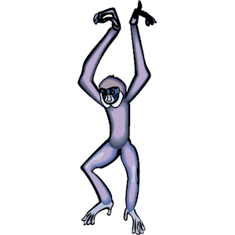
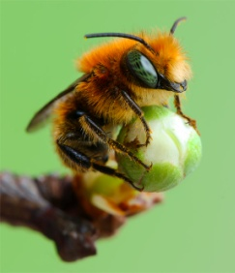
SEXUAL BEHAVIOUR
Sexual strategies
+
Parental care
Sexual conflicts lead to the formation of different male-female relationship:
POLYGAMY
1 males, many females
MONOGAMY
1 male, 1 female
Gibbons (if only one take cares, they both have 0 survived offspring)
POLYANDRY
1 female, many males
(very rare)
Some bees copulate with different males to obtain food gifts

Slide 45

SEXUAL BEHAVIOUR
Sexual strategies
+
Parental care
Sexual conflicts lead to the formation of different male-female relationship:
Our children require several years before being independent (we need to collect our efforts, otherwise 0 fitness)
Cultural factors
MONOGAMY
1 male, 1 female

Slide 46
SEXUAL BEHAVIOUR
Sexual strategies
+
Parental care
Sexual conflicts lead to the formation of different male-female relationship:
POLYGAMY
1 males, many females
According to some evolutionary psychologists, we are mainly polygamists

Slide 47
SEXUAL BEHAVIOUR
Sexual strategies
+
Parental care
POLYGAMY
1 males, many females
Men who failed to commit might have
failed to attract any women at all.
So, why do males marriage ?
To increase in the quality of the woman a man would be able to attract.
Certainty of paternity
Defend the offspring or they cannot survive

Slide 48
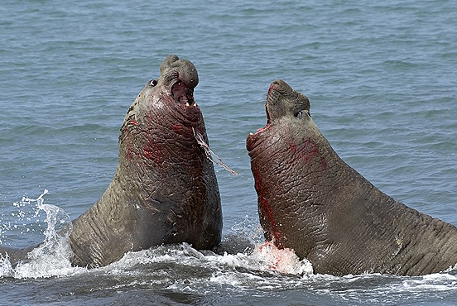
SEXUAL BEHAVIOUR
Sexual strategies
+
Parental care
The fact that females are more selective typically leads to:
INTRA-SEXUAL COMPETITION: Male-male interaction to have access to females.
Among elephant seals, only alpha males have access to the females

Slide 49
SEXUAL BEHAVIOUR
Sexual strategies
+
Parental care
The fact that females are more selective typically leads to:
INTRA-SEXUAL COMPETITION:
There is high variability in successful rate of copulations among males
(Some males with 0 females, other with 10 females)
(Females instead have the same number of males)
Among elephant seals, only alpha males have access to the females

Slide 50
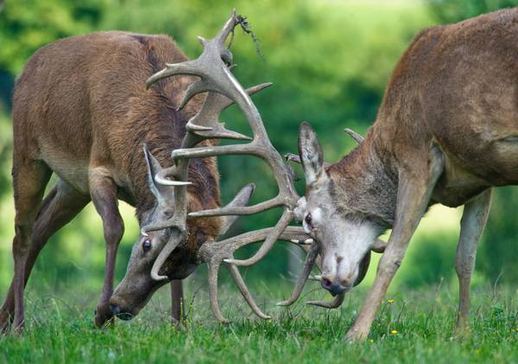
SEXUAL BEHAVIOUR
Sexual strategies
+
Parental care
The fact that females are more selective typically leads to:
INTRA-SEXUAL COMPETITION:
There is high variability in successful rate of copulations among males
(Some males with 0 females, other with 10 females)
(Females instead have the same average of males)
Male deers

Slide 51
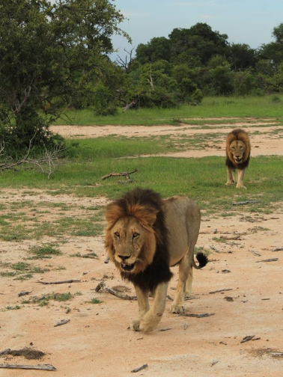
SEXUAL BEHAVIOUR
Sexual strategies
+
Parental care
The fact that females are more selective typically leads to:
INTRA-SEXUAL COMPETITION:
In some case, as soon as a new male became the dominant one, he kills all newborns and juveniles of the group, in order to make females more receptive and ready to have new offspring.
I took this picture in South Africa!

Slide 52
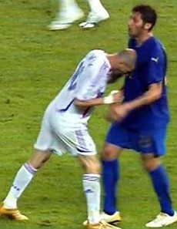
SEXUAL BEHAVIOUR
Sexual strategies
+
Parental care
The fact that females are more selective typically leads to:
INTRA-SEXUAL COMPETITION:
In our species, education and culture help us to avoid direct fighting.
However, males often found alternative ways to exhibit this evolutionary-ancient pressure to face their potential sexual competitor.

Slide 53
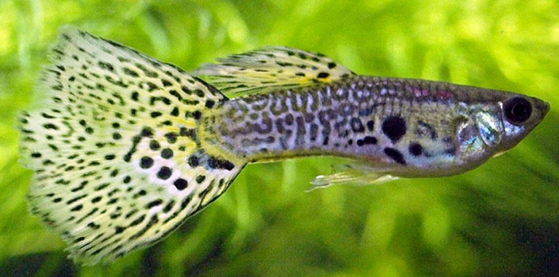
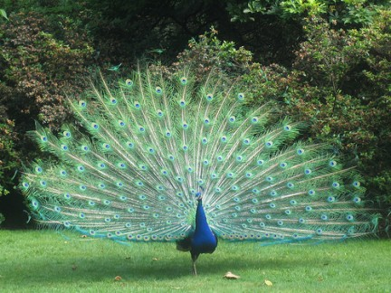
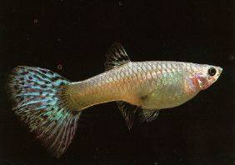
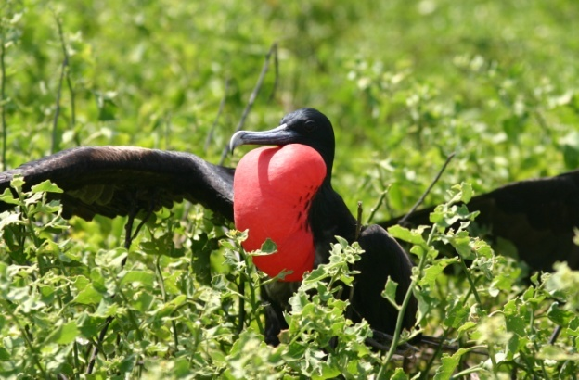
SEXUAL BEHAVIOUR
Sexual strategies
+
Parental care
The fact that females are more selective typically leads to:
ORNAMENTAL TRAITS:
“Choose me, I am sexy!”
Males
Females
Several males have very energy-consuming traits, but they are necessary to spread their genes.

Slide 54
SEXUAL BEHAVIOUR
Sexual strategies
+
Parental care
Both sexes have ornamental traits, it’s the different amount of them that can reveal us which is the “choosing” sex.

Slide 55
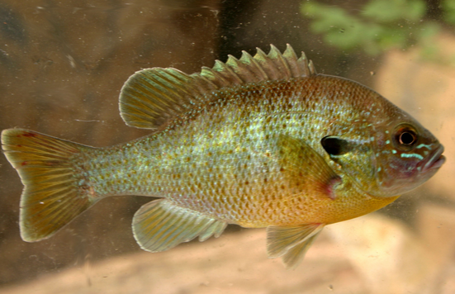
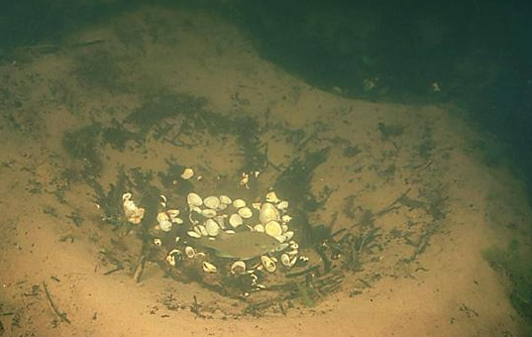
SEXUAL BEHAVIOUR
Sexual strategies
+
Parental care
If not selected by females, males have poor alternatives..
a) SNEAKER MALES
1 Male control eggs at the bottom of the lake to attract females;
Other smaller males hide themselves in the surroundings, and even behave as females (no attacks);
As soon as females come there, sneaker males release their sperm in the water in the attempt to fertilize the eggs just released by females.

Slide 56
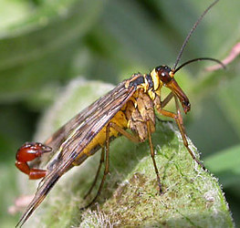
SEXUAL BEHAVIOUR
Sexual strategies
+
Parental care
If not selected by females, males have poor alternatives..
b) FORCED COPULATION
Scorpionfly has 3 strategies:
Give a dead insect as a gift
Give his saliva as gift
Forced copulation
Notes:
SALAIVA

Slide 57
WHEN YOU WANT TO MAKE A GOOD IMPRESSION TO A GIRL BY SHOWING YOUR ETHOLOGICAL KNOWLEDGE…
BUT SHE DOES NOT APPRECIATE YOUR DEAD INSECTS

Slide 58
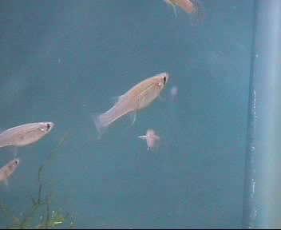
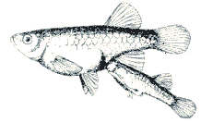
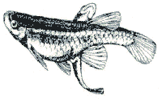

SEXUAL BEHAVIOUR
b) FORCED COPULATION
Male mosquitofish just use this strategy (no gift, no funny colors)… they have been select to think about females continuously !
♂
♀
Notes:
In Gambusia, as other poeciilid fish, male sexual harassment is the only strategy to mate. Males try to mate with a frequency of one sexual act per minute, whereas females don’t collaborate since they can store the sperm for months.
These different optima in mating rates generate a strong sexual conflict: for these reason females adopt some strategies to avoid males (to improve the predatory defence and feeding behaviour).
One of these strategies consists to join a large shoal of other females, to reduce (for a dilution effect) the energetic cost linked to the presence of male.
Here I’m going to show you a short movie in which we can have an idea of the interaction between male and females

Slide 59
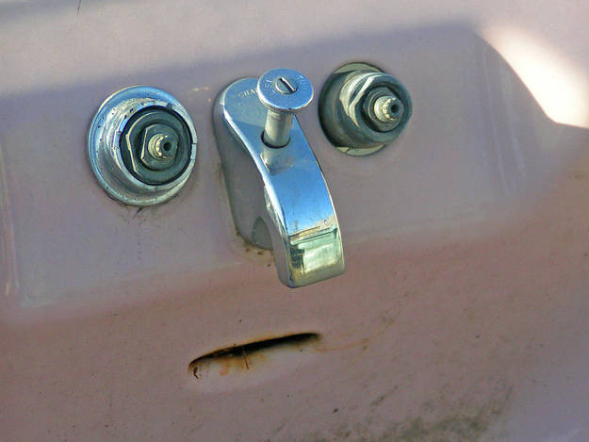
SEXUAL BEHAVIOUR
Which hormones are typically involved in parental care?
Mr Sad SinK:
What an awful slide!
Notes:
In Gambusia, as other poeciilid fish, male sexual harassment is the only strategy to mate. Males try to mate with a frequency of one sexual act per minute, whereas females don’t collaborate since they can store the sperm for months.
These different optima in mating rates generate a strong sexual conflict: for these reason females adopt some strategies to avoid males (to improve the predatory defence and feeding behaviour).
One of these strategies consists to join a large shoal of other females, to reduce (for a dilution effect) the energetic cost linked to the presence of male.
Here I’m going to show you a short movie in which we can have an idea of the interaction between male and females

Slide 60
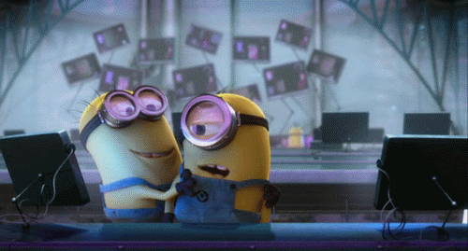
SEXUAL BEHAVIOUR
Which hormones are typically involved in parental care?
When we hug someone, oxytocin is released into our bodies by our pituitary gland.
Lower heart rates
Lower our cortisol levels (Cortisol is the hormone responsible for stress, high blood pressure)
Give me some oxytocin !
Notes:
In Gambusia, as other poeciilid fish, male sexual harassment is the only strategy to mate. Males try to mate with a frequency of one sexual act per minute, whereas females don’t collaborate since they can store the sperm for months.
These different optima in mating rates generate a strong sexual conflict: for these reason females adopt some strategies to avoid males (to improve the predatory defence and feeding behaviour).
One of these strategies consists to join a large shoal of other females, to reduce (for a dilution effect) the energetic cost linked to the presence of male.
Here I’m going to show you a short movie in which we can have an idea of the interaction between male and females

Slide 61
IN SUM

Slide 62
SEXUAL BEHAVIOUR
FINAL GOAL?
Spread your genes into next generation !
HOW?
REPRODUCTION… but it’s not enough
PARENTAL CARES: someone must take care of offspring (= my genes)
WHO CHOOSE WHOM?
I take care of offspring? I select you very carefully (at least you should provide me good genes)….
You wanna select me? So, let me
Fight against my competitors
Be cool with you (ornamental traits)

Slide 63
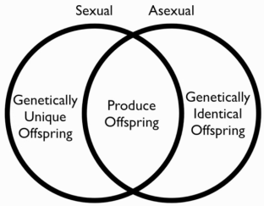



SEXUAL BEHAVIOUR
Sexual reproduction is widespread because it increases the possibility to have offspring able to survive in different (variable) environments.
The “choosy sex” is determined mainly by the costs associated to parental cares.
As females in nature have more parental cares, female is often the “choosing” sex.
As a consequence, in the other sex ornamental traits are reported, and more aggressive interaction is observed.

