Slide 1
The peripheral nervous system

Slide 2
Peripheral

Slide 3
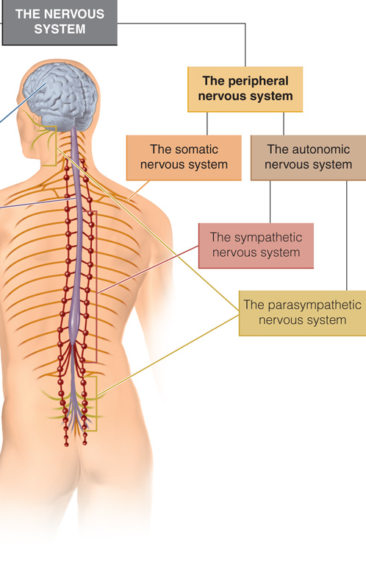
The peripheral nervous system
SOMATIC NERVOUS SYSTEM
(it brings sensory input to the brain and spinal cord and returns commands to the muscles)
Cranial Nerves
Spinal Nerves
AUTONOMIC NERVOUS SYSTEM
(it controls the actions of smooth muscles and many glands and organs.
Enteric Nervous System
Sympathetic
Parasympathetic
Enteric

Slide 4
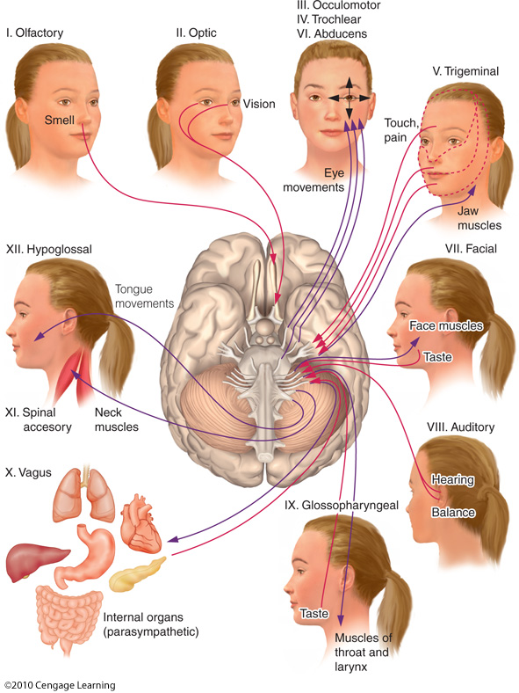
The peripheral nervous system
SOMATIC NERVOUS SYSTEM
Cranial Nerves

Slide 5
The peripheral nervous system
SOMATIC NERVOUS SYSTEM
Cranial Nerves
3 of the cranial nerves carry only sensory information:
N. 1 (olfactory nerve),
N. 2 (optic nerve),
N. 8 (auditory nerve).
5 of the nerves carry only motor information:
N. 3 (oculomotor nerve)
N. 4 (Trochlear nerve)
N. 6 (abducens nerve)
N. 11 (accessory nerve) – neck
N. 12 (hypoglossal nerve) - tongue
Eye

Slide 6
The peripheral nervous system
SOMATIC NERVOUS SYSTEM
Cranial Nerves
The remaining 4 nerves have mixed sensory and motor functions.
N. 5: The trigeminal nerve controls chewing movements and also provides some feedback regarding facial expression.
N. 7: The facial nerve produces facial expressions and carries the sensation of taste.
N. 9: The glossopharyngeal nerve performs both sensory and motor functions for the throat.
N. 10: the vagus nerve (vagus comes from the same Latin root as vagabond) provide input and receive sensation from the heart, liver, and digestive tract

Slide 7
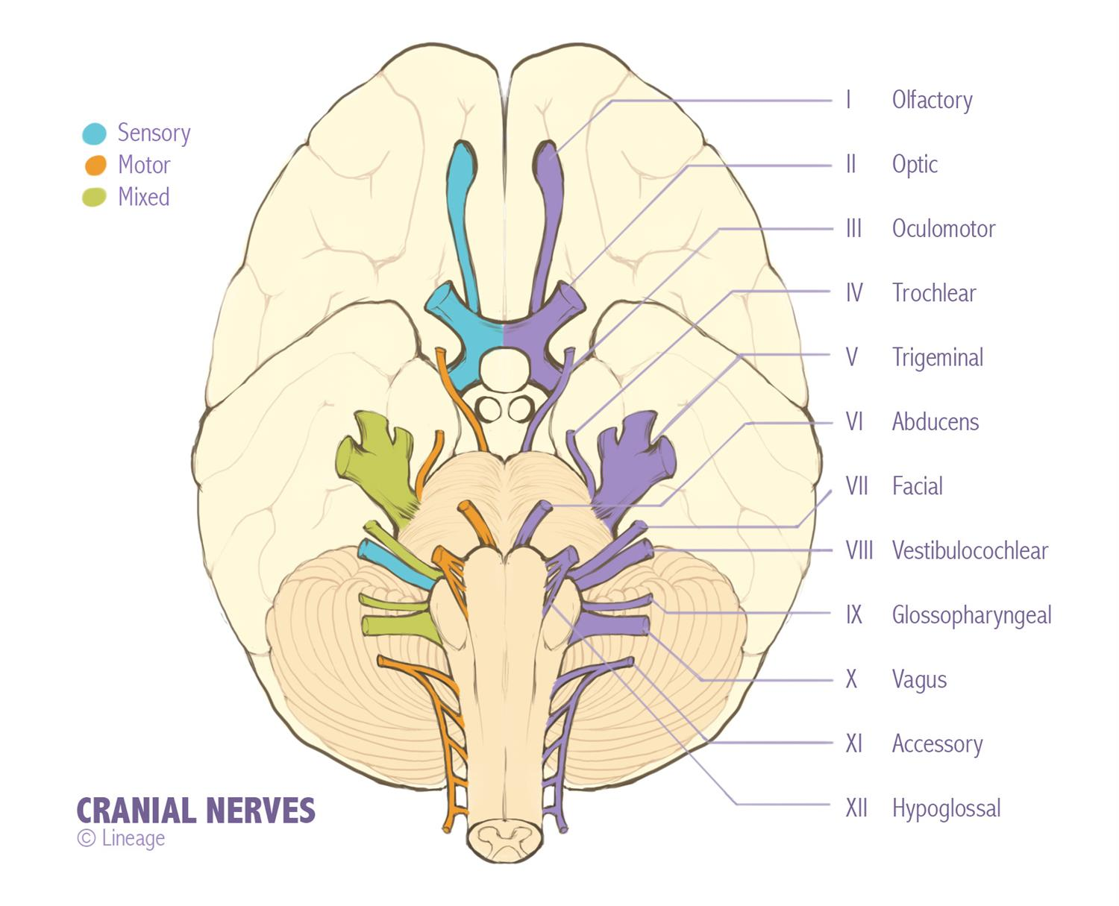
The peripheral nervous system
SOMATIC NERVOUS SYSTEM
Cranial Nerves

Slide 8
The peripheral nervous system
SOMATIC NERVOUS SYSTEM
Spinal Nerves
31 pairs of spinal nerves exit the spinal cord to provide sensory and motor pathways to the torso, arms, and legs.
Each spinal nerve is also known as a mixed nerve because it contains a sensory, or afferent, nerve (the "a" means toward the CNS in this case, as in access) and a motor, or efferent, nerve (the "e" means away from the CNS, as in exit).

Slide 9
The peripheral nervous system
AUTONOMIC NERVOUS SYSTEM
Sympathetic
Parasympathetic
A sort "cruise control” nervous system.
It manages many vital functions without conscious effort or awareness. You wouldn’t have much of a social life if you had to consciously command your lungs to inhale and exhale and your heart to beat.
This doesn't mean that you are incapable of taking voluntary control of autonomic functions.
Biofeedback: A set of techniques that enable people to control typically unconscious or involuntary functions such as blood pressure.

Slide 10
The peripheral nervous system
AUTONOMIC NERVOUS SYSTEM
Sympathetic
Parasympathetic
Dr Germano Gallicchio
(Bangor University)

Slide 11
The peripheral nervous system
AUTONOMIC NERVOUS SYSTEM
Sympathetic
Parasympathetic
The organs receive input from both the sympathetic and parasympathetic systems, hence it is important for the organs to have a way to identify the source of the Input.

Slide 12
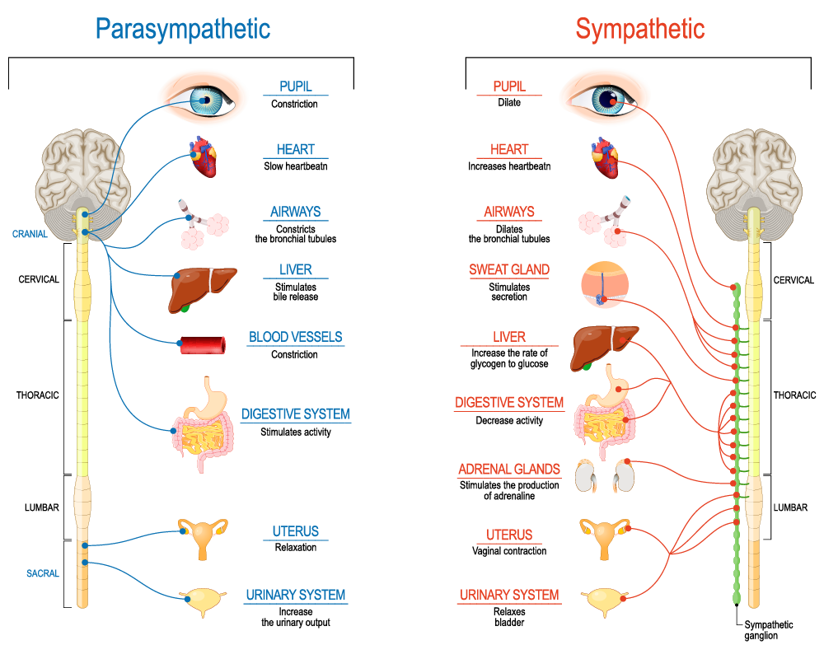
The peripheral nervous system
AUTONOMIC NERVOUS SYSTEM

Slide 13
The peripheral nervous system
AUTONOMIC NERVOUS SYSTEM
Sympathetic
The sympathetic nervous system prepares the body for fighting or fleeing by shutting down low-priority systems and putting blood and oxygen into the most necessary parts of the body.
Salivation and digestion are put on standby. If you're facing a hungry lion on the Serengeti plain, you don't need to worry about digesting your lunch unless you survive the encounter. Your heart and lungs operate to provide extra oxygen, which is fed to the large-muscle groups.
Blood vessels near the skin's surface are constricted to channel blood to the large-muscle groups. Aside from giving you that pale look, you enjoy the added benefit of not bleeding very badly should you be cut.

Slide 14
The peripheral nervous system
AUTONOMIC NERVOUS SYSTEM
Sympathetic
Parasympathetic
The organs receive input from both the sympathetic and parasympathetic systems, hence it is important for the organs to have a way to identify the source of the Input.

Slide 15
The peripheral nervous system
AUTONOMIC NERVOUS SYSTEM
Sympathetic
Parasympathetic
Postganglionic neuron
Preganglionic neuron
Preganglionic neuron
Postganglionic neuron

Slide 16
The peripheral nervous system
AUTONOMIC NERVOUS SYSTEM
Sympathetic
Axons from neurons in the thoracic and lumbar segments of the spinal cord communicate with a series of ganglia just outside the cord known as the sympathetic chain.
Fibers from cells in the sympathetic chain then communicate with target organs. Because the messages from the spinal neurons reach the sympathetic chain through fibers of equal length, they arrive at the same time.

Slide 17
The peripheral nervous system
AUTONOMIC NERVOUS SYSTEM
Sympathetic
Consequently, input from the sympathetic chain arrives at all of the target organs simultaneously. This coordinated response is essential for survival

Slide 18
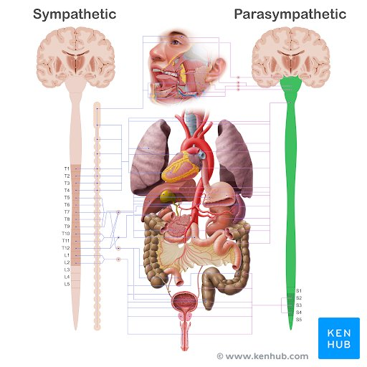
The peripheral nervous system
AUTONOMIC NERVOUS SYSTEM
Parasympathetic
The neurons for the parasympathetic nervous system are found above and below the regions associate to sympatetic nervous system, in the brain and sacral divisions of the spinal cord, specifically (“para” = around).
Because timing is not as important to parasympathetic activity the coordination provided by a chain is not necessary.

Slide 19
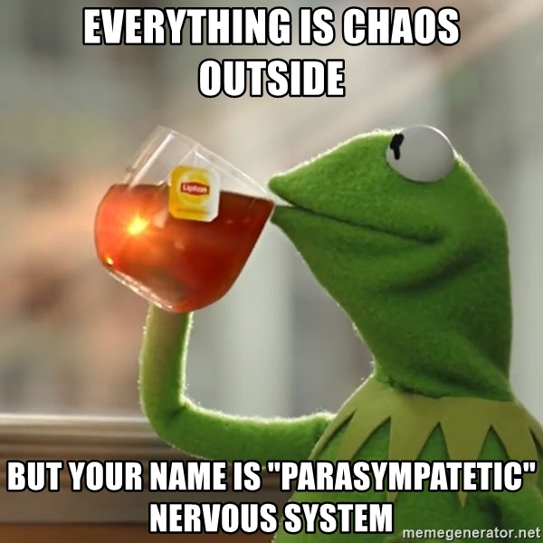

Slide 20
The peripheral nervous system
AUTONOMIC NERVOUS SYSTEM
A visual summary
Sympathetic
Parasympathetic

Slide 21
The peripheral nervous system
AUTONOMIC NERVOUS SYSTEM
Enteric
Mr Sad Sink

