Slide 1
THE SPINAL CORD

Slide 2
The spinal cord
Spinal cord weighs only 2 percent as much as the brain
The neurons making up the spinal cord are found in the upper 2/3 of the vertebral column.
The spinal cord is shorter than the vertebral column because the cord itself stops growing earlier in a child's development than the bones in the vertebral column do.
Running down the center of the spinal
cord is the central canal, through which CSF circulates.
The spinal nerves exit between the bones of the vertebral column. The bones are cushioned from one another with disks.

Slide 3
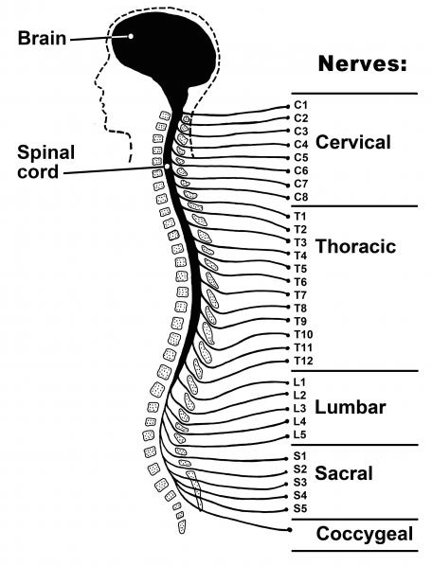
The spinal cord
31 spinal

Slide 4
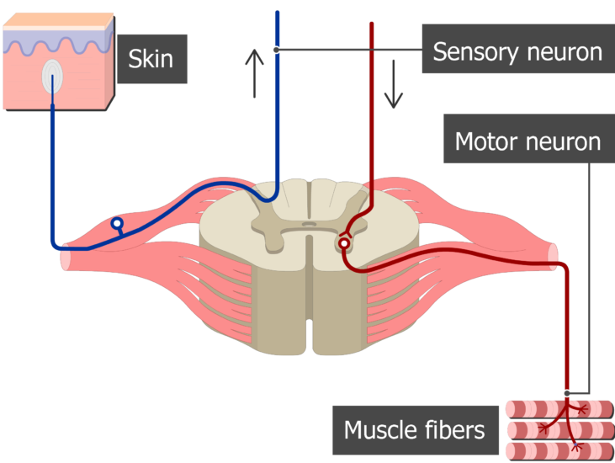
The spinal cord
What is this ‘white’?
These large tracts of axons are responsible for carrying information to and from the brain.
Axons from sensory neurons that carry information about touch, position, pain, and temperature travel up the dorsal parts of the spinal cord.
Dorsal
Ventral
Axons from motor neurons, responsible for movement, travel in the ventral parts of the cord.

Slide 5
The spinal cord
What is this ‘gray’?
There appears to be a gray butterfly or letter H shape in the center of the cord.
Gray matter consists of areas primarily made up of cell bodies
The neurons found in the dorsal horns receive sensory input, whereas neurons in the ventral horns pass motor information on to the muscles
Dorsal
Ventral

Slide 6
The spinal cord
A model of the spinal cord

Slide 7
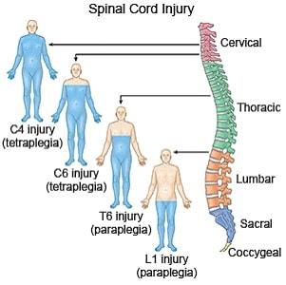
The spinal cord
Paraplegic/tetraplegic patient

Slide 8
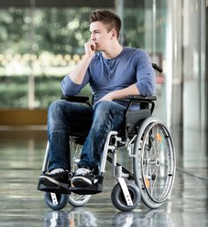
The spinal cord
Paraplegic/tetraplegic patient
A person with lumbar-level damage is a paraplegic. Use of the arms and torso is maintained, but sensation and movement in the lower torso and legs are lost.
A person with cervical damage is a quadriplegic/tetraplegic (quad meaning "four:' indicating loss of control over all four limbs). All sensation and ability to move the arms, legs, and torso are lost

Slide 9
The spinal cord

