Slide 1
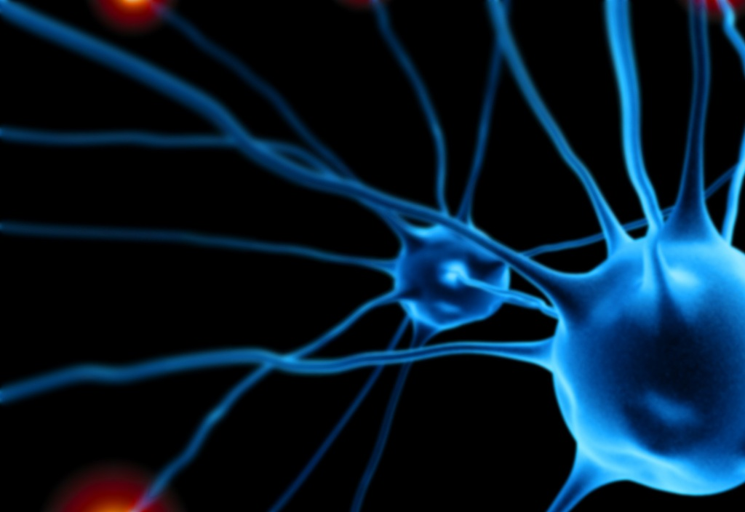
What is behavioural neuroscience?

Slide 2
What is behavioural neuroscience?
DEFINITION
Neuroscience
Neuroscience is the scientific study of the nervous system, in health and in disease

Slide 3
What is behavioural neuroscience?
DEFINITION
The molecular neuroscientist explores the nervous system at the level of the molecules that serve as its building blocks.

Slide 4
What is behavioural neuroscience?
DEFINITION
The structure, physiological properties, and functions of single cells found within the nervous system

Slide 5
What is behavioural neuroscience?
DEFINITION
These isolated cells would be of no use unless they could forge connections, which they do at junctions we call synapses. Synaptic neuroscience examines the strength and flexibility of neural connections

Slide 6
What is behavioural neuroscience?
DEFINITION
Beyond the single synapse, we find that interconnected neurons form pathways or networks

Slide 7
What is behavioural neuroscience?
DEFINIION
Behavioral neuroscientists (psychobiologists) use all of the previous levels of analysis, from the molecular up through the network, in their efforts to understand the biological correlates of behavior.
BEHAVIOUR
BRAIN

Slide 8
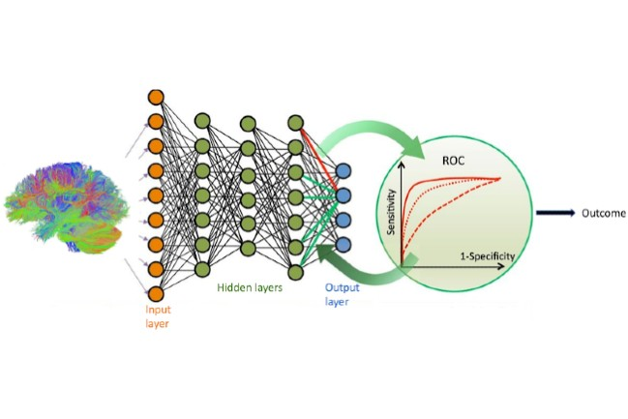
What is behavioural neuroscience?
DEFINITION
Computational neuroscience runs parallel to the types of neuroscience described so far, but it draws from computer science, electrical engineering, mathematics, and physics to produce models of the nervous system from the molecular up through the behavioral levels of analysis

Slide 9
What is behavioural neuroscience?
DEFINITION
Because of the diversity of skills needed to pursue each of these approaches, neuroscience is an essentially interdisciplinary field of study, reaching across traditional academic departments of biology, chemistry, psychology, medicine, mathematics, physics, engineering, and computer science.

Slide 10
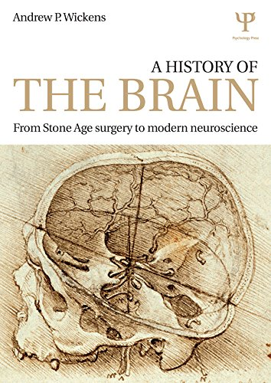
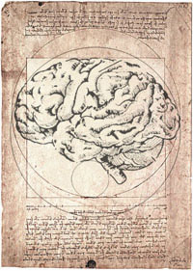
What is behavioural neuroscience?
HISTORY OF NEUROSCIENCE

Slide 11
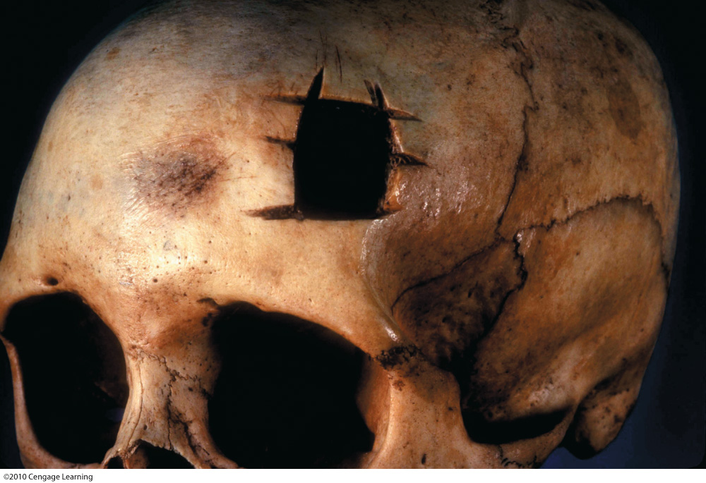
What is behavioural neuroscience?
HISTORY OF NEUROSCIENCE
To release demons or relieve feelings of pressure ?
Archaeological evidence of brain surgery suggests that, as long as 7,000 years ago, people tried to cure others by drilling holes in the skull, a process known as trephining or trepanation.
Regrowth around some of the holes indicates that at least some of the patients survived the procedure.

Slide 12
What is behavioural neuroscience?
HISTORY OF NEUROSCIENCE

Slide 13
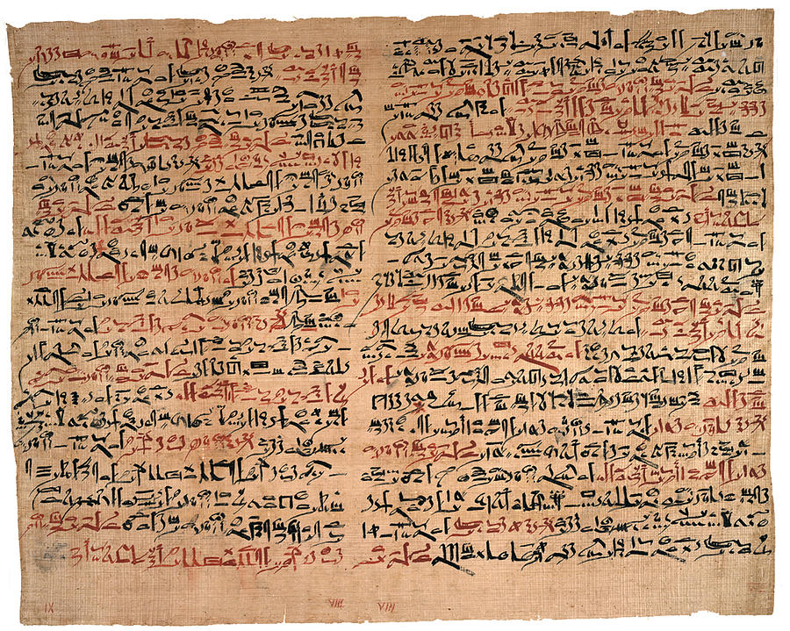
What is behavioural neuroscience?
HISTORY OF NEUROSCIENCE
Edwin Smith Surgical Papyrus (1600 BC)
Oldest known medical writing in history
The author understood that paralysis and lack of sensation in the body resulted from nervous system damage

Slide 14
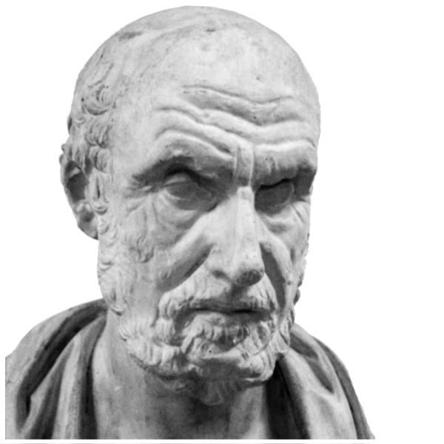
What is behavioural neuroscience?
HISTORY OF NEUROSCIENCE
Ancient Greece
Building on the knowledge taken from ancient Egypt, the Greek scholars of the fourth century BCE proposed that the brain was the organ of sensation.
Hippocrates (460-379 BC) correctly identified epilepsy as originating in the brain

Slide 15
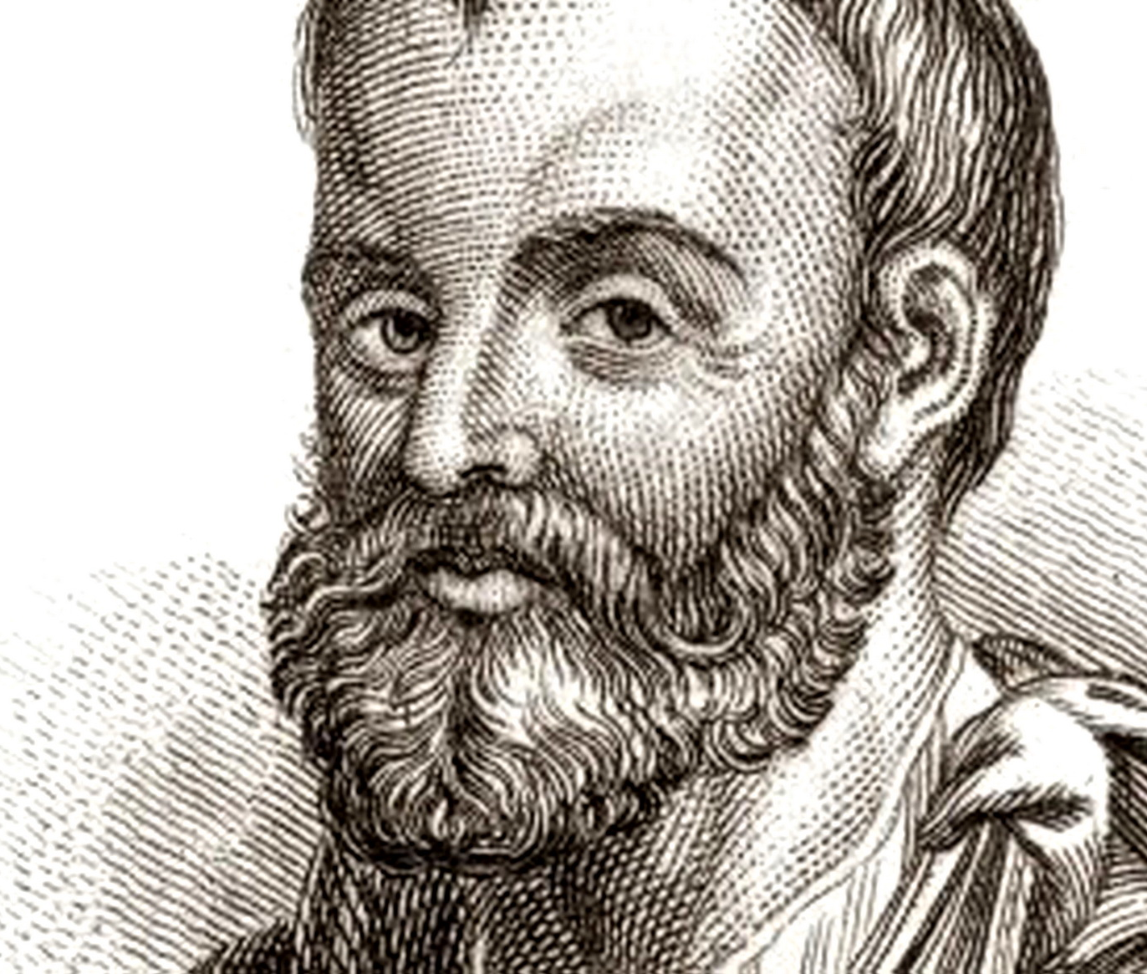
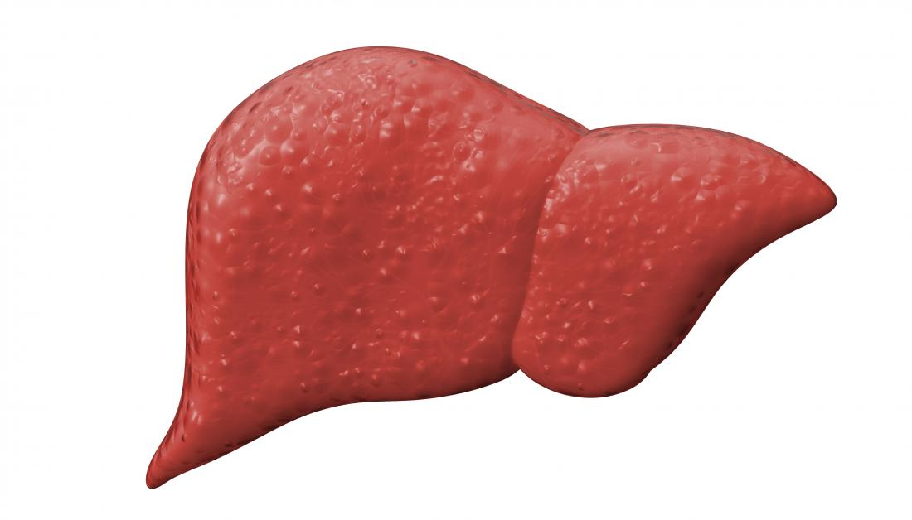
What is behavioural neuroscience?
HISTORY OF NEUROSCIENCE
Ancient Greece
Building on the knowledge taken from ancient Egypt, the Greek scholars of the fourth century BCE proposed that the brain was the organ of sensation.
Animal spirit hypothesis
Galen (130-200 AD) made careful dissections of animals.
1) a form of spirits called natural spirits were produced in the liver after the consumption of food.

Slide 16
What is behavioural neuroscience?
HISTORY OF NEUROSCIENCE
Ancient Greece
Building on the knowledge taken from ancient Egypt, the Greek scholars of the fourth century BCE proposed that the brain was the organ of sensation.
Animal spirit hypothesis
Galen (130-200 AD) made careful dissections of animals.
2) Natural spirits then were sent to the heart, where they were converted to vital spirits.
Vital spirits were carried in the carotid arteries to the brain to either the ventricles or to a complex of arteries at the base of the brain that Galen called the rete mirabile

Slide 17
What is behavioural neuroscience?
HISTORY OF NEUROSCIENCE
Ancient Greece
Building on the knowledge taken from ancient Egypt, the Greek scholars of the fourth century BCE proposed that the brain was the organ of sensation.
Animal spirit hypothesis
Galen (130-200 AD) made careful dissections of animals.
3) In one of these locations, the vital spirits were converted to animal spirits---the highest form of spirits. The animal spirits were then stored in the ventricles.

Slide 18
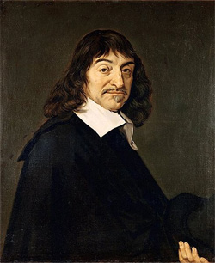
What is behavioural neuroscience?
HISTORY OF NEUROSCIENCE
CARTESIO (1596-1650) AND THE DUALISM
BODY AND MIND ARE SEPARATE ENTITIES.
The mind is neither physical nor accessible to study through the natural science

Slide 19
What is behavioural neuroscience?
HISTORY OF NEUROSCIENCE
Work by Luigi Galvani (1737-1798) established electricity as the mode of communication used by the nervous system
He placed a dissected frog on a table next to an electrical machine, and when one of his assistants touched the frog's nerves with a metal scalpel at the same time as the electrical machine emitted a spark, the frog's leg muscle contracted, causing a convulsive movement of the limb.

Slide 20
What is behavioural neuroscience?
HISTORY OF NEUROSCIENCE
Work by Luigi Galvani (1737-1798) established electricity as the mode of communication used by the nervous system
This inspired Mary Shelley to write Frankenstein !

Slide 21
What is behavioural neuroscience?
HISTORY OF NEUROSCIENCE
(0.58 -)

Slide 22
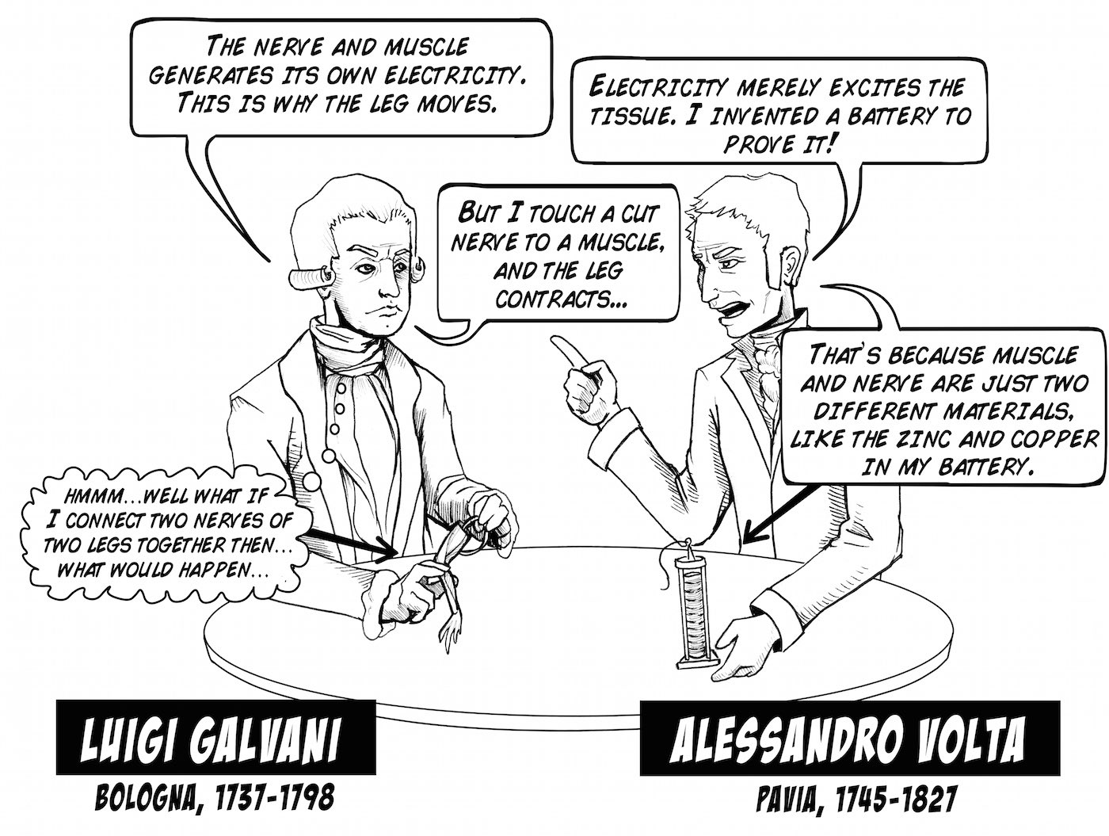
What is behavioural neuroscience?
HISTORY OF NEUROSCIENCE
Volta believed that the “animal electricity” (advanced by Galvani) and the electricity from electrostatic generators were the same. This rationale led Volta to believe the reason Galvani’s frog legs kicked was a result of the metals used, not the animal tissue.

Slide 23
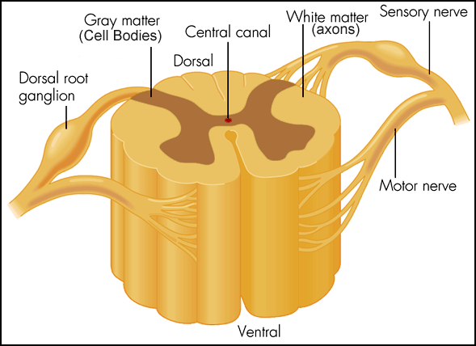
What is behavioural neuroscience?
HISTORY OF NEUROSCIENCE
Charles Bell (1774-1842) and Francois Magendie (1783-1855) demonstrated that information traveled in one direction, not two, within sensory and motor nerves (‘Bell–Magendie law’)

Slide 24
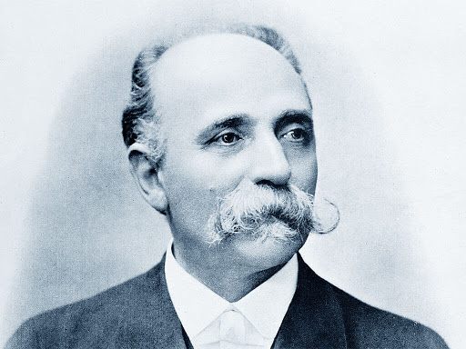
What is behavioural neuroscience?
HISTORY OF NEUROSCIENCE
CAMILLO GOLGI
1843-1926
RAMON Y CAYAL
1852-1934
They shared the Nobel Prize for their work in 1906.

Slide 25
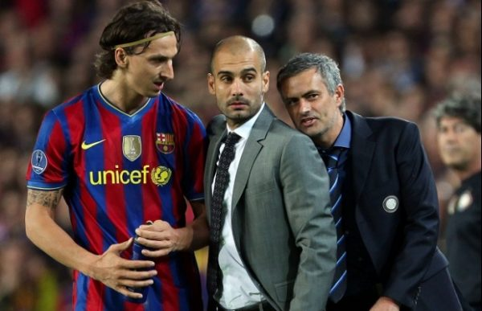
What is behavioural neuroscience?
HISTORY OF NEUROSCIENCE
CAMILLO GOLGI
1843-1926
RAMON Y CAYAL
1852-1934
Friends?
QUITE THE OPPOSITE!!

Slide 26
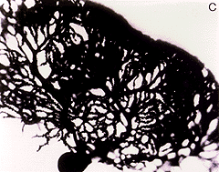
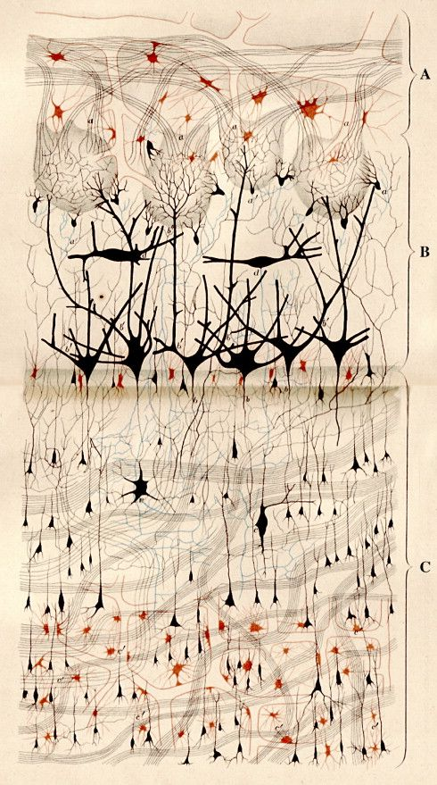
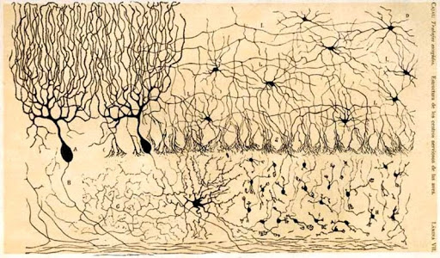
What is behavioural neuroscience?
HISTORY OF NEUROSCIENCE
CAMILLO GOLGI
1843-1926
RAMON Y CAYAL
1852-1934
Black reaction technique
NEURON DOCTRINE: Nervous system was composed of an array of separate, independent cells (it’s not a continuous network)
RETICULAR THEORY: Nervous system as a single, vast, continuous network.

Slide 27
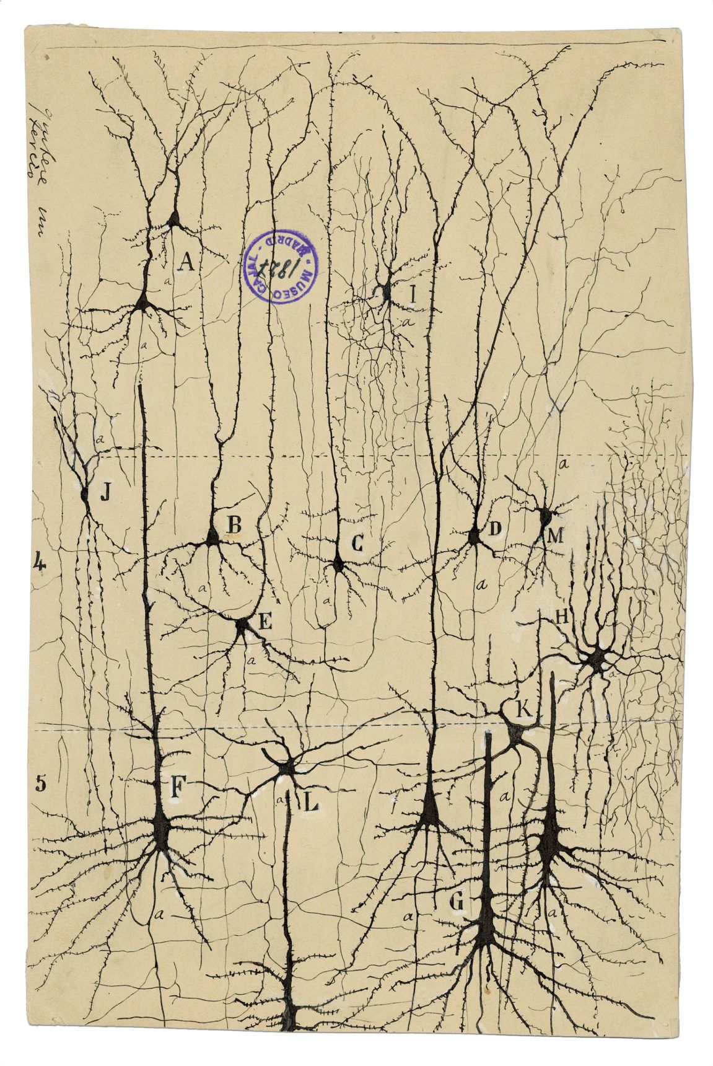
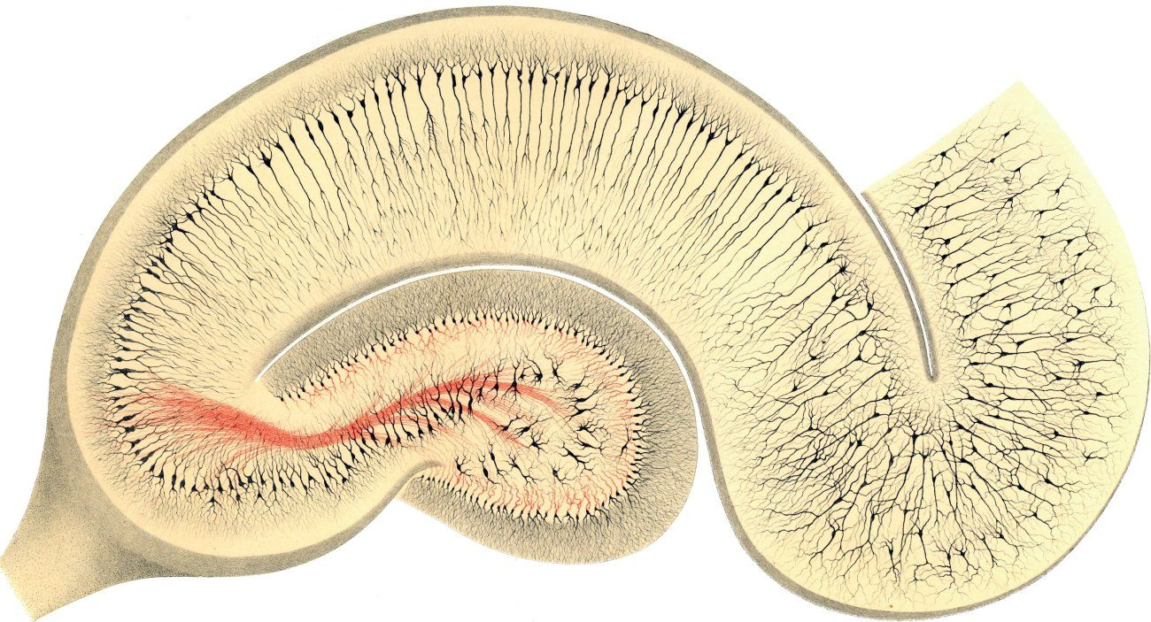
What is behavioural neuroscience?
HISTORY OF NEUROSCIENCE
CAMILLO GOLGI
1843-1926
RAMON Y CAYAL
1852-1934

Slide 28
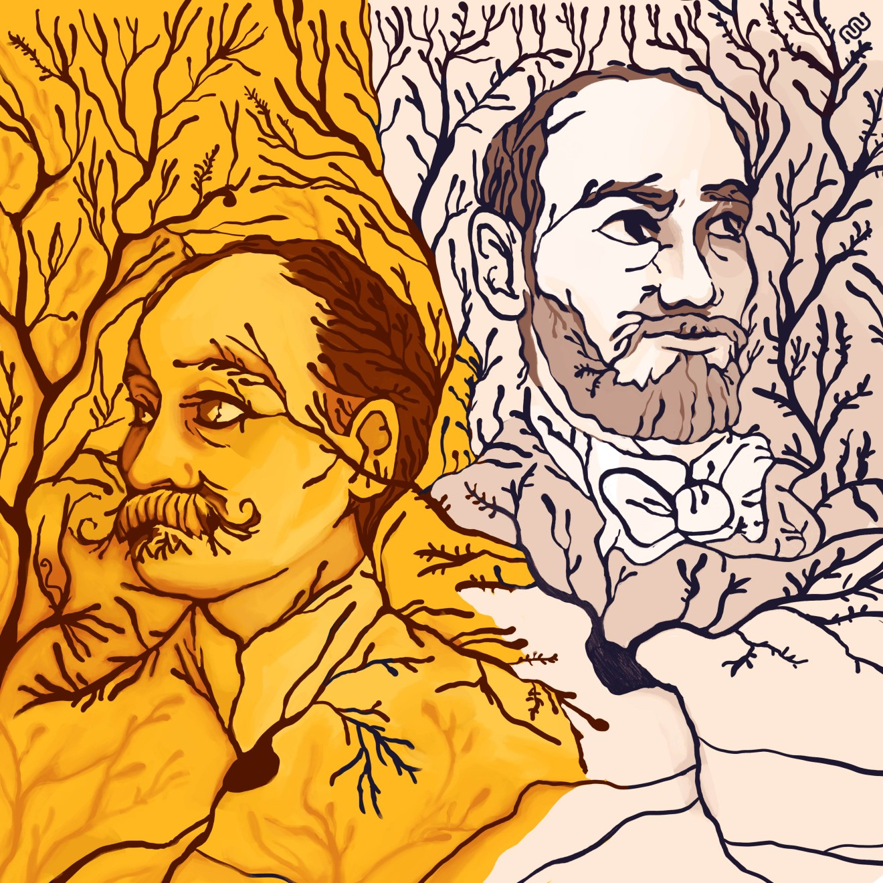
What is behavioural neuroscience?
HISTORY OF NEUROSCIENCE
CAMILLO GOLGI
1843-1926
RAMON Y CAYAL
1852-1934
The history showed that Ramón y Cajal was more correct. Golgi created the proper method to see the cells, but his conclusions were wrong

Slide 29
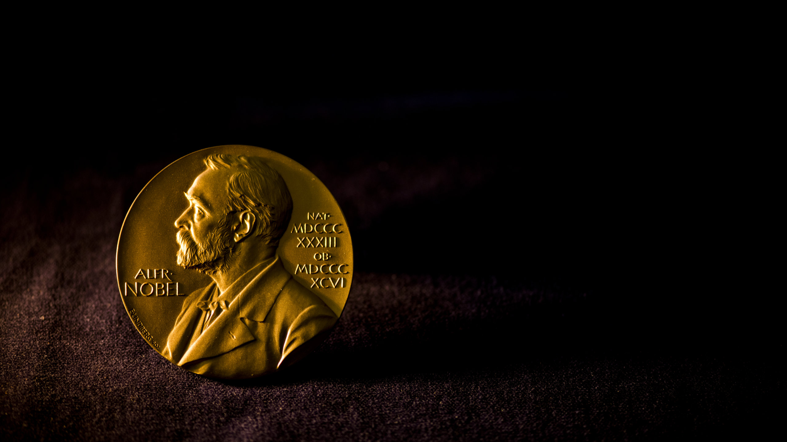
What is behavioural neuroscience?
HISTORY OF NEUROSCIENCE
CAMILLO GOLGI
1843-1926
RAMON Y CAYAL
1852-1934
Golgi criticized the colleague even in the Nobel lecture day !

Slide 30
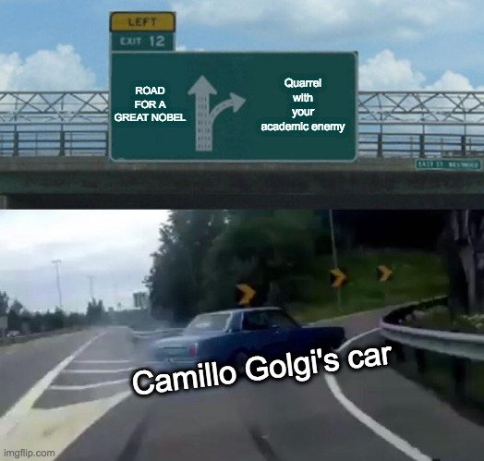
What is behavioural neuroscience?
HISTORY OF NEUROSCIENCE

Slide 31
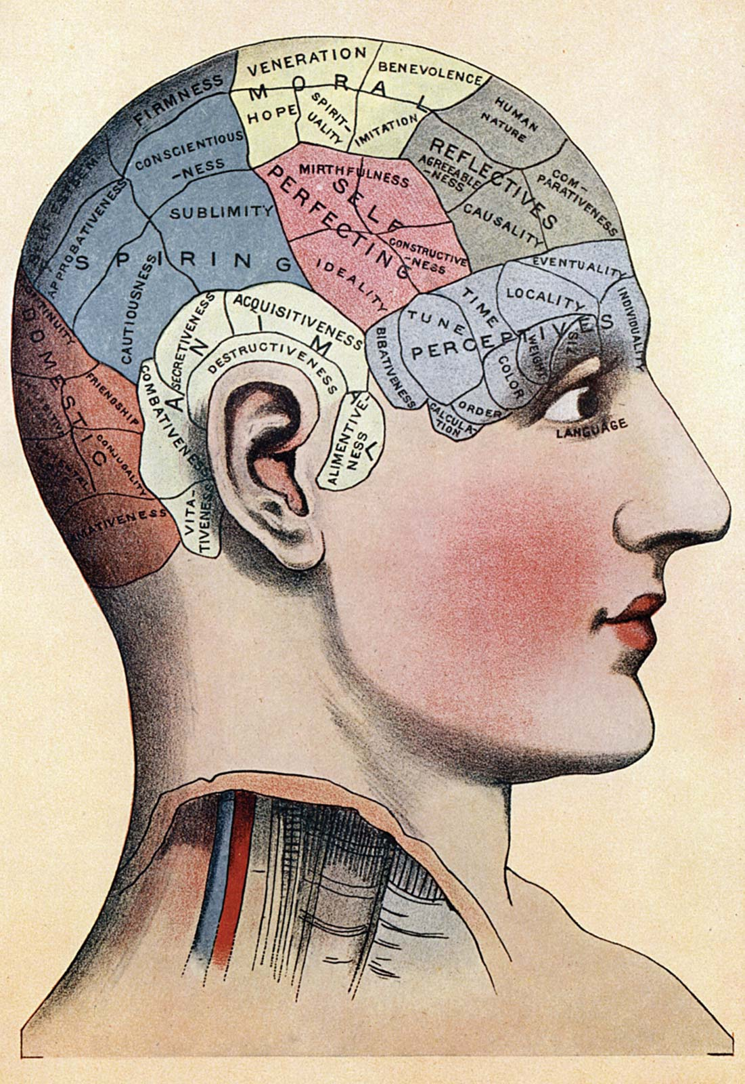
What is behavioural neuroscience?
HISTORY OF NEUROSCIENCE
PHRENOLOGY
The structure of people's skulls could be correlated with their individual personality characteristics and abilities
Bumps on the skull were believed to indicate that the underlying trait had been "exercised”.
Franz Josef Gall (1758- 1828) and then Johann G. Spurzheim (1776-1832).

Slide 32
What is behavioural neuroscience?
HISTORY OF NEUROSCIENCE
PHRENOLOGY
This is however the basis for modern neuroscience (you can localize cognitive functions in different parts of the brain)
Franz Josef Gall (1758- 1828) and then Johann G. Spurzheim (1776-1832).

Slide 33
What is behavioural neuroscience?
HISTORY OF NEUROSCIENCE
The beginning of modern neuropsychology
Paul Broca (mid 1800) correlated damages he observed in patients with their behavior and concluded that language functions were localized in the brain

Slide 34
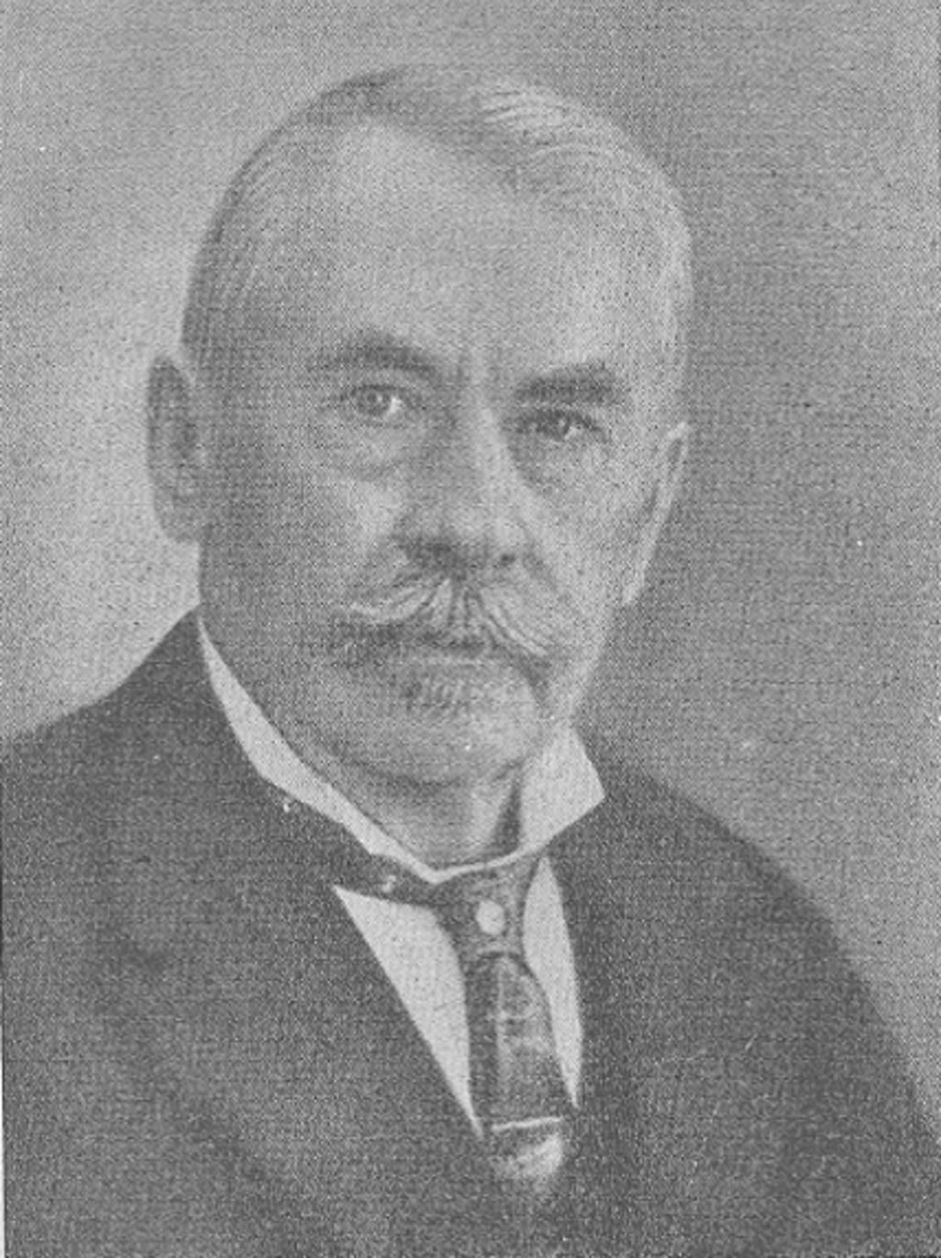
What is behavioural neuroscience?
HISTORY OF NEUROSCIENCE
The beginning of modern neuropsychology
Theodor Fritsch (1838-1927) and Eduard Hitzig (1838- 1907) described how electrically stimulating the cortex of a rabbit and a dog produced movement on the opposite side of the body

Slide 35
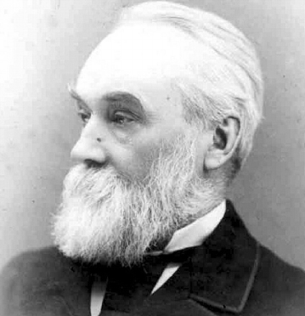
What is behavioural neuroscience?
HISTORY OF NEUROSCIENCE
The beginning of modern neuropsychology
John Hughlings Jackson (1835-1911). proposed that the nervous system was organized as a hierarchy, with simpler processing carried out by lower levels and more sophisticated processing carried out by higher levels, such as the cerebral cortex.

Slide 36
What is behavioural neuroscience?
HISTORY OF NEUROSCIENCE
The beginning of modern neuropsychology
We normally inhibit aggressive behaviors, associated with activity in lower levels of the brain, by engaging our higher cortical executive functions.
E.g., when a person consumes alcohol, the cortical inhibition might fail..

Slide 37
What is behavioural neuroscience?
HISTORY OF NEUROSCIENCE
1932: Charles Sherrington coins the term synapse
1970: Bernard Katz for his work on chemical transmission at the synapse
2000: Eric Kandel received the Nobel for his study on neurobiology of learning

