Slide 1
SLEEP THROUGHOUT THE LIFE SPAN

Slide 2
Nightly sleep patterns change as a function of age.
QUANTITY
(more / less hours)
QUALITY
(sleep phases)

Slide 3
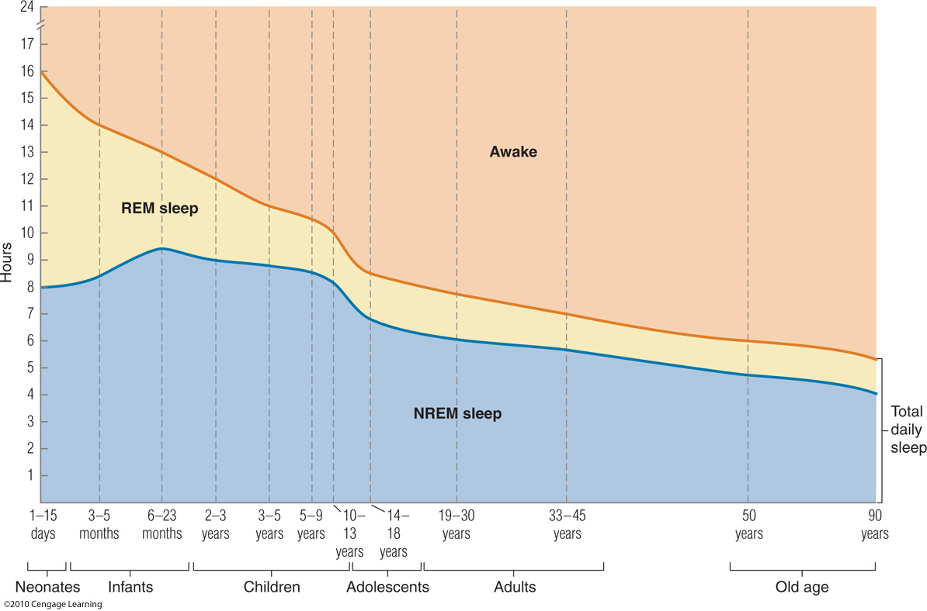

Slide 4
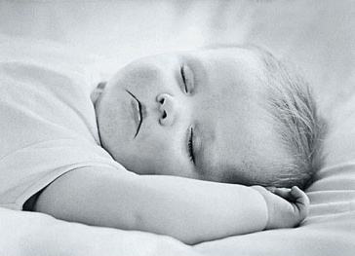
14-16 hours sleeping
50% REM, 50% non-REM

Slide 5

1 Year:
13 hours sleeping
< % REM
Irregular sleep

Slide 6

1-5 Years:
8.7 hours sleeping
High % of non-REM sleep (stage 3 e 4)

Slide 7

Puberty:
Decrease in REM and a substantial decrease in Stages 3 and 4 sleep

Slide 8

25-35 years:
Further decline of stage 3-4
(from 20% to 5%)

Slide 9
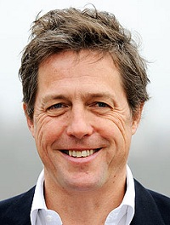
50 Years -
Total sleep time decreases by about 27 minutes per decade;
Reduction in sleep spindles (useful to keep sleeping)
NO DEEP SLEEP, as few 3-4 stages

Slide 10
We sleep less
We lose REM
We lose deep stages of NREM

Slide 11
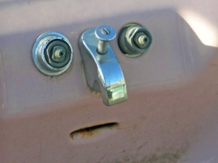
You cannot read all this stuff..
Mr. Sad Sink

Slide 12
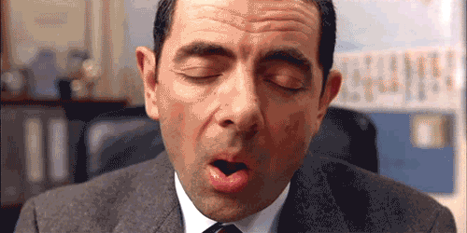
SLEEP AND WAKING
PLAN OF THE LESSON
Circadian Rhythms
Sleep and EEG
Dreams
Neurobiology of sleep
Sleep disorders

Slide 13

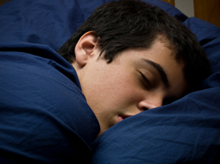

Slide 14


Dreaming behavior occurs during both REM sleep and NREM
REM:
Lengthy,
Complicated,
Vivid
Storylike
NREM
Short episodes
Single images (in a logical sequence)
Lack of emotion.

Slide 15


Dude, did you dream something ?
Let me tell you ..
Umh… don’t remember.
REM:
> Probability that people remember the dream
NREM:
< Probability

Slide 16
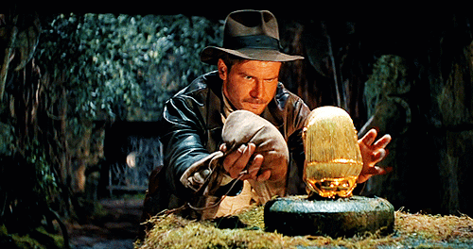


What do we dream ?
Hall (1951) reviewed the content of thousands of dreams…
Adventurous life?
Erotic dreams?
Horror stories?

Slide 17
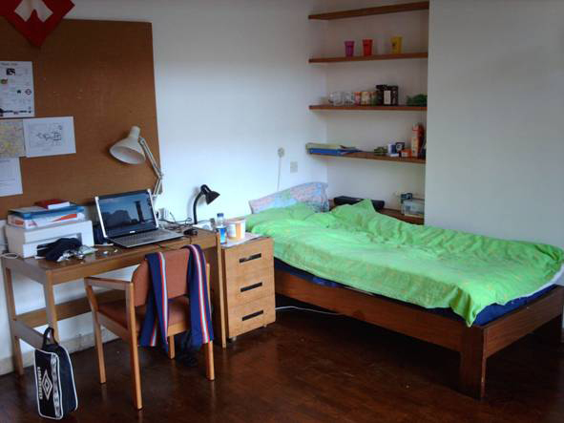
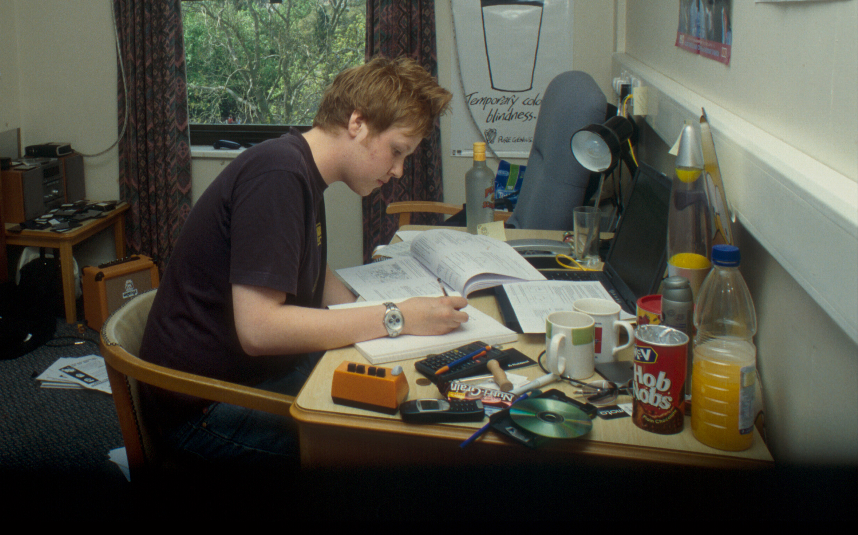

What do we dream ?
Hall (1951) reviewed the content of thousands of dreams…
Familiar place
I was in my room..
I was studying for the best course even done (Mondini-Agrillo, of course)
Routine activities
15% characters in the dream
(often as “director” of the movie)
I was seen the event from the outside..
Then some other students knock at my door..
Imaginary strangers

Slide 18
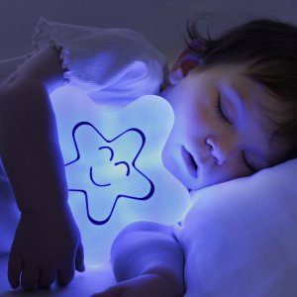
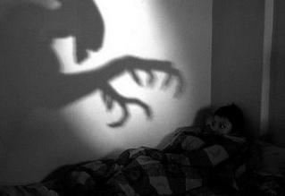
What do we dream ?
Sweet dreams ? Not really..
70 % of our dreams have negative emotional content
College students nightmares:
being chased,
falling,
flying,
appearing naked,
being unable to find a restroom,
being frozen with fright,
taking exams for which one is unprepared (never happen with “Brain and Behaviour”)

Slide 19

What do we dream ?
Viewing upsetting entertainment (horror movies) or reports of natural disaster increases the likelihood of negative dreams.

Slide 20
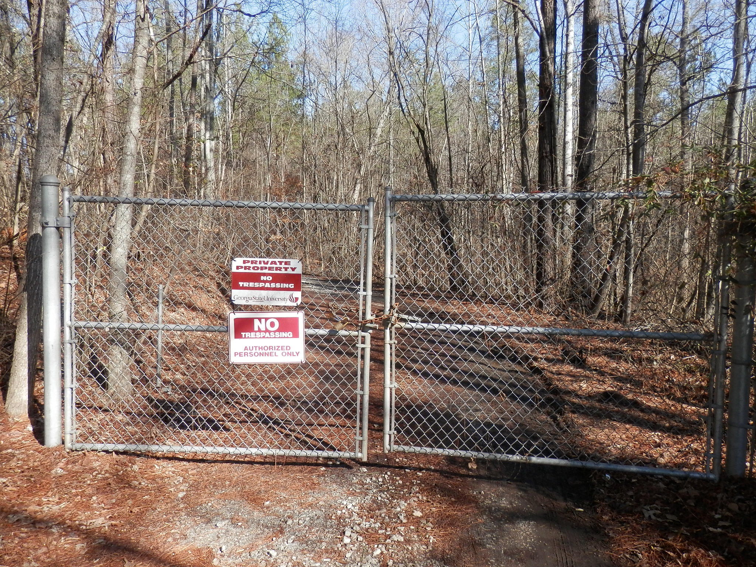





THAT’S TRUE, TRUST ME !
House
Entrance with old-fashion gate
Old cemetery
Falling tree after storms prevents us to leave the house quite often..

Slide 21
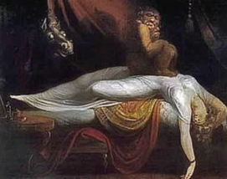
If particularly bad
REM
NREM
NIGHTMARES
NIGHT TERRORS
Late in sleep cycle
Time of night
Within 4 hours of bedtime
Upset, scared
State on waking
Disoriented, confused
Response to caregivers
Unaware of presence, not consolable
Comforted
Memory of events
None unless fully awakened.
Feeling of oppression
Vivid recall of dream
Return to sleep
Usually rapid unless fully awakened
Often delayed by fear

Slide 22
If particularly bad
REM
NREM
NIGHTMARES
NIGHT TERRORS
Late in sleep cycle
Time of night
Within 4 hours of bedtime
Upset, scared
State on waking
Disoriented, confused
Response to caregivers
Unaware of presence, not consolable
Comforted
Memory of events
None unless fully awakened.
Feeling of oppression
Vivid recall of dream
Return to sleep
Usually rapid unless fully awakened
Often delayed by fear

Slide 23
If particularly bad
REM
NREM
NIGHTMARES
NIGHT TERRORS

Slide 24


Lucid dreaming
Dreamer is aware that he or she is dreaming and uses this awareness to control or direct the content of the dream

Slide 25
Lucid dreaming
TEMPORAL ESTIMATION OF EVENTS OCCURRING DURING DREAMS
Please signal the onset of one activity (running around a building) with specific dream actions that would be observable on a polygraph (i.e., eye movements and fist clenches)
Please do the same at the end of the activity (so we record the time spent to do it during a dream)
THE SAME DURATION COMPARED TO A REAL EVENT !

Slide 26
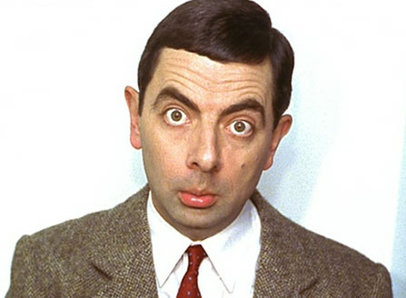
WHY DO WE DREAM ?
Uhm, why…
As in other research fields, we have recently collected several information that helped us to understand “how” it happens (the description of the event)..
.. Another aspect is to understand “why”..

Slide 27
WHY DO WE DREAM ?
1) Activation-synthesis theory
(Hobson & McCarley, 1977)
Content of dreams reflects ongoing neural activity.
When sleeping volunteers were sprinkled with water, they reported dreams of rain and other water-related themes.

Slide 28
WHY DO WE DREAM ?
1) Activation-synthesis theory
(Hobson & McCarley, 1977)
Content of dreams reflects ongoing neural activity.
When sleeping volunteers were sprinkled with water, they reported dreams of rain and other water-related themes.
Dreams of being unable to move in a dangerous situation accurately mirror the muscle paralysis present during the REM state.

Slide 29
WHY DO WE DREAM ?
1) Activation-synthesis theory
(Hobson & McCarley, 1977)
Content of dreams reflects ongoing neural activity.
When sleeping volunteers were sprinkled with water, they reported dreams of rain and other water-related themes.
Dreams of being unable to move in a dangerous situation accurately mirror the muscle paralysis present during the REM state.
Common dreams of flying or falling could be caused by the unusual activation of the vestibular system during REM sleep

Slide 30
WHY DO WE DREAM ?
1) Activation-synthesis theory
(Hobson & McCarley, 1977)
Content of dreams reflects ongoing neural activity.
When sleeping volunteers were sprinkled with water, they reported dreams of rain and other water-related themes.
Dreams of being unable to move in a dangerous situation accurately mirror the muscle paralysis present during the REM state.
Common dreams of flying or falling could be caused by the unusual activation of the vestibular system during REM sleep
Dreams with sexual content are consistent with the physical sexual arousal that occurs during REM sleep

Slide 31
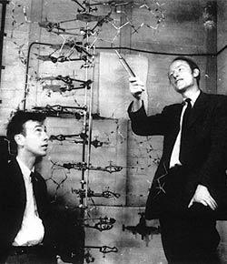
WHY DO WE DREAM ?
2) Forget irrelevant and unnecessary information
(Crick & Mitchison, 1983)
3) Dreams as a way to practice (as game)
Dreaming is viewed as a way to simulate escape from threatening situations (cats often dream to hunt something)

Slide 32

And why do we sleep ?
Ehm, why..
3 main functions
To keep us safe
To restore our bodies
To help us remember
Dr. Nicola Cellini

Slide 33


And why do we sleep ?
1) TO KEEP US SAFE
Sleep prevents animals from being active when they are NOT safe from predation
Active during day: diurnal species (Humans)
Active during night: nocturnal species (Owls)

Slide 34
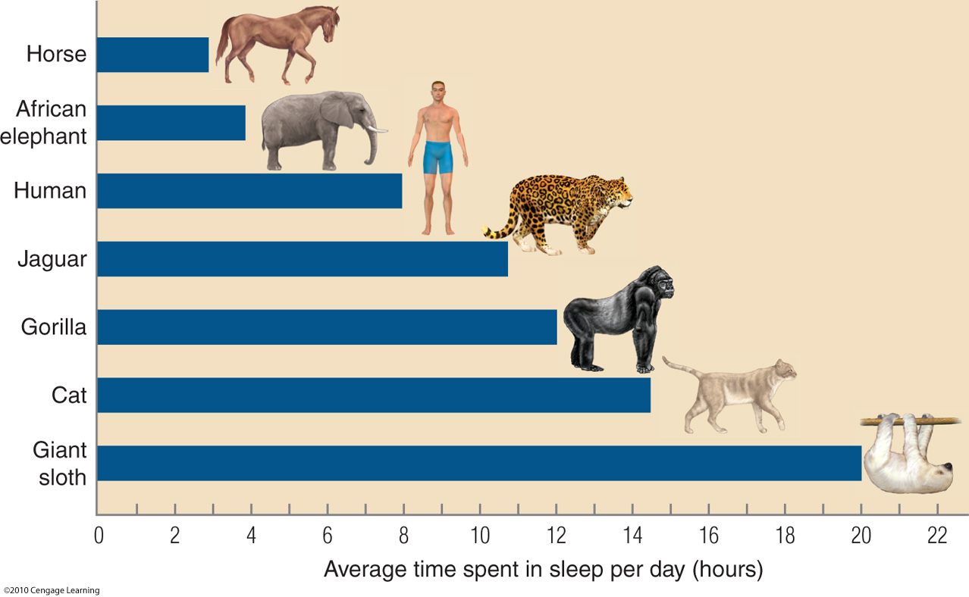
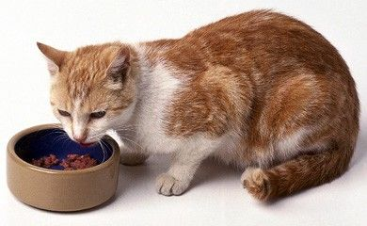
And why do we sleep ?
1) TO KEEP US SAFE
We can predict the amount of time an animal will sleep on the basis of its risk of predation and whether it has a safe place
Horses are heavily preyed in the wild..
Predators can sleep longer..

Slide 35


And why do we sleep ?
2) TO RESTORE OUR BODIES
Sleep (particularly NREM) helps us restore our bodies and conserve energy.
Metabolism rates are positively correlated with the production of free radicals, which can be harmful to many tissues.
Small animals
> Metabolic rate (15 years)
> Sleep
Large animals
< Metabolic rates (50 years)
< Sleep
Free radicals
Metabolic rate
Free radicals are highly reactive and unstable molecules, usually oxygen molecules.
Their unstable nature is caused by having an unpaired electron. As a result of this unpaired electron, free radicals seek out and take electrons from other molecules, which oftentimes causes damage to the second molecule.

Slide 36
And why do we sleep ?
2) TO RESTORE OUR BODIES
Sleep (particularly NREM) helps us restore our bodies and conserve energy.
Metabolism rates are positively correlated with the production of free radicals, which can be harmful to many tissues.
Small animals
> Metabolic rate (15 years)
> Sleep
Large animals
< Metabolic rates (50 years)
< Sleep
Free radicals
Metabolic rate
During NREM sleep, lower body temperatures and rates of metabolism might provide an ideal environment for repairing the damage produced by free radicals during wakefulness

Slide 37
And why do we sleep ?
2) TO RESTORE OUR BODIES
Sleep (particularly NREM) helps us restore our bodies and conserve energy.
Most growth hormone (GH) is released during Stage 3 and Stage 4 NREM.
In childhood, GH is primarily responsible for physical growth but, throughout life, it contributes to building muscle and bone mass and maintaining immune system function.

Slide 38
And why do we sleep ?
2) TO RESTORE OUR BODIES
Sleep (particularly NREM) helps us restore our bodies and conserve energy.
Sleep is important because of the production of this hormone,
Growth hormone levels are reduced by sleep deprivation

Slide 39
And why do we sleep ?
3) TO HELP US REMEMBER
Originally, many psychologists believed that the positive role of sleep in memory formation resulted from a lack of interference. In other words, you were more likely to remember things you learned right before sleep because sleep limited the amount of new data entering the system.
Maybe there is something more…
Sleep-related memory processes might involve the reorganization of existing memory systems to accommodate new information

Slide 40
And why do we sleep ?
3) TO HELP US REMEMBER
Staying up all night resulted in poor memory retention for a visual task, and two additional nights of sleep did not compensate for the initial deprivation

Slide 41

Night before the exams ?
Go to bed, sleep and you will optimize the chance of remembering what you have studied.

Slide 42
And why do we sleep ?
3) TO HELP US REMEMBER
Staying up all night resulted in poor memory retention for a visual task, and two additional nights of sleep did not compensate for the initial deprivation
Memories for word pairs were stronger following a period of NREM than following a period of wakefulness

Slide 43
And why do we sleep ?
3) TO HELP US REMEMBER
REM sleep improves the retention of highly emotional material
Memories for procedures, such as how to solve a puzzle or ride a bicycle, are enhanced following Stage 2 NREM sleep

Slide 44

BENEFITS OF NREM SLEEP
After a night of deprivation of 3-4 stages, volunteers typically complain of muscle and joint pain
Elderly people has:
< Stage 3-4 NREM sleep
> Muscle and joint pain
Runners competing in ultramarathons (twice the length of a marathon) add 20-30 minutes of sleep in the following night.
Most of this increase is NREM.

Slide 45
BENEFITS OF REM SLEEP
Only birds and mammals show true REM sleep.
Identifying a function for REM sleep is challenging.
REM sleep increases after having learned something..

Slide 46
BENEFITS OF REM SLEEP
Only birds and mammals show true REM sleep.
Identifying a function for REM sleep is challenging.
Brain development
The large proportion of REM sleep observed in young children correlates with periods of time in which the brain is undergoing great changes
REM rebound
After days of deprivation, we spend an unusually large amount of their sleep time in REM.
The fact that we try to make up for lost REM sleep suggests that REM sleep may be crucial for brain survival.

Slide 47
SLEEP AND WAKING
PLAN OF THE LESSON
Circadian Rhythms
Sleep and EEG
Dreams
Neurobiology of sleep
Sleep disorders

Slide 48
THE CONTROL OF WAKEFULNESS

Slide 49
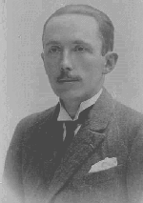
THE CONTROL OF WAKEFULNESS
Frederic Bremer

Slide 50
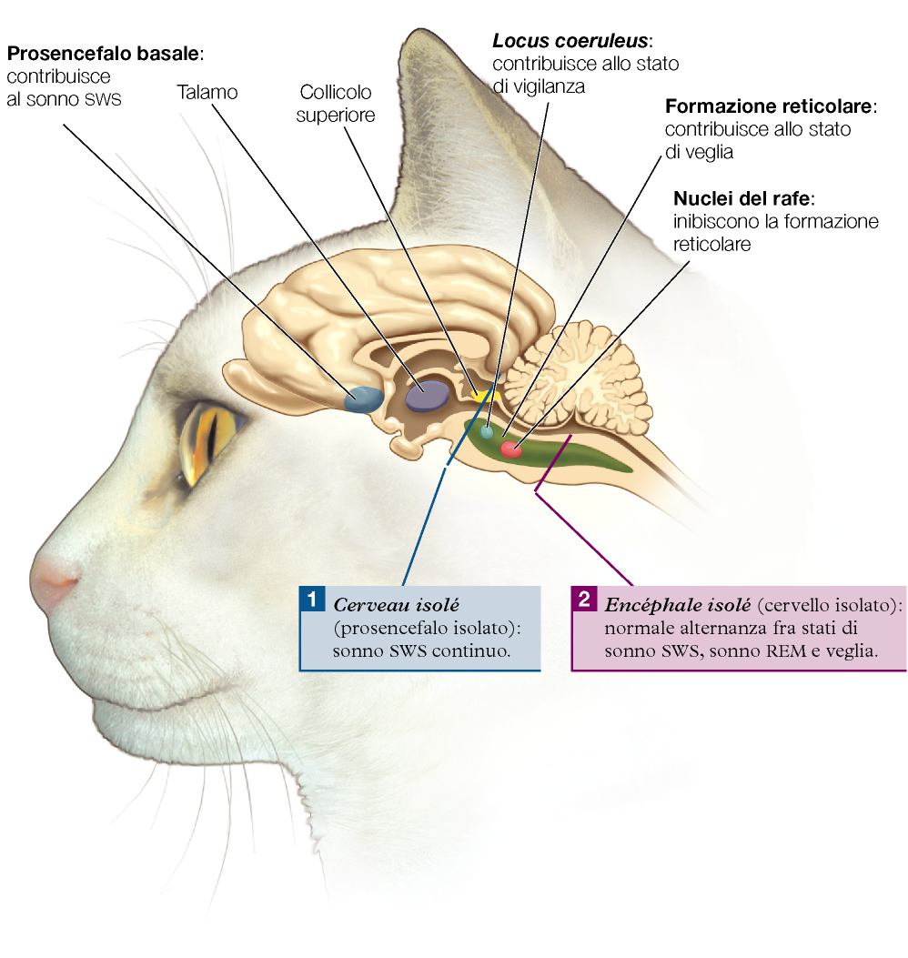
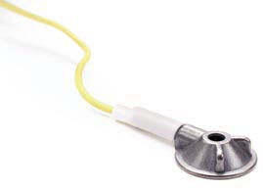
THE CONTROL OF WAKEFULNESS
He recorded brain activity…
Cerveau isolè
transection through the brainstem between the superior and inferior colliculi.
Frederic Bremer
The cat showed permanent synchronized EEG
(always SLEEP)

Slide 51
THE CONTROL OF WAKEFULNESS
He recorded brain activity…
Encephale isolè
transection at the caudal end of the medulla, just above the spinal cord.
Frederic Bremer
The cat showed normal sleep and waking cycles.

Slide 52
THE CONTROL OF WAKEFULNESS
2 Main Conclusions
Sleep does not primarily depends on spinal cord
(they could sleep even without input from spinal cord)
2) The center of wakefulness must be in the reticular formation.
Frederic Bremer

Slide 53
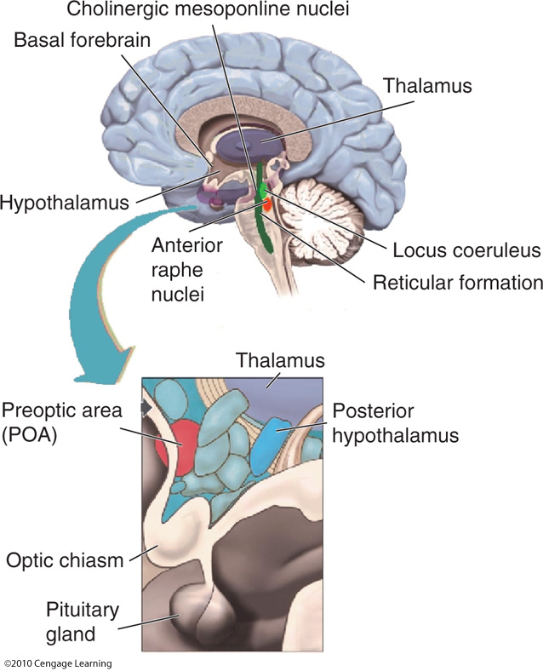
THE CONTROL OF WAKEFULNESS
No one structure is uniquely responsible for wakefulness.

Slide 54
THE CONTROL OF WAKEFULNESS

Slide 55
THE CONTROL OF NREM

Slide 56
THE CONTROL OF REM

Slide 57
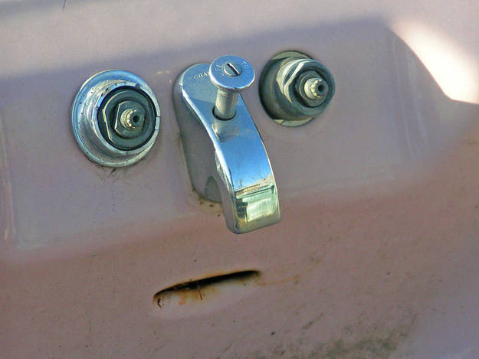
SO, TAKEN TOGETHER…

Slide 58
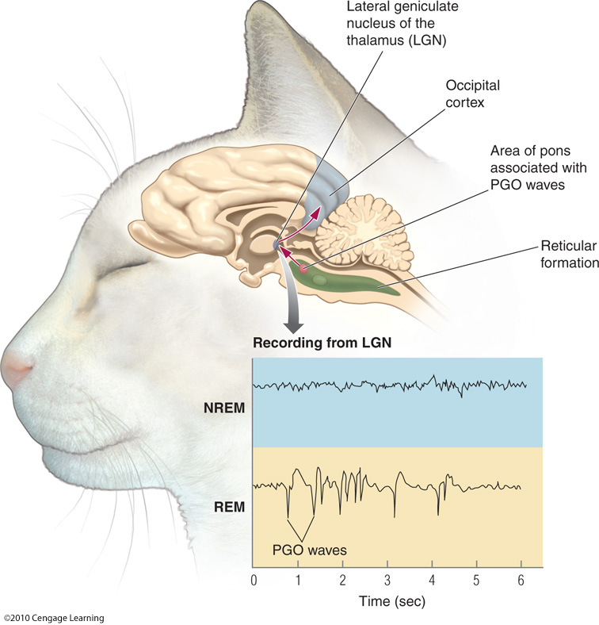
Pons-Geniculate- Occipital Spikes (PGO)
An electrical waveform observed during REM sleep
Pons
Thalamus
Occipital cortex

Slide 59
Pons-Geniculate- Occipital Spikes (PGO)
An electrical waveform observed during REM sleep
Pons
Thalamus
Occipital cortex

Slide 60
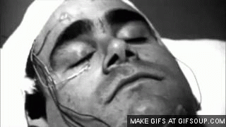
Pons-Geniculate- Occipital Spikes (PGO)
Each PGO wave is associated with an eye movement

