Slide 1
GENETICS
& THE DEVELOPMENT OF THE HUMAN BRAIN
Christian Agrillo

Slide 2
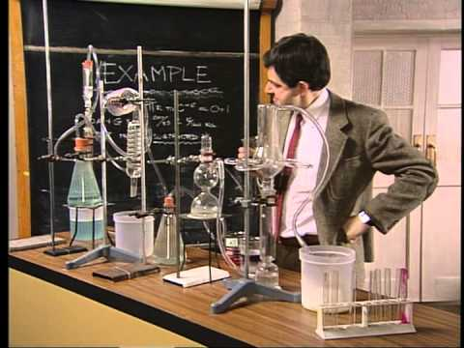
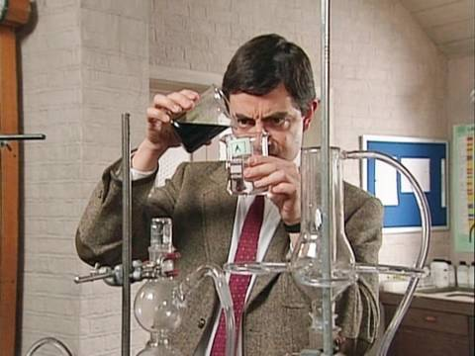
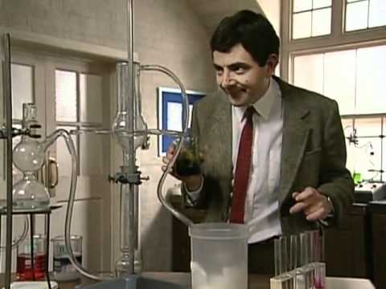
CHAPTER 5
We are going to talk about..
Genetics and Behaviour
DNA structure
DNA transcription and translation
Genes-Environment interaction
Sources of genetic diversity
2) Development of neural system
Growth and differentiation of the nervous system
Effect of experience on development
Disorders of brain development
Redevelopment in response to damage
The adult nervous system

Slide 3
CHAPTER 5
We are going to talk about..
Genetics and Behaviour
DNA structure
DNA transcription and translation
Genes-Environment interaction
Sources of genetic diversity
2) Development of neural system
Growth and differentiation of the nervous system
Effect of experience on development
Disorders of brain development
Redevelopment in response to damage
The adult nervous system

Slide 4
CHAPTER 5
The great majority of structures in a cell are proteins or have been made by proteins.

Slide 5
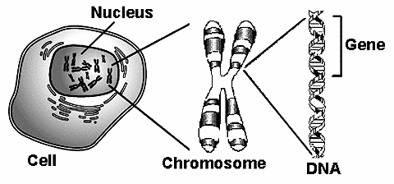
CHAPTER 5
GENE
A functional hereditary unit
CHROMOSOME
DNA
Molecules that compose chromosomes
A strand of DNA within the nucleus
(23 pairs)
Notes:
5

Slide 6
CHAPTER 5
GENE
CHROMOSOME
DNA
Notes:
6

Slide 7
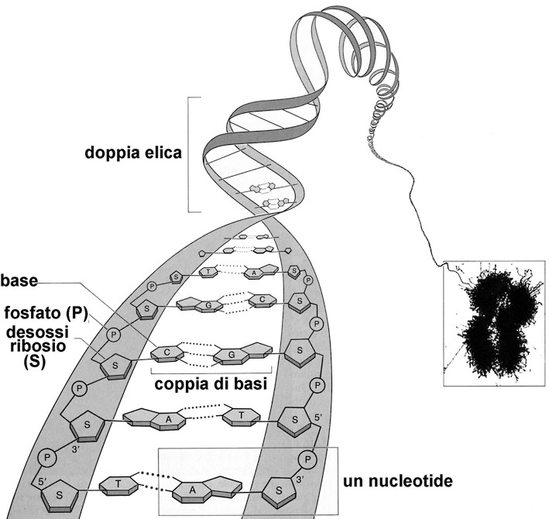
CHAPTER 5
DNA stands for Deoxyribose Nucleic Acid
DNA is a very large molecule made up of a long chain of sub-units, called Nucleotides
Each nucleotide is made up of:
1) A sugar called deoxyribose
2) a phosphate group
3) an organic base
Nucleotide
Nucleotide
Notes:
7

Slide 8
CHAPTER 5
DNA stands for Deoxyribose Nucleic Acid
DNA is a very large molecule made up of a long chain of sub-units, called Nucleotides
Each nucleotide is made up of:
Ribose is a sugar, like glucose, but with only five
carbon atoms in its molecule
1) A sugar called deoxyribose
2) a phosphate group
Deoxyribose is almost the same but lacks one
oxygen atom
3) an organic base
Both molecules may be represented by the symbol
Notes:
8

Slide 9
CHAPTER 5
DNA stands for Deoxyribose Nucleic Acid
DNA is a very large molecule made up of a long chain of sub-units, called Nucleotides
Each nucleotide is made up of:
1) A sugar called deoxyribose
2) a phosphate group
3) an organic base
A phosphate group is attached to the sugar molecule in place of the -OH group on the 5' carbon.
It is also called PO₄
Notes:
9

Slide 10
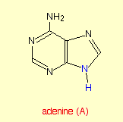
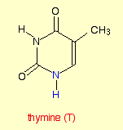
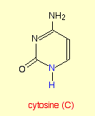
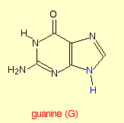
CHAPTER 5
DNA stands for Deoxyribose Nucleic Acid
DNA is a very large molecule made up of a long chain of sub-units, called Nucleotides
Each nucleotide is made up of:
1) A sugar called deoxyribose
They are 4 different organic bases
2) a phosphate group
3) an organic base
Notes:
10

Slide 11
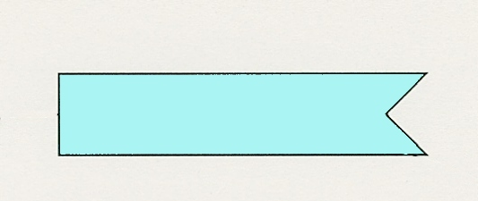
CHAPTER 5
DNA stands for Deoxyribose Nucleic Acid
DNA is a very large molecule made up of a long chain of sub-units, called Nucleotides
Adenine (A)
Each nucleotide is made up of:
1) A sugar called deoxyribose
Thymine (T)
2) a phosphate group
3) an organic base
Cytosine (C)
Guanine (G)
Notes:
11

Slide 12
CHAPTER 5
DNA stands for Deoxyribose Nucleic Acid
DNA is a very large molecule made up of a long chain of sub-units, called Nucleotides
Adenine (A)
Thymine (T)
Cytosine (C)
Guanine (G)
Notes:
12

Slide 13
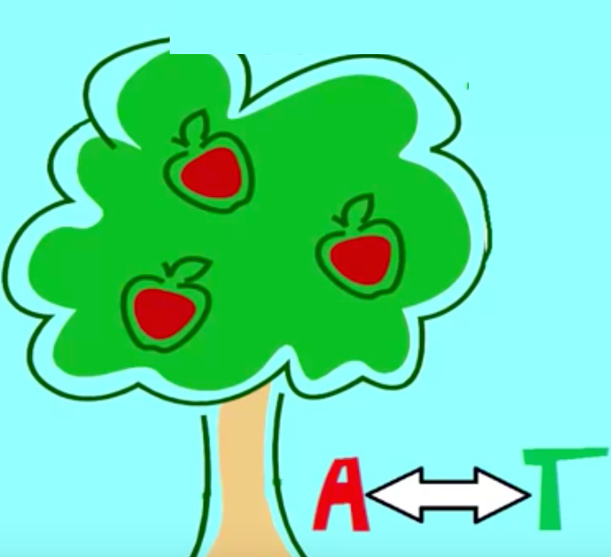
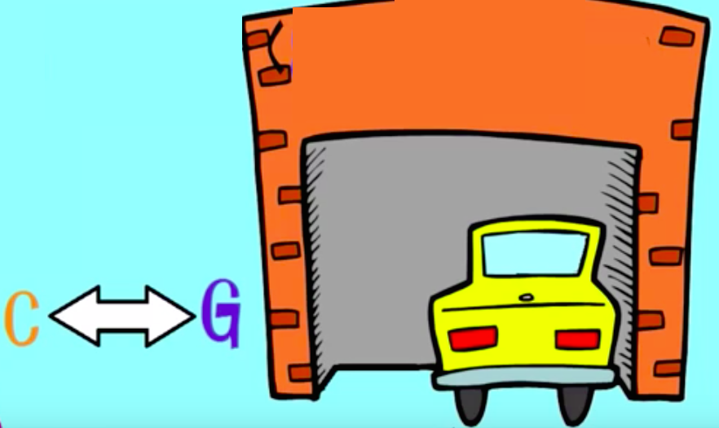
CHAPTER 5
DNA stands for Deoxyribose Nucleic Acid
DNA is a very large molecule made up of a long chain of sub-units, called Nucleotides
A VISUAL STRATEGY
Apple in the Tree
(Adenine – Thymine)
Car in the Garage
(Cytosine - Guanine)
Notes:
13

Slide 14
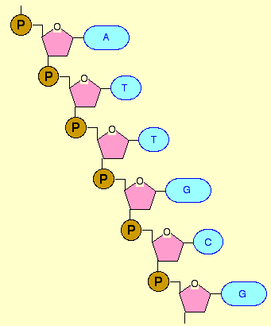
CHAPTER 5
A molecule of DNA is formed by millions of nucleotides joined together in a long chain
However, DNA consists of a double strand of nucleotides !
Notes:
14

Slide 15
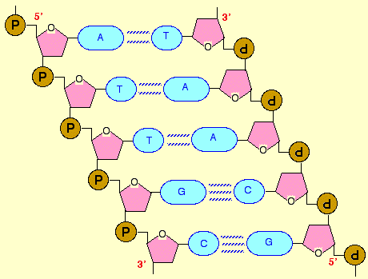
CHAPTER 5
The bases always pair up in the same way:
A-T (2 hydrogen bonds)
C-G (3 hydrogen bonds)
Notes:
15

Slide 16
CHAPTER 5
Notes:
16

Slide 17
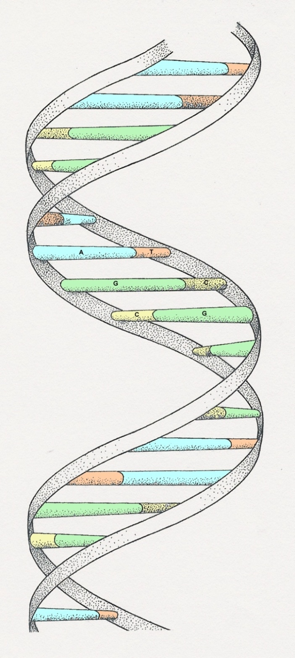
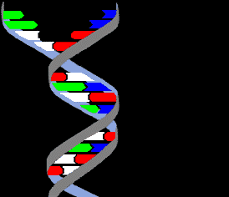
CHAPTER 5
The paired strands are coiled into a spiral called A DOUBLE HELIX
Bases
Sugar-phosphate chain

Slide 18
CHAPTER 5

Slide 19
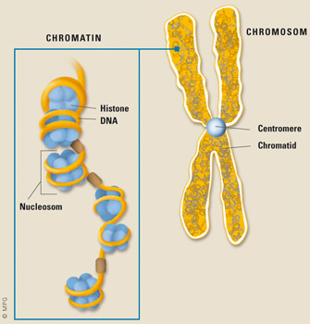
CHAPTER 5
From DNA to chromosome
proteins
Histones + DNA

Slide 20
CHAPTER 5
From DNA to chromosome
proteins
Histones + DNA

Slide 21
CHAPTER 5
From DNA to chromosome
proteins
Histones + DNA

Slide 22
CHAPTER 5
0:00-1:20

Slide 23
CHAPTER 5
We are going to talk about..
Genetics and Behaviour
DNA structure
DNA transcription and translation
Genes-Environment interaction
Sources of genetic diversity

Slide 24
CHAPTER 5
The combination of the four bases represents a sort of “language”…
This must be converted in aminoacids!

Slide 25
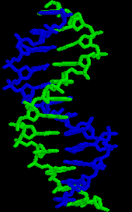
CHAPTER 5
HOW DOES IT WORK?
Imagine you have just seen a Chinese sentence…
You have not the pale idea of what it means…
… still you are attracted by it !

Slide 26
CHAPTER 5
HOW DOES IT WORK?
Imagine you have just seen a Chinese sentence…
1) TRANSCRIPTION
2) TRANSLATION

Slide 27
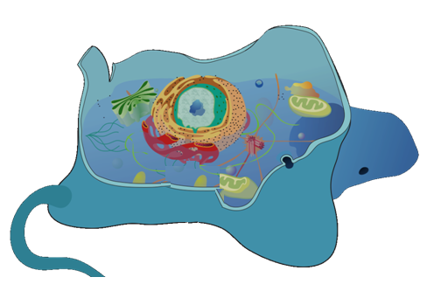
CHAPTER 5
TRASCRIPTION
(Nucleus)
2) TRANSLATION
(citoplasm)

Slide 28
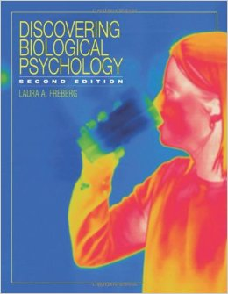
CHAPTER 5
1) Transcription

Slide 29
CHAPTER 5
1) Transcription
An enzyme called RNA polymerase attaches to the start of the genes
It moves along DNA making a strand of messenger RNA out of free basis in the nucleus
(a sequence of 3 bases in DNA s called codon)
It opens the 2 strands

Slide 30
CHAPTER 5
1) Transcription
An enzyme called RNA polymerase attaches to the start of the genes
In RNA Timine is substituted by Uracil
It moves along DNA making a strand of messenger RNA out of free basis in the nucleus
(a sequence of 3 bases in DNA molecular is called codon)

Slide 31
CHAPTER 5
Before translation, we need to remove non-coding sections of mRNA:
“intron splicing”
Only exons are present

Slide 32
CHAPTER 5
At this stage, the messenger RNA moves out of the nucleus into the cytoplasm

Slide 33
CHAPTER 5
2) Translation

Slide 34
CHAPTER 5
2) Translation
Protein factors called ribosomes bind to the messenger RNA and reads the code
In the cytoplasm there is transfer RNA molecules that will carry the amino acids

Slide 35
CHAPTER 5
2) Translation
As each triplet is read, a transfer RNA delivers the corresponding amino acids
All these aminoacids finally form the protein

Slide 36
CHAPTER 5
A summary of these processes….

Slide 37
CHAPTER 5
We are going to talk about..
Genetics and Behaviour
DNA structure
DNA transcription and translation
Genes-Environment interaction
Sources of genetic diversity
Notes:
So during these 2 lessons we will talk about GENETICS and Behaviour (in particular…)
In the second part we will talk about the development of neural system

Slide 38
CHAPTER 5
“… Exeter, Harvard - he's the product of good environment.
It's got nothing to do with environment.
With his genes, you could put him anywhere and he'd come out on top..”

Slide 39
CHAPTER 5
Poor
Rich
What’s the role of genes in behaviour?

Slide 40
CHAPTER 5
But before proceeding.. it’s dictionary time !

Slide 41
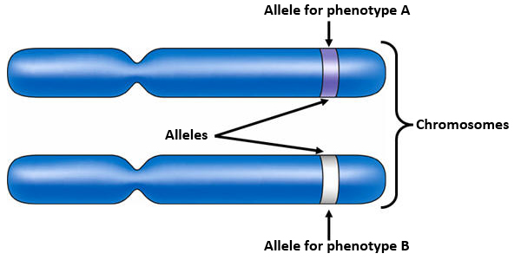
CHAPTER 5
Alleles
Alternative versions of a particular gene
2 CONDITIONS
Homozygous
If a person has 2 identical alleles of a particular gene
(A-A o B-B)
Heterozygous
Different alleles of a particular gene
(A-B o B-A)

Slide 42
CHAPTER 5
Alleles
Alternative versions of a particular gene
2 CONDITIONS
Homozygous
If a person has 2 identical alleles of a particular gene
Heterozygous
Different alleles of a particular gene
Recessive alleles will produce its phenotype only in this condition

Slide 43
CHAPTER 5
Alleles
Alternative versions of a particular gene
2 CONDITIONS
Homozygous
If a person has 2 identical alleles of a particular gene
Heterozygous
Different alleles of a particular gene
Dominant alleles will produce its phenotype in both conditions

Slide 44
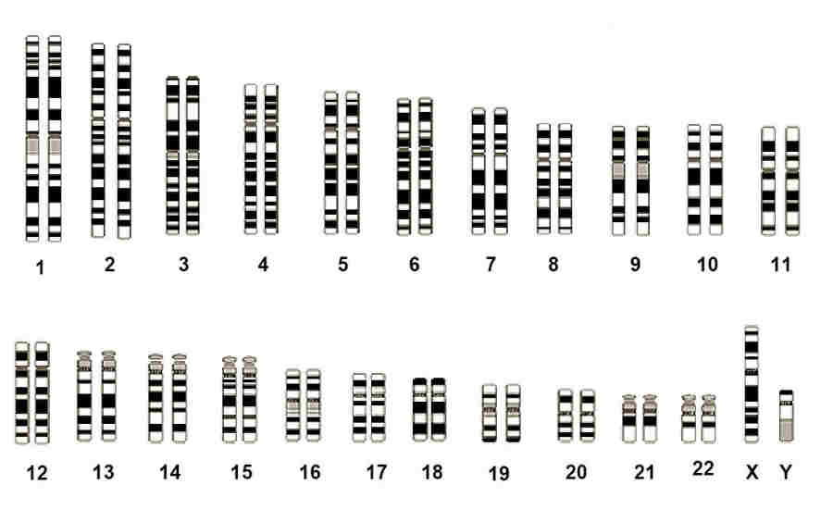
CHAPTER 5
Genome:
A complete set of chromosomes
Genotype:
Genetic composition of an organism
Phenotype:
The observable appearance of an organism
(genome + environment)

Slide 45
CHAPTER 5
Interacts
Phenotype

Slide 46
CHAPTER 5
IN DETAILS..

Slide 47
CHAPTER 5
How can we understand the exact role of heritability ?

Slide 48
CHAPTER 5
How can we understand the exact role of heritability ?

Slide 49
CHAPTER 5
How can we understand the exact role of heritability ?
As the environment is the same, differences are due to heritability

Slide 50
CHAPTER 5
How can we understand the exact role of heritability ?
As the environment is the same, differences are due to heritability

Slide 51
CHAPTER 5
How can we understand the exact role of heritability ?
???
As the environment is different, you cannot dissociate the role of genes and environment.

Slide 52
CHAPTER 5
How can we understand the exact role of heritability ?
Eddie Murphy and Dan Aykroyd lived in two different environments since they were born, thus Mortimer brothers could not finely study it

Slide 53
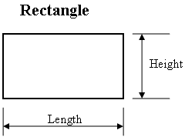
CHAPTER 5
So, doctor, what is more important – genes or environment?
This is a tricky question…
What’s the most important determinant of the area of a rectangle, its height or length?
Both dimensions are fundamental.

Slide 54
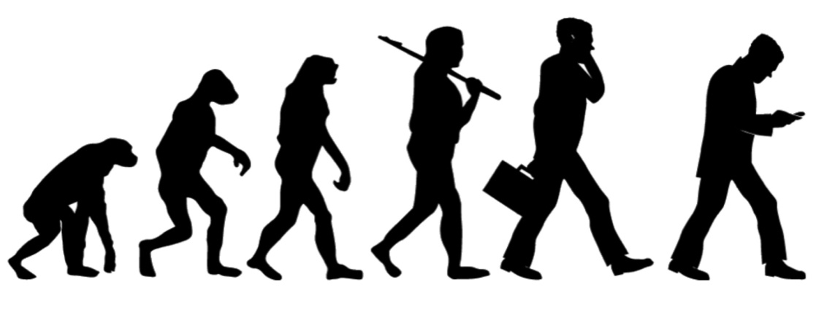
CHAPTER 5
So, doctor, what is more important – genes or environment?
This is a tricky question…
Don’t forget that evolution selected us in a way that we can promptly react to environmental variation.
So we have a “genetic program”, but it is not a “fixed” program (as many computer software); instead it can be modified by environmental conditions.

Slide 55
CHAPTER 5
How can we understand the exact role of heritability ?
Role of the Heritability:
Adopted children
(≠ genes; = environment)
Role of the Environment:
Twins living in different families
(= genes; ≠ environment)

Slide 56
CHAPTER 5
How can we understand the exact role of heritability ?
Are twins living in the same family useful for this topic?
(= genes, = environment)
you cannot dissociate the contribute of the 2 factors

Slide 57
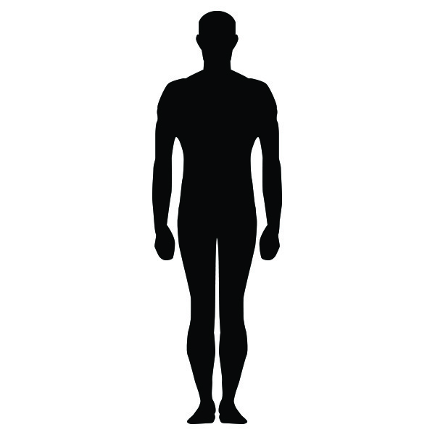
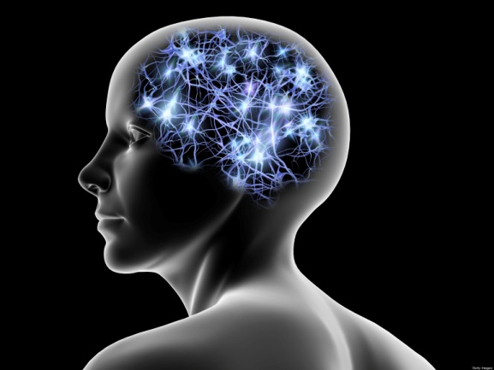
CHAPTER 5
Genes are fundamental for our body
(color hair, eyes etc)..
However they are fundamental for our BRAIN and – as a consequence – for our cognition and other psychological factors, such as QI, personality etc…

Slide 58
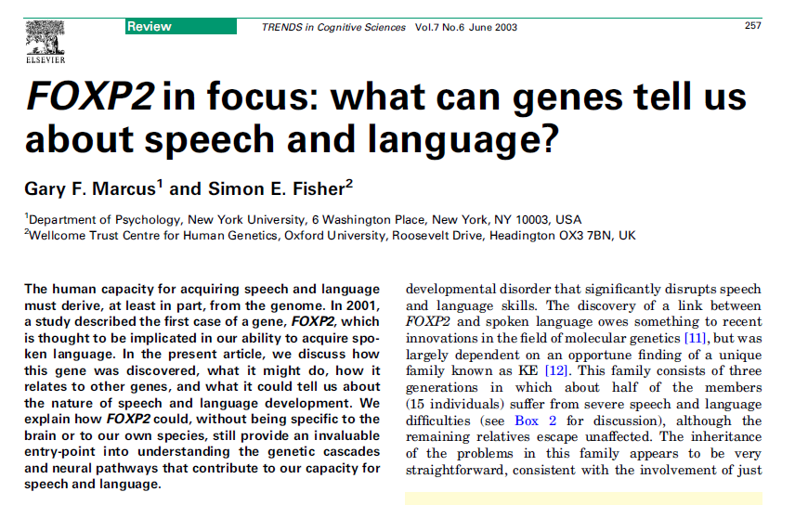
CHAPTER 5
What about language?

Slide 59
CHAPTER 5
What about numerical abilities?
More blue or yellow ?

Slide 60
CHAPTER 5
What about musical abilities?
Do you play an instrument?
Never asked if you’re a born with the ‘musical genes’ !?!

Slide 61
CHAPTER 5
What about intelligence?
GENES determine GRAY MATTER, that is positively correlated with QI (> gray matter, > QI)…
Identical twins have a very similar amount of GRAY MATTER (and presumably a similar QI).

Slide 62
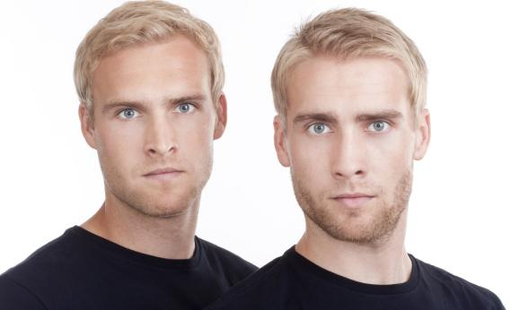
CHAPTER 5
What about sexual orientation?
The chances of a homosexual male twin having a homosexual brother are 20-25% for fraternal twins and about 50% for identical twins (Kirk, Bailey, & Martin, 2000).

Slide 63
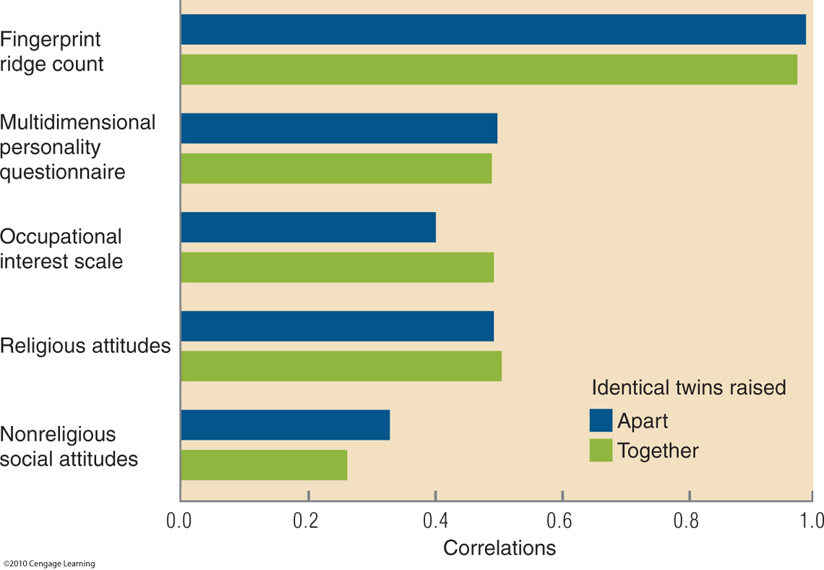
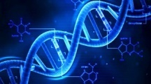
CHAPTER 5

Slide 64
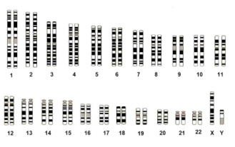
CHAPTER 5
In summary
So, in some cases genes count more than environment (e.g. development of color perception)…
….in some others environment counts more than genes (e.g., musical abilities)
.. but it is always a continuum in which both dimensions play a role.

Slide 65
CHAPTER 5
We are going to talk about..
Genetics and Behaviour
DNA structure
DNA transcription and translation
Genes-Environment interaction
Sources of genetic diversity
Notes:
So during these 2 lessons we will talk about GENETICS and Behaviour (in particular…)
In the second part we will talk about the development of neural system

Slide 66
CHAPTER 5
SOURCES OF INTER-INDIVIDUAL DIVERSITY
For sure, most of variation in phenotypes and our behaviour depends on environment…
a) Exposure to some conditions
If you are never exposed to light after birth, you tend to lose visual modality..

Slide 67
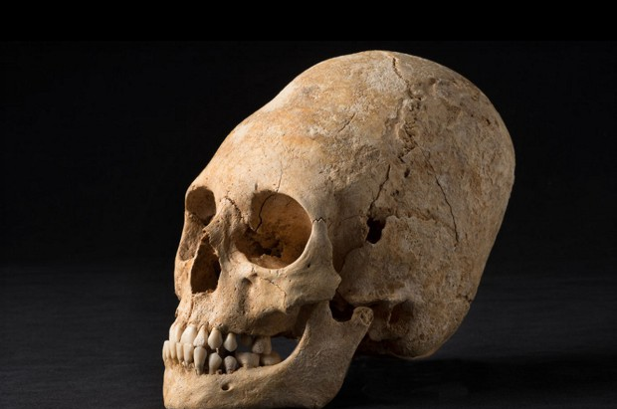
CHAPTER 5
SOURCES OF INTER-INDIVIDUAL DIVERSITY
For sure, most of variation in phenotypes and our behaviour depends on environment…
b) Culture
We change the phenotypes according to the social context
Prolonged skull

Slide 68
CHAPTER 5
SOURCES OF INTER-INDIVIDUAL DIVERSITY
However, there is also a source of GENETIC diversity that makes us so different one from another

Slide 69
CHAPTER 5
SOURCES OF GENETIC DIVERSITY
1) Sexual reproduction (Meiosis / crossing over)
2) Mutations
3) The special cases of the sex chromosomes

Slide 70
CHAPTER 5
SOURCES OF GENETIC DIVERSITY
1) Sexual reproduction (Meiosis / crossing over)
2) Mutations
3) The special cases of the sex chromosomes

Slide 71
CHAPTER 5
Two types of reproduction
1) Asexual
2) Sexual
Notes:
Several studies showed that humans have both verbal and pre-verbal numerical systems.
Verbal systems are stricly related to language and are fundamental for our mathematical skills.
However, we also have pre-verbal numerical systems, such as the ability to quickly estimate which group is larger. These are very ancient systems that permited us to discriminate between quantities in nature, during human evolution. However we still use pre-verbal numerical systems, even today, for instance when we have to select which queue is shorter at the airport.

Slide 72
CHAPTER 5
Two types of reproduction
1) Asexual
2) Sexual
Notes:
Several studies showed that humans have both verbal and pre-verbal numerical systems.
Verbal systems are stricly related to language and are fundamental for our mathematical skills.
However, we also have pre-verbal numerical systems, such as the ability to quickly estimate which group is larger. These are very ancient systems that permited us to discriminate between quantities in nature, during human evolution. However we still use pre-verbal numerical systems, even today, for instance when we have to select which queue is shorter at the airport.

Slide 73
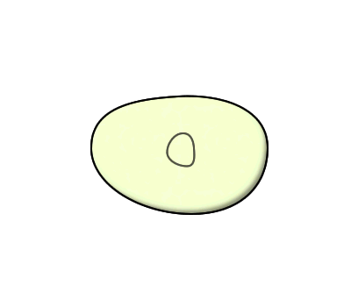
CHAPTER 5
Two types of reproduction
1) Asexual
Asexual reproduction is a type of reproduction by which offspring arises from a single organism. Hence, it inherits the genes of that parent only.
It generates a clone.
Notes:
Several studies showed that humans have both verbal and pre-verbal numerical systems.
Verbal systems are stricly related to language and are fundamental for our mathematical skills.
However, we also have pre-verbal numerical systems, such as the ability to quickly estimate which group is larger. These are very ancient systems that permited us to discriminate between quantities in nature, during human evolution. However we still use pre-verbal numerical systems, even today, for instance when we have to select which queue is shorter at the airport.

Slide 74
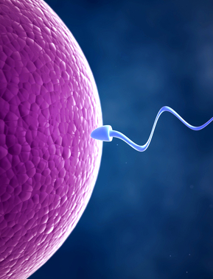
CHAPTER 5
Two types of reproduction
2) Sexual
This involves two parents that contribute genetic information to produce unique offspring.
Both parents provide one gamete to the process. The result is a new organism with a unique genome.
Notes:
Several studies showed that humans have both verbal and pre-verbal numerical systems.
Verbal systems are stricly related to language and are fundamental for our mathematical skills.
However, we also have pre-verbal numerical systems, such as the ability to quickly estimate which group is larger. These are very ancient systems that permited us to discriminate between quantities in nature, during human evolution. However we still use pre-verbal numerical systems, even today, for instance when we have to select which queue is shorter at the airport.

Slide 75
SEXUAL BEHAVIOUR
Sexual vs. Asexual
Pros and Cons
CONS
You need to find a partner
You can get sexual diseases
You may attract predator
New individual may not survive
Notes:
Several studies showed that humans have both verbal and pre-verbal numerical systems.
Verbal systems are stricly related to language and are fundamental for our mathematical skills.
However, we also have pre-verbal numerical systems, such as the ability to quickly estimate which group is larger. These are very ancient systems that permited us to discriminate between quantities in nature, during human evolution. However we still use pre-verbal numerical systems, even today, for instance when we have to select which queue is shorter at the airport.

Slide 76
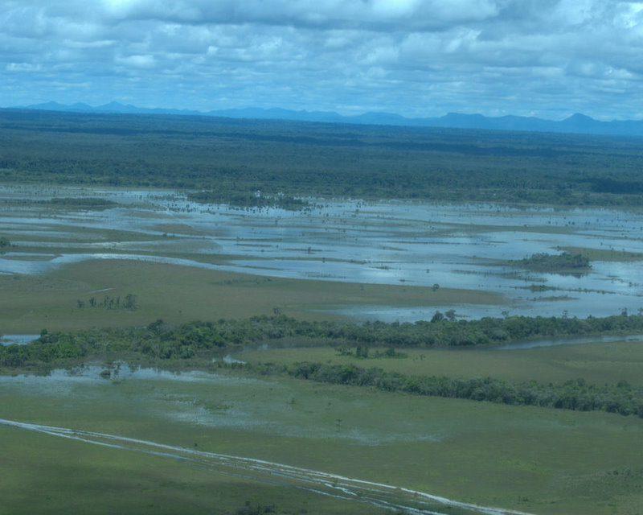
SEXUAL BEHAVIOUR
Sexual vs. Asexual
Pros and Cons
PROS
New individuals are unique and have different features (body, personality etc)
This enhances the probability that, if there is a sudden environmental change, at least some individuals can survive.
Notes:
Several studies showed that humans have both verbal and pre-verbal numerical systems.
Verbal systems are stricly related to language and are fundamental for our mathematical skills.
However, we also have pre-verbal numerical systems, such as the ability to quickly estimate which group is larger. These are very ancient systems that permited us to discriminate between quantities in nature, during human evolution. However we still use pre-verbal numerical systems, even today, for instance when we have to select which queue is shorter at the airport.

Slide 77
CHAPTER 5
Meiosis (cell divisions that produces sperm and egg cells)

Slide 78
IL COMPORTAMENTO SESSUALE
CHAPTER 5
Meiosis (cell divisions that produces sperm and egg cells)

Slide 79
IL COMPORTAMENTO SESSUALE
CHAPTER 5
Meiosis (cell divisions that produces sperm and egg cells)
Crossing over: a process in which chromosomes exchange equivalent segments of DNA material
New combination of genes in the chromosomes !
Notes:
Several studies showed that humans have both verbal and pre-verbal numerical systems.
Verbal systems are stricly related to language and are fundamental for our mathematical skills.
However, we also have pre-verbal numerical systems, such as the ability to quickly estimate which group is larger. These are very ancient systems that permited us to discriminate between quantities in nature, during human evolution. However we still use pre-verbal numerical systems, even today, for instance when we have to select which queue is shorter at the airport.

Slide 80
CHAPTER 5
SOURCES OF GENETIC DIVERSITY
1) Sexual reproduction (Meiosis / crossing over)
2) Mutations
3) The special cases of the sex chromosomes

Slide 81
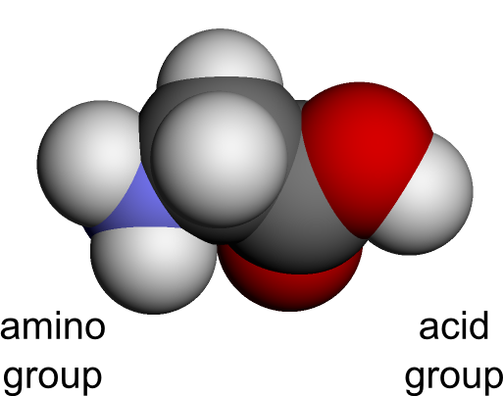
IL COMPORTAMENTO SESSUALE
CHAPTER 5
Mutations
Heritable alteration of genes
(during chromosome replications, mutations may happen)
A
C
G
64 potential CODONS (4 x 4 x 4)
T
CG
T
AG
T
C
A
20 potential aminoacids
HENCE
More codons encode the same aminoacid…

Slide 82
IL COMPORTAMENTO SESSUALE
CHAPTER 5
Mutations
Heritable alteration of genes (during chromosomes replications, mutations or errors may happen)
Mutations have NO effect if:
1) if a codon that encodes a particular aminoacid is switched with another codon that produce the same aminoacid.
2) If that codon does not influence phenotypical traits (e.g., introns)
3) If the result of mutation is a recessive allele.

Slide 83
IL COMPORTAMENTO SESSUALE
CHAPTER 5
Mutations
Heritable alteration of genes (during chromosomes replications, mutations or errors may happen)
In other cases (2 recessive mutant alleles / 1 dominant mutant allele), mutations have
POSITIVE effects
NEGATIVE effects
Notes:
Several studies showed that humans have both verbal and pre-verbal numerical systems.
Verbal systems are stricly related to language and are fundamental for our mathematical skills.
However, we also have pre-verbal numerical systems, such as the ability to quickly estimate which group is larger. These are very ancient systems that permited us to discriminate between quantities in nature, during human evolution. However we still use pre-verbal numerical systems, even today, for instance when we have to select which queue is shorter at the airport.

Slide 84
IL COMPORTAMENTO SESSUALE
CHAPTER 5
Mutations
Heritable alteration of genes (during chromosomes replications, mutations or errors may happen)
Types of mutation
Wrong base match
Extra base is added in

Slide 85
IL COMPORTAMENTO SESSUALE
CHAPTER 5
Mutations
Heritable alteration of genes (during chromosomes replications, mutations or errors may happen)
Types of mutation
Insertion and Deletion are particularly dangerous for “frame-shift”
(everything read after the mutation may be messed up)
A base is removed

Slide 86
IL COMPORTAMENTO SESSUALE
CHAPTER 5
Mutations
Heritable alteration of genes (during chromosomes replications, mutations or errors may happen)
Types of mutation

Slide 87
IL COMPORTAMENTO SESSUALE
CHAPTER 5
Mutations
Heritable alteration of genes (during chromosomes replications, mutations or errors may happen)
Types of mutation

Slide 88
IL COMPORTAMENTO SESSUALE
CHAPTER 5
Mutations
Heritable alteration of genes (during chromosomes replications, mutations or errors may happen)
Types of mutation

Slide 89
CHAPTER 5
SOURCES OF GENETIC DIVERSITY
1) Sexual reproduction (Meiosis / crossing over)
2) Mutations
3) The special cases of the sex chromosomes

Slide 90
CHAPTER 5
Sex chromosomes
Smaller than X:
Only a dozen of genes (“X” has around 2000 genes)
Lots of junk DNA
DIFFERENT GENES:
Hemophilia
Color blindness
Sex-linked characteristics
Several genes involved in male fertility

Slide 91
CHAPTER 5
Sex chromosomes
Males are more likely to have sex-linked disorders, as a single recessive gene in X has not any compensating dominant gene.

Slide 92
CHAPTER 5
Sex chromosomes
Colorblindess gene
Color blindess is due to a recessive allele

Slide 93
CHAPTER 5
Sex chromosomes
Color blindess is due to a recessive allele

Slide 94
CHAPTER 5
Sex chromosomes
Color blindess is due to a recessive allele

Slide 95
CHAPTER 5
Sex chromosomes
Color blindess is due to a recessive allele

Slide 96
CHAPTER 5
Sex chromosomes
Color blindess is due to a recessive allele

Slide 97
CHAPTER 5
Sex chromosomes
ANOTHER EXAMPLE
(try by yourself)
E.g.: color blindess

Slide 98
CHAPTER 5
Sex chromosomes
Colorblindess gene
What about sons and daughters?
E.g.: color blindess
All children see colors!
(100% daughters are carrier)

Slide 99
CHAPTER 5
Sex chromosomes
3° EXAMPLE
(try by yourself)
E.g.: color blindess

Slide 100
CHAPTER 5
Sex chromosomes
Colorblindess gene
What about sons and daughters?
E.g.: color blindess
DAUGHTERS
50% Carrier
50% Colorblind
SONS
50% Normal
50 % Colorblind

Slide 101
CHAPTER 5
Sex chromosomes
A curiosity:
Most of color blinders see several colors; they simply see a different colored world !
For this reason they are often unaware of their peculiar world until they do “Ishihara” test.
E.g.: color blindess

Slide 102
CHAPTER 5
Sex chromosomes
Color blind test (0:00-1:25)

Slide 103
CHAPTER 5
Sex chromosomes
What is like to be color blind ?

Slide 104
CHAPTER 5
Sex chromosomes
X chromosome inactivation
The lack of matching pairs for most genes in sex chromosomes appears to have led to a phenomenon known as “X chromosome inactivation”.
Because many genes on the X chromosome are not duplicated in the Y chromosome, females could potentially produce double the amounts of some proteins compared to males….

Slide 105
CHAPTER 5
Sex chromosomes
X chromosome inactivation
To compensate it, most genes on one X chromosome in female cells are randomly silenced during development.
Somatic cells
Some genes of the inactivated chromosome are still working, however, otherwise it will be a sort of “Turner syndrome” (X0).

Slide 106
CHAPTER 5
Sex chromosomes
X chromosome inactivation

Slide 107
CHAPTER 5
Sex chromosomes
X chromosome inactivation
The genes for black and orange in cats exist in the same location of the X chromosome..
Which is my kitty ?!?
Calico cat
Either black or orange
Calico cat
A black gene in one chromosome X and an orange one for the other chromosome X

Slide 108
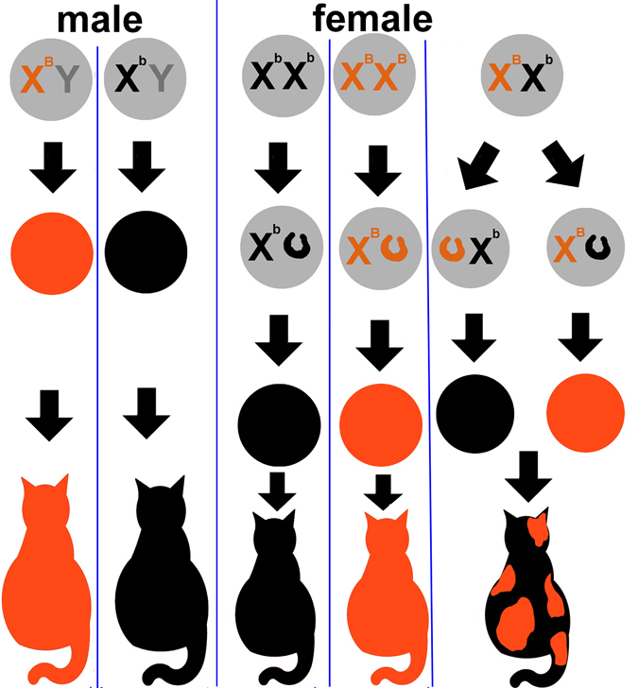
CHAPTER 5
Sex chromosomes
X chromosome inactivation

Slide 109
CHAPTER 5
Sex chromosomes
X chromosome inactivation

Slide 110
CHAPTER 5
Sex chromosomes
X chromosome inactivation

Slide 111
CHAPTER 5
Sex chromosomes
X chromosome inactivation

Slide 112
CHAPTER 5
Sex chromosomes
X chromosome inactivation
Notes:
112

Slide 113
CHAPTER 5
Sex chromosomes
X chromosome inactivation

Slide 114
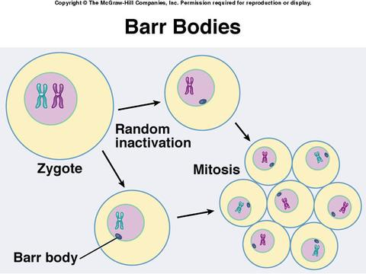
CHAPTER 5
Sex chromosomes
X chromosome inactivation

Slide 115
CHAPTER 5
We are going to talk about..
2) Development of neural system
Growth and differentiation of the nervous system
Effect of experience on development
Disorders of brain development
Redevelopment in response to damage
The adult nervous system

Slide 116
CHAPTER 5
Development of neural system
WEEKS
0
2
8
Zygote
Embryo
Fetus

Slide 117
CHAPTER 5
Development of neural system
Nervous system
Skin
hair
0
2
Connective tissue
Muscles
Blood vessels
Bone
Urogenital system
Zygote
Internal organs, as stomach
intestines

Slide 118
CHAPTER 5
Development of neural system
Genes + inducing factors determine the development of the Neural Plate.
This originates in the so-called “Organizer region of the mesoderm”
2
8
This will become skin
Embryo

Slide 119
CHAPTER 5
Development of neural system
By transplanting cells from the organizer region of one amphibian embryo near the ectoderm of a second host, complete duplicate nervous system can be formed.
2
8
Embryo

Slide 120
CHAPTER 5
Development of neural system
2
8
Embryo
From day 18 to 23, the developing ectoderm begins to fold and form the neural tube…

Slide 121
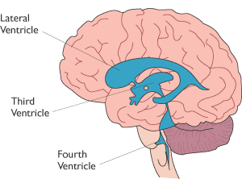
CHAPTER 5
Development of neural system
Neural tube will become :
Ventricules
2
8
The surrounding tissue will become:
brain
spinal cord
Embryo
From day 18 to 23, the developing ectoderm begins to fold and form the neural tube…

Slide 122
CHAPTER 5
Development of neural system
Once the neural tube has been formed, development of mature nervous system proceeds in 6 stages:
1) The formation of neurons and glia
2) Cell migration
3) Differentiation
4) Growth of axons and dendrites
5) Formation of synapses
6) Cell death

Slide 123
CHAPTER 5
Development of neural system
Once the neural tube has been formed, development of mature nervous system proceeds in 6 stages:
1) The formation of neurons and glia
2) Cell migration
3) Differentiation
4) Growth of axons and dendrites
5) Formation of synapses
6) Cell death

Slide 124
CHAPTER 5
Development of neural system
1) The formation of neurons and glia
Neurons and glia originate from cells in the ventricular zone, in the inner face of the neural tube.
By mitosis, they duplicate each other…
Daughter cells in the ventricular zone divide along lines that are perpendicular to the zone, producing additional progenitor cells.

Slide 125
CHAPTER 5
Development of neural system
1) The formation of neurons and glia
Neurons and glia originate from cells in the ventricular zona, in the inner face of the neural tube.
By mitosis, they duplicate each other…
Subsequently some daughter cells divide along lines that are parallel to the ventricular zone, forming cells that will migrate away.

Slide 126
CHAPTER 5
Development of neural system
1) The formation of neurons and glia
At the peak of this process, up to 250000 new neural cells / minute can be generated !

Slide 127
CHAPTER 5
Development of neural system
Once the neural tube has been formed, development of mature nervous system proceeds in 6 stages:
1) The formation of neurons and glia
2) Cell migration
3) Differentiation
4) Growth of axons and dendrites
5) Formation of synapses
6) Cell death

Slide 128
CHAPTER 5
Development of neural system
2) Cell migration
Migration is guided by progenitor cells called “radial glia”. These glia grow out from the ventricular layer of the outer margins of the nervous system (like the spokes of a wheel!)
8
Fetus

Slide 129
CHAPTER 5
Development of neural system
2) Cell migration
2/3 new cells migrate along radial glia
1/3 new cells migrate horizontally (no need for radial glia)
8
Fetus

Slide 130
CHAPTER 5
Development of neural system
2) Cell migration
Another schematic representation
8
Fetus

Slide 131
CHAPTER 5
Development of neural system
2) Cell migration
Migrate cells form the cerebral cortex in an inside-out fashion.
Layer 1
8
Layer 2
Layer 3
A cell migrating to Layer 4 has to bypass Layer 6 and 5 before..
Layer 4
Layer 5
Fetus
Layer 6

Slide 132
CHAPTER 5
Development of neural system
2) Cell migration
Once migration is complete, most radial glia pulls back their branches (but some remain in place throughout adulthood)
8
Fetus

Slide 133
CHAPTER 5
Development of neural system
Once the neural tube has been formed, development of mature nervous system proceeds in 6 stages:
1) The formation of neurons and glia
2) Cell migration
3) Differentiation
4) Growth of axons and dendrites
5) Formation of synapses
6) Cell death

Slide 134
CHAPTER 5
Development of neural system
3) Differentiation
(different types of neurons are necessary)
2 different processes:
2a) Differentiation of the dorsal and ventral halves of neural tube
Neurons in the ventral half develop into motor neurons
Neurons in the dorsal half develop into sensory neurons

Slide 135
CHAPTER 5
Development of neural system
3) Differentiation
(different types of neurons are necessary)
2 different processes:
2b) Differentiation of the neural tube along the rostral-caudal axis
This process will generate the division of nervous system

Slide 136
CHAPTER 5
Development of neural system
3) Differentiation
(different types of neurons are necessary)
2 different processes:
2b) Differentiation of the neural tube along the rostral-caudal axis
Hox genes encode for a protein that control differentiation

Slide 137
CHAPTER 5
Development of neural system
3) Differentiation
(different types of neurons are necessary)
2 different processes:
2b) Differentiation of the neural tube along the rostral-caudal axis
Hox genes does not have this effect

Slide 138
CHAPTER 5
Development of neural system
Once the neural tube has been formed, development of mature nervous system proceeds in 6 stages:
1) The formation of neurons and glia
2) Cell migration
3) Differentiation
4) Growth of axons and dendrites
5) Formation of synapses
6) Cell death

Slide 139
CHAPTER 5
Development of neural system
4) Growth of axons and dendrites
Once different neurons are in the correct place, they need to growth in order to form synapses
Growing axons make their journey in a series of steps;
later-developing axons can follow the pathways of the earlier-maturing axons
Developing axons and dendrites end in growth cones.
They interact with extracellular environment, guiding the nerve fiber to the target cell

Slide 140
CHAPTER 5
Development of neural system
4) Growth of axons and dendrites
They have both motor and sensory abilities that help the developing branch to find the correct pathway.
Filopodia: long, fingerlike extensions from the core
Lamellipodia: additional flat, sheetlike extension from the core
Main body containing mitochondria, microtubules and other organelles

Slide 141
CHAPTER 5
Development of neural system
4) Growth of axons and dendrites
Developing axons and dendrites end in growth cones. They have both motor and sensory abilities that help the developing branch to find the correct pathway.
“Guidepost cells” along the route release chemicals that either attract or repel the growing cell.
Microtubules from the main body of the cone move forward as the cone extends, forming a new segment of axon/dendrite
Filopodia and lamellopodia are capable of movement, and they have the ability to stick to elements of the extracellular environment

Slide 142
CHAPTER 5
Development of neural system
4) Growth of axons and dendrites
Filopodia can signal the growth cone to move forward, backward or turn in another direction
Growth cones respond to extracellular environment
.. by sticking to the surface of other cells

Slide 143
CHAPTER 5
Development of neural system
4) Growth of axons and dendrites
Filopodia can signal the growth cone to move forward, backward or turn in another direction
Growth cones respond to extracellular environment
.. by sticking to other axons travelling in the same direction

Slide 144
CHAPTER 5
Development of neural system
4) Growth of axons and dendrites
Filopodia can signal the growth cone to move forward, backward or turn in another direction
Growth cones respond to extracellular environment
.. by growing toward chemical attractants

Slide 145
CHAPTER 5
Development of neural system
4) Growth of axons and dendrites
Filopodia can signal the growth cone to move forward, backward or turn in another direction
Growth cones respond to extracellular environment
.. by being repulsed by chemical factors.

Slide 146
CHAPTER 5
Development of neural system
4) Growth of axons and dendrites
Filopodia can signal the growth cone to move forward, backward or turn in another direction
Axons that are growing in the same direction often stick together in a process known as “fasciculation”

Slide 147
CHAPTER 5
Development of neural system
Once the neural tube has been formed, development of mature nervous system proceeds in 6 stages:
1) The formation of neurons and glia
2) Cell migration
3) Differentiation
4) Growth of axons and dendrites
5) Formation of synapses
6) Cell death

Slide 148
CHAPTER 5
Development of neural system
5) Formation of synapses
Now that all branches are in the proper place, connections must be created.

Slide 149
CHAPTER 5
Development of neural system
5) Formation of synapses
Now that all branches are in the proper place, connections must be created.
Initially, receptors are evenly distributed within the membrane of the muscle fiber.
A delicate sequence of chemical releases by both presynaptic and postsynaptic structures stimulate movements of receptors to the synaptyic site…

Slide 150
CHAPTER 5
Development of neural system
Once the neural tube has been formed, development of mature nervous system proceeds in 6 stages:
1) The formation of neurons and glia
2) Cell migration
3) Differentiation
4) Growth of axons and dendrites
5) Formation of synapses
6) Cell death

Slide 151
CHAPTER 5
Development of neural system
6) Cell death
A large number of cells die in the process known as “apoptosis”
(from Greek “falling leaves”)
This phenomenon was firstly study by Hamburger (half of spinal motor neurons in chick brain die before hatching)

Slide 152
CHAPTER 5
Development of neural system
6) Cell death
A large number of cells die in the process known as “apoptosis”
(from Greek “falling leaves”)
Inhibit
Cell death gene
Neurotrophins
(e.g., nerve growth factor)
Trigger the activity of enzimes
Caspases
Break up DNA and proteins
Apoptosis is an ACTIVE process that must be inhibited

Slide 153
CHAPTER 5
Development of neural system
It could work !!!

Slide 154
CHAPTER 5
Development of neural system
It could work !!!
Not really..
Too many surviving cells might result in problems.
Autistic children have higher levels of neurotrophins.

Slide 155
CHAPTER 5
Apoptosis ≠ Necrosis

Slide 156
CHAPTER 5
Development of neural system
SYNAPTIC PRUNING
We don’t only lose neurons during development, but also synapses.
We initially have a burst of synaptic growth, but then there is a reduction of non-functional synapses..
Stable in adulthood

Slide 157
CHAPTER 5
Development of neural system
MYELINATION
Fatty material (composed of lipids and lipoproteins) that encloses certain axons and nerve fibers
Useful to increase the speed at which impulses propagate

Slide 158
CHAPTER 5
Development of neural system
MYELINATION
24 Weeks: first myelin in cranial and spinal nerves..
1 Year: burst of myelination.
SENSORY parts are myelinated earlier than MOTOR parts

Slide 159
CHAPTER 5
Development of neural system
MYELINATION
Occurs in rostral direction starting with the spinal cord, then hindbrain, midbrain, and forebrain

Slide 160
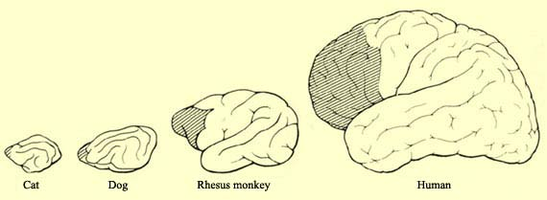
CHAPTER 5
Development of neural system
MYELINATION
In pre-frontal lobe this is not complete until adulthood.

