Slide 1
Thalamus

Slide 3
Ventral = Very
Posterior = Painful

Slide 4
Lateral = Looking
Geniculate = Good

Slide 5
Medial = Making
Geniculate = Good
Nucleus = Noise

Slide 6
Medial = Making
Geniculate = Good
Nucleus = Noise
Lateral = Looking
Geniculate = Good
Ventral = Very
Posterior = Painful

Slide 7
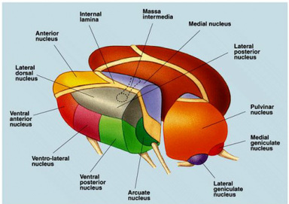
lateral
Ventral posterior medial nucleus

Slide 8
lateral
Ventral posterior medial nucleus

Slide 9
Hypothalamus

Slide 11
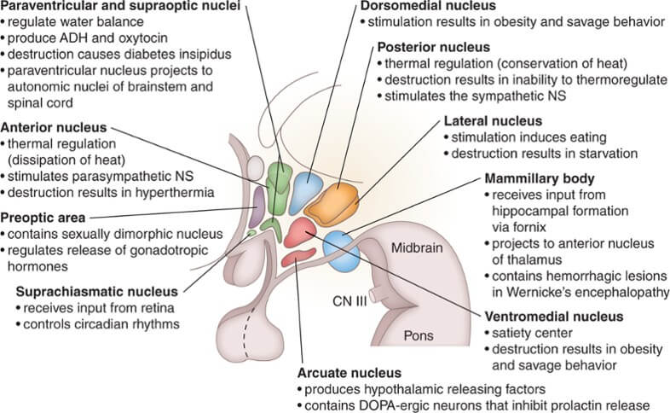
Posterior nucleus
is responsible for heating
Anterior nucleus
is responsible for Cooling
=
Air Conditioning

Slide 12
Lateral
L Fatter (al)
Ventromedial
Full

Slide 13
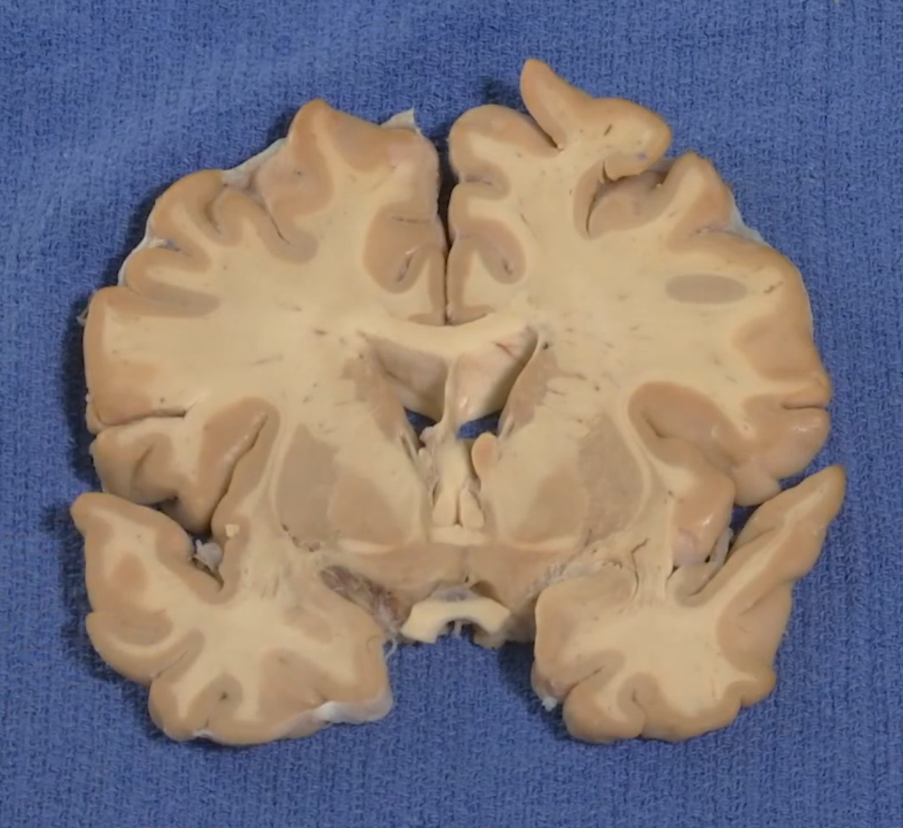
Preoptic area
Suprachiasmatic nucleus

Slide 14
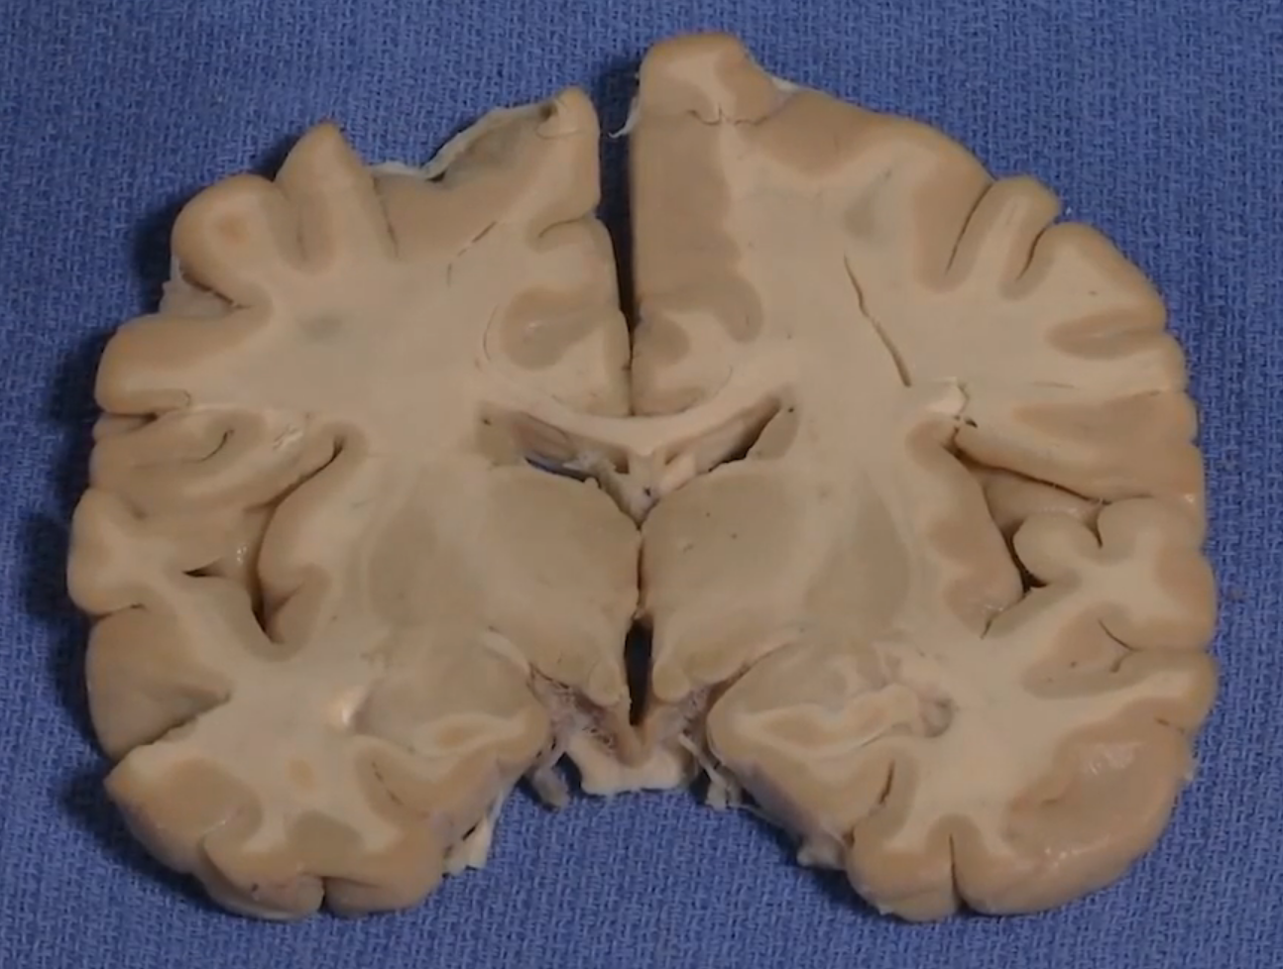
Mamillary bodies
Arcuate nucleus

Slide 15
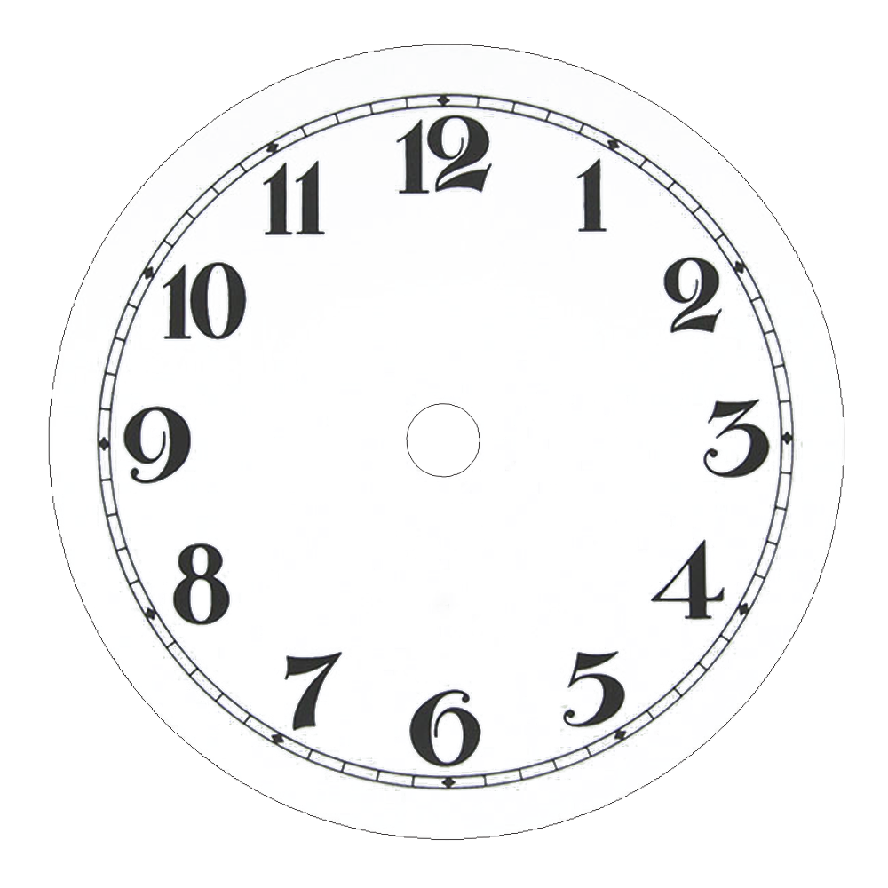
It’s
time

Slide 16
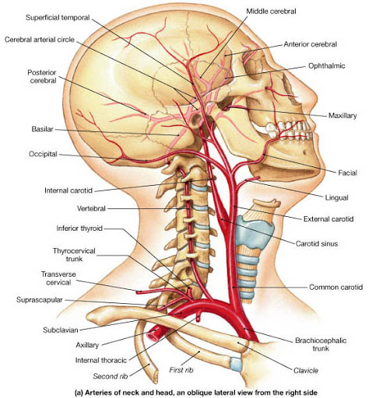
Circle of Willis

Slide 17
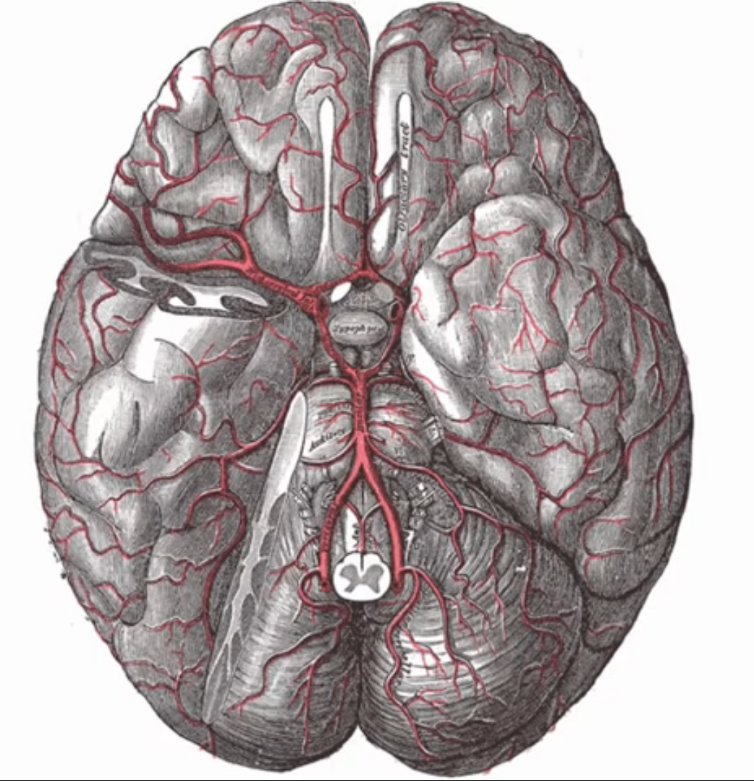

Slide 18
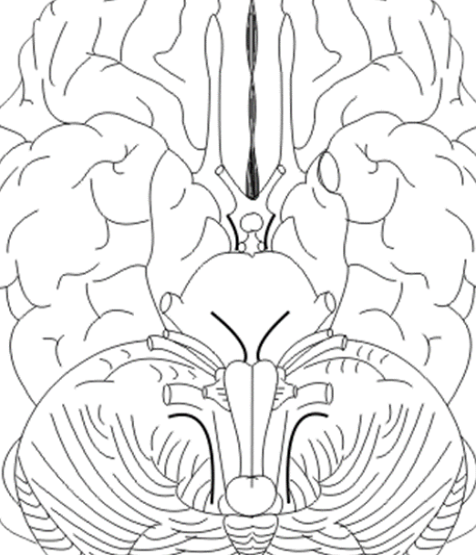
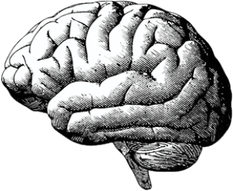
Anterior cerebral artery
Anterior communicating artery
Middle cerebral artery
Posterior communicating artery
Internal carotid artery
Posterior cerebral artery
Basilar artery
Vertebral artery

Slide 19
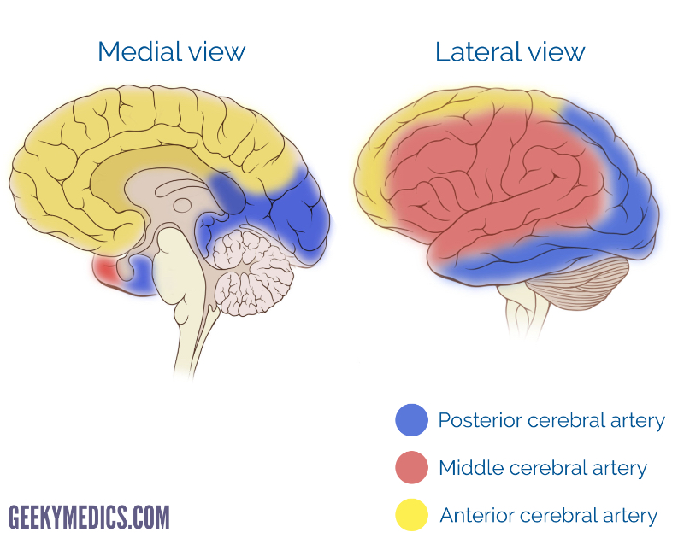

Slide 20
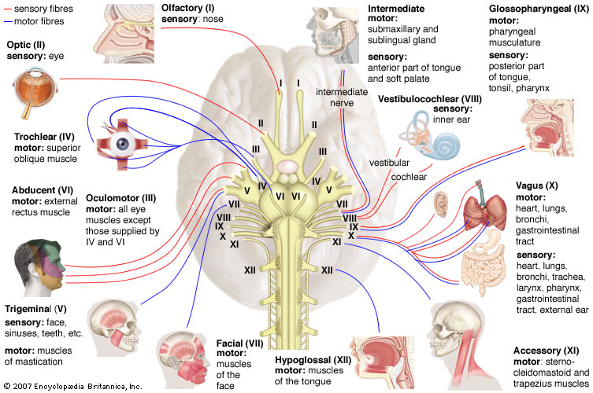
The cranial nerves

Slide 21
On
Occasion
Our
Trusty
Truck
Acts
Funny
Very
Good
Vehicle
Any
How

Slide 22
On
Occasion
Very
Our
Good
Trusty
Vehicle
Truck
Any
Acts
How
Funny

Slide 23
O
Olfactory
I
Vestibulocochlear
O
V
Optic
II
VIII
Glossopharyngeal
O
G
Oculomotor
III
IX
Trochlear
T
V
Vagal
IV
X
Trigeminal
T
Accessory
A
V
XI
Abducens
A
H
VI
Hypoglossal
XII
F
Facial
VII

Slide 24
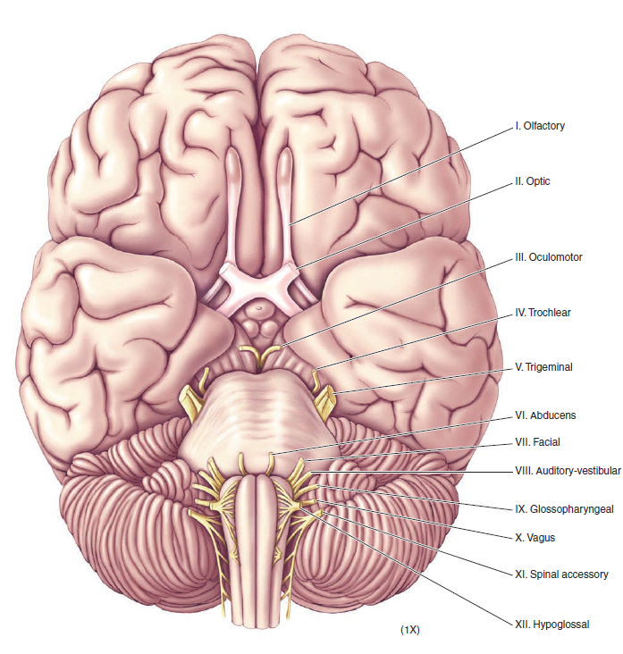
On
Occasion
Our
Trusty
3
Truck
Acts
6
Funny
Very
Good
Vehicle
Any
12
How

Slide 25
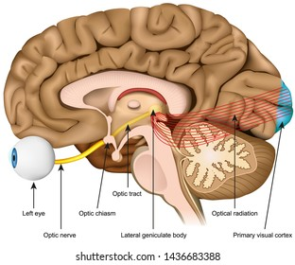
Olfactory nerve (I)
Optic nerve (II)

Slide 26
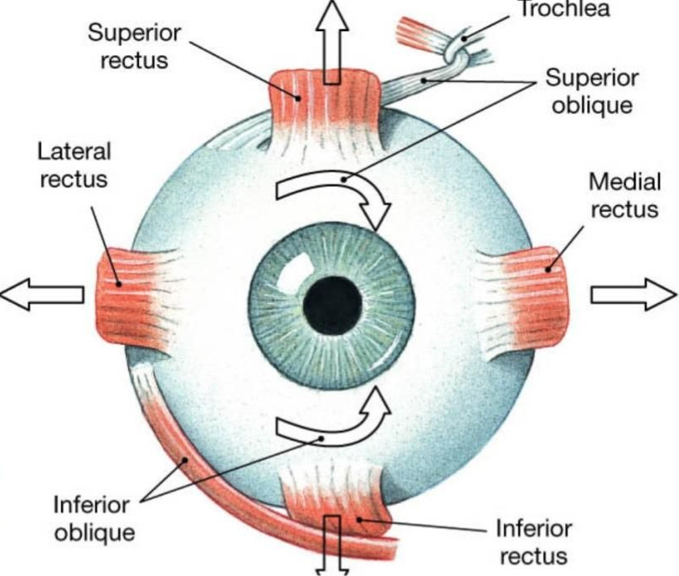
UPducens

Slide 27
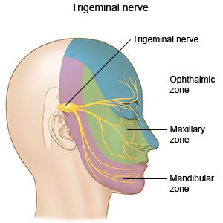
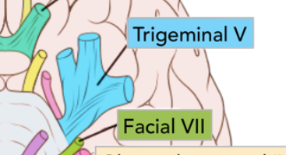

Slide 28
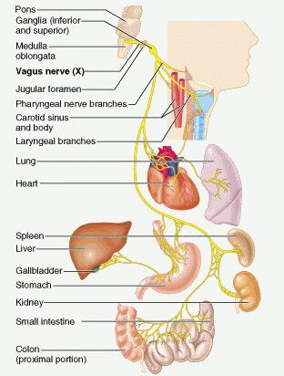
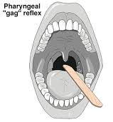

Slide 29
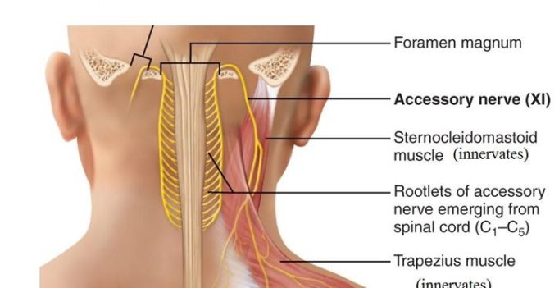
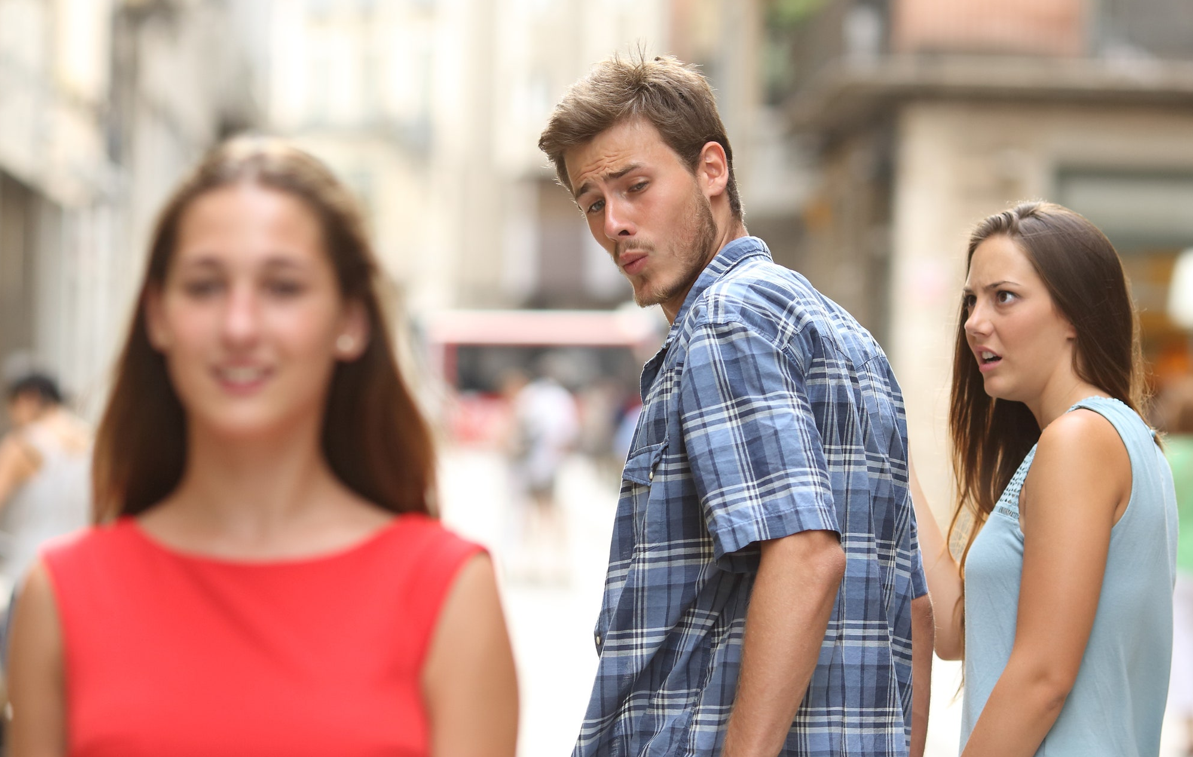
XI ACCESSORY CRANIAL NERVE

Slide 30
https://www.youtube.com/watch?v=6ENCJkXJvio

Slide 31
It’s
time

