Slide 1
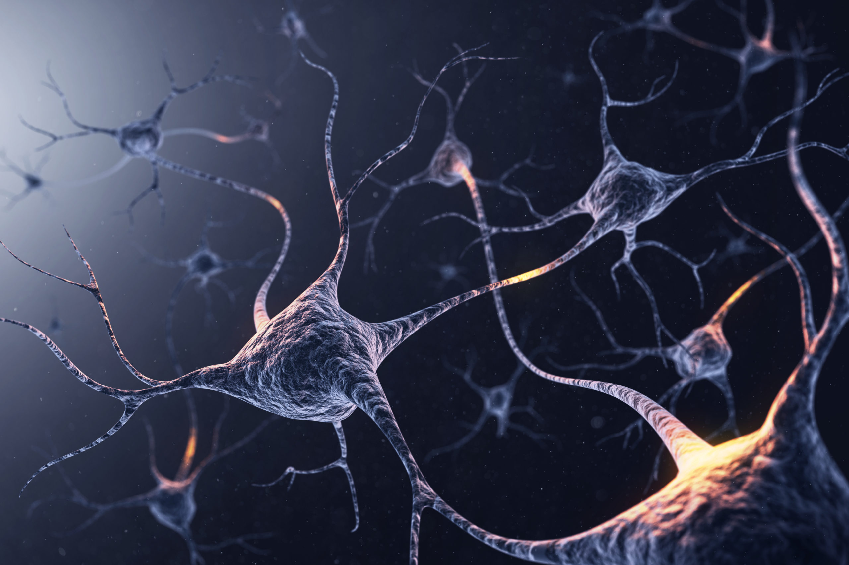
BRAIN AND BEHAVIOUR
Prof. Christian Agrillo

Slide 2
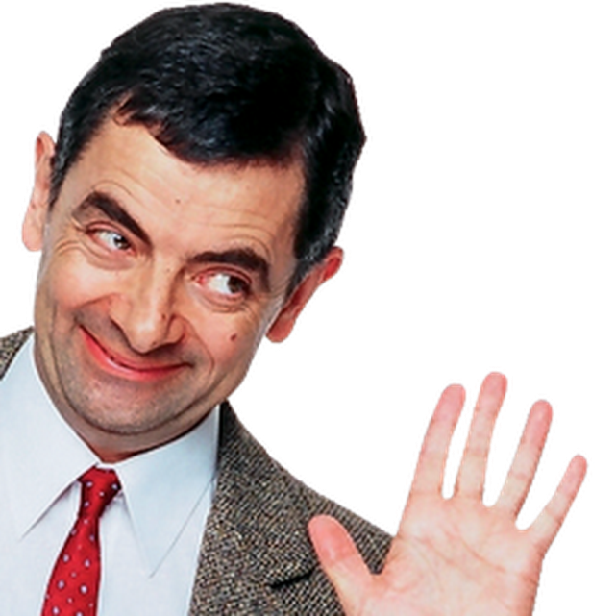
INTRO OF THE COURSE
Meet the professor !
Nice to meet you!
Christian Agrillo
Associate Professor

Slide 3
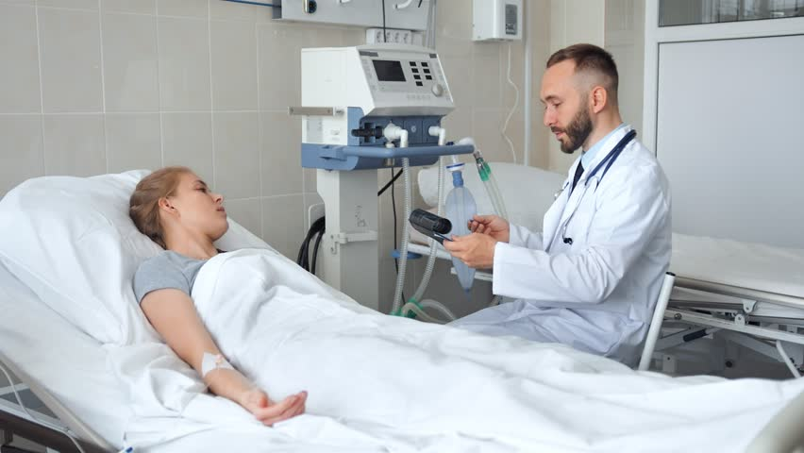
INTRO OF THE COURSE
WHY all this ‘BRAIN’ here ?
Doctors should study the brain, not me!

Slide 4
INTRO OF THE COURSE
Why ‘brain’ here?
You cannot work in this field if you don’t know the biological bases of our behaviour

Slide 5
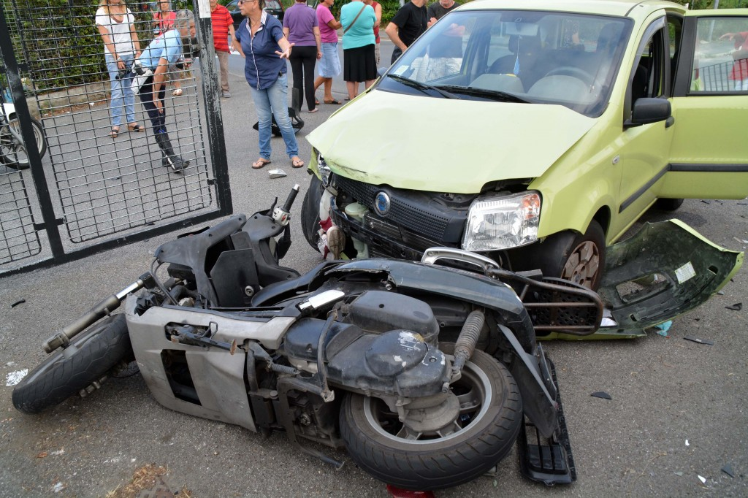
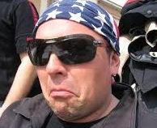
INTRO OF THE COURSE
Why ‘brain’ here?
You cannot work in this field if you don’t know the biological bases of our behaviour
“Doctor, this boy had a traumatic brain injury. He damaged frontal lobe and continue to perseverate with the same type of error..”
Well, this guy is a teenager, therefore he wants to defend his identity and his choices

Slide 6
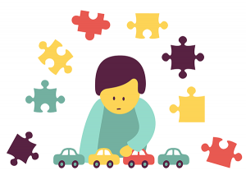
INTRO OF THE COURSE
Why ‘brain’ here?
You cannot work in this field if you don’t know the biological bases of our behaviour
“Doctor, why does my kid suffer from autism ? ”
It happens with ‘refrigerator mothers’

Slide 7
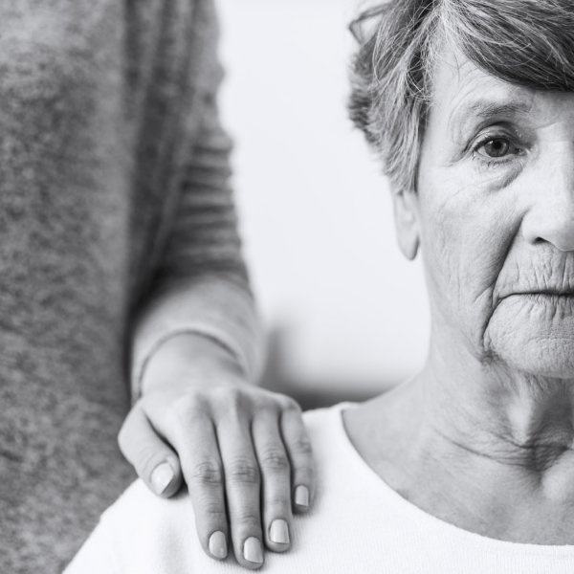
INTRO OF THE COURSE
Why ‘brain’ here?
You cannot work in this field if you don’t know the biological bases of our behaviour
“Doctor, my mother suffers Parkinson disease, she never smiles if she sees something funny”
“Well, I can imaging, she is in pain!”

Slide 8
INTRO OF THE COURSE
Why ‘brain’ here?
You cannot work in this field if you don’t know the biological bases of our behaviour
“Doctor, this girl took Ecstacy! ”.

Slide 9
INTRO OF THE COURSE
Why ‘brain’ here?
You cannot work in this field if you don’t know the biological bases of our behaviour
“Doctor, I am so stressed.. ”

Slide 10
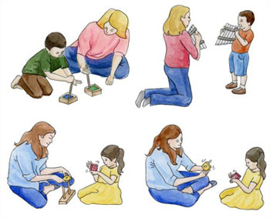
INTRO OF THE COURSE
Why ‘brain’ here?
You cannot work in this field if you don’t know the biological bases of our behaviour
“Doctor, why do we learn by imitation ? I have heard about mirror neurons”.
“Mirror what ?!?”

Slide 11
INTRO OF THE COURSE
Apart from practical aspects, as psychologists you must read human behaviour at different levels..
Bob was aggressive with Susan..
He was nervous!
People generally have 1-2 ‘keys’ to enter other minds..
Sociological interpretation (media, cultural stereotypes?)
Antropological interpretation (is it intrinsic to humans in all societies?)
Cognitive interpretation (cognitive control of emotions?)
Psychodynamic interpretation (first interactions with parents?)
Psychobiological interpretation (males have been selected by evolution for being more aggressive; hormones..)

Slide 12
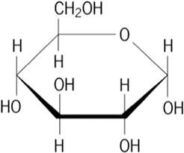
INTRO OF THE COURSE
Which type of study are we going to do here ?
Neuroanatomy
(main structures of the brain)
Neurobiology
(neurons, synapses, etc)
Neurochemistry (chemistry of neurons)

Slide 13
INTRO OF THE COURSE
Which type of study we are going to do here ?
Neuroanatomy
(main structures of the brain)
Neurobiology
(neurons, synapses, etc)
Neurochemistry (chemistry of neurons)

Slide 14
INTRO OF THE COURSE
HAVE A LOOK OF OUR MOODLE !

Slide 15
INTRO OF THE COURSE
Meet the teaching assistant !
Dott. Alessandra Pecunioso

Slide 16
Assessing your knowledge at the end of the course is fundamental and we are ready to do it at the very best of our possibilities..

Slide 17
To evalue your knowledge
THE EXAM
(The same day or split in a couple of days)
WRITTEN
Oral
Open questions
(to see how you argue a couple of issues)
Stage 1: Neuroanatomy task
(75% of correct choices to enter to stage 2)
Stage 2: Multiple choice task on the whole program (1 correct; 3 incorrect)
26
22
30
26
0
18
30
Insufficient
Oral

Slide 18
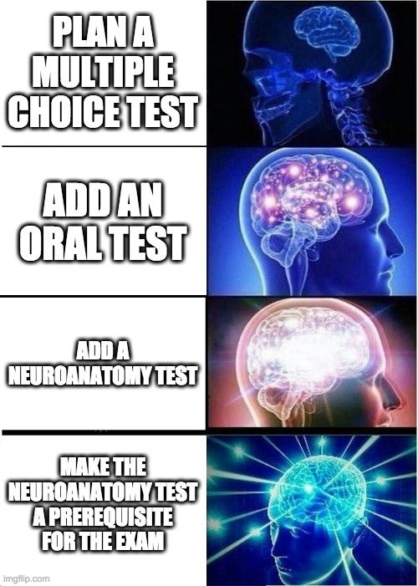
MEME of the day

Slide 19
EXAMPLE OF THE WRITTEN EXAM: Neuroanatomy task
Anatomy test
What is number :
12 = Corpus callosum
08 = Anterior commissure
11 = Lateral ventricle
10 = Amygdala
03= Nucleus caudatus
05 = Putamen
07 = Globus pallidus
01 = Cingulate cortex
2 figures (8 names to be identified for each figure)
75% correct choices: The exam goes on!

Slide 20
EXAMPLE OF THE WRITTEN EXAM:
Multiple choice test
Intracellular fluid is:
a. rich in K+ , with small amounts of Na+ and Cl- .
b. rich in K+ and Cl- , with very small amounts of Na+ .
c. rich in Cl- , with very small amounts of K+ and Na+ .
d. rich in Na+ and Cl- , with small amounts of K+ .

Slide 21
EXAMPLE OF THE ORAL EXAM:
If I sleep 16 hours and I have no sleeping disorders, how old am I?
Which ormones are important for parental cares?
If this patient enter your room, can you guess his genotype (and eventually his cognitive disorders) by his phenotype?

Slide 22
TEXTBOOK and Chapters to be studied
Chapt. 01
Chapt. 02
Chapt. 03
Chapt. 04
Chapt. 05
Chapt. 07
Chapt. 10
Chapt. 11
Chapt. 12
Chapt. 13
Chapt. 14

Slide 23
TEXTBOOK and Chapters to be studied

Slide 24
CONTENTS and EXAM
An overall view
TEXTBOOK
My slides

Slide 25
CONTENTS and EXAM
WRITTEN PART
Pictures
1a) Neuroanatomy test: You will do several exercises during the course with very similar pictures.

Slide 26
CONTENTS and EXAM
WRITTEN PART
TEXTBOOK
1a) Neuroanatomy test
1b) Multiple choice test

Slide 27
CONTENTS and EXAM
31 Overall questions
CORRECT CHOICES? +1
No Response? 0
Wrong Response? 0
Examples:
18/31? You got 18!
31/31? You got 30 cum laude!
WRITTEN PART
TEXTBOOK

Slide 28
CONTENTS and EXAM
WRITTEN PART:
31 Overall questions
The distribution of questions among the chapters changes continuously

Slide 29
CONTENTS and EXAM
WRITTEN PART:
Example:
Exam “X”
2 Questions
3 Questions
5 Questions
3 Questions
3 Questions
2 Questions
3 Questions
3 Questions
2 Questions
3 Questions
2 Questions

Slide 30
CONTENTS and EXAM
WRITTEN PART:
Example:
Exam “Y”
3 Questions
1 Questions
2 Questions
4 Questions
3 Questions
2 Questions
4 Questions
2 Questions
3 Questions
3 Questions
4 Questions

Slide 31
CONTENTS and EXAM
WRITTEN PART
TEXTBOOK
(but definitively easier if you follow my lessons)
My slides
1a) Neuroanatomy test
1b) Multiple choice test
2) Oral test (it may involve any chapter…)

