Slide 1
…some terminology

Slide 2
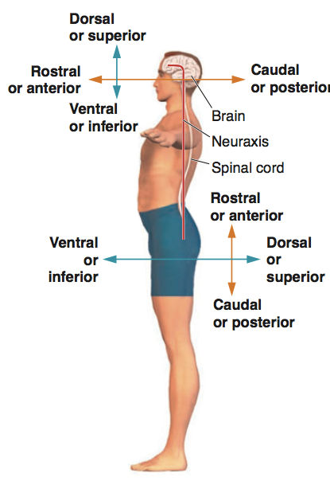
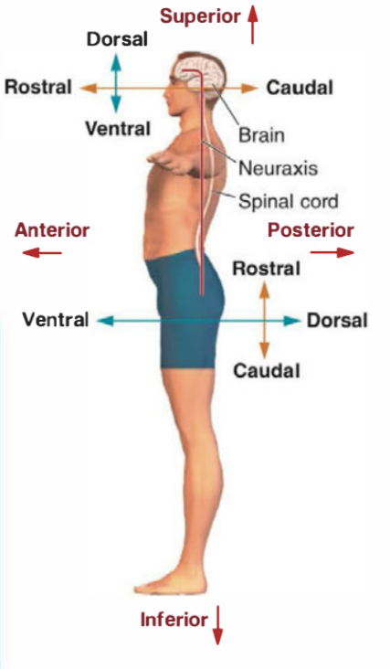

Slide 3
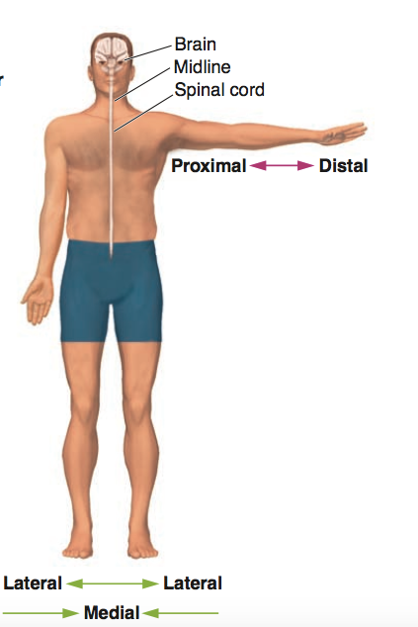

Slide 4
It’s
time

Slide 5
Horizontal
Sagittal
Coronal

Slide 6
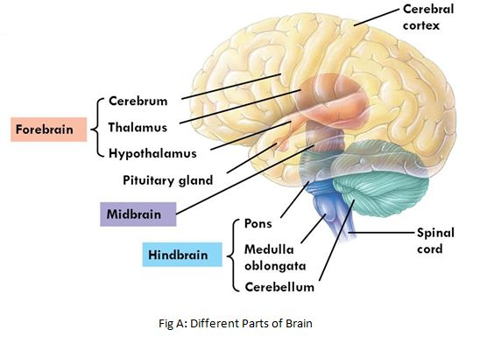
The subdivision of the brain

Slide 7
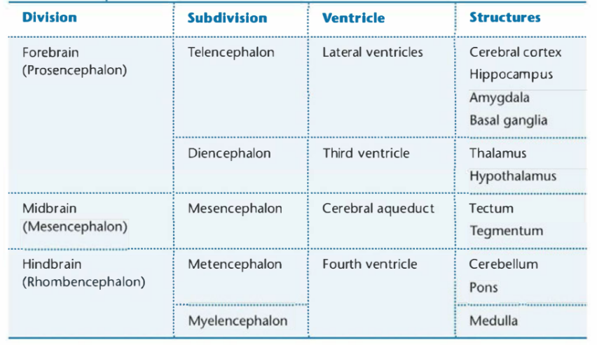
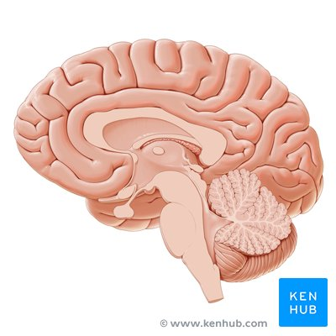

Slide 8
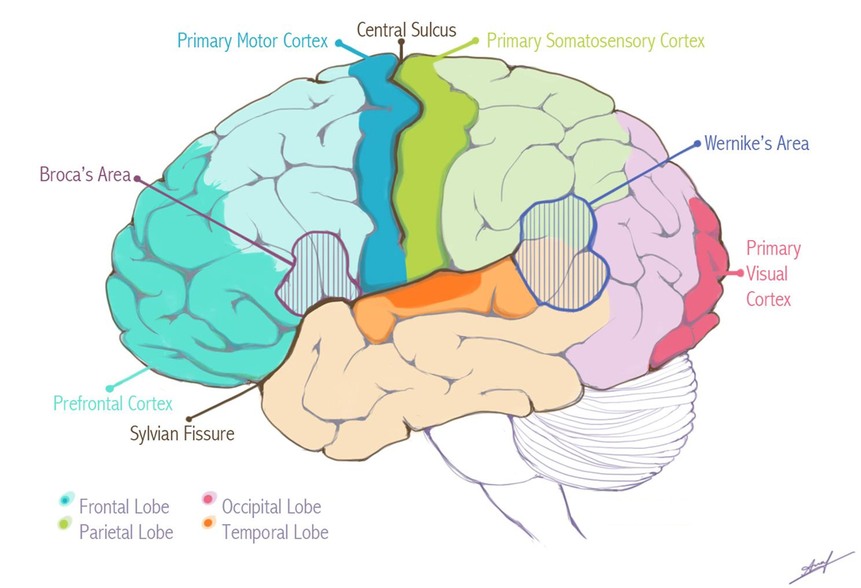
The cerebral cortex

Slide 9
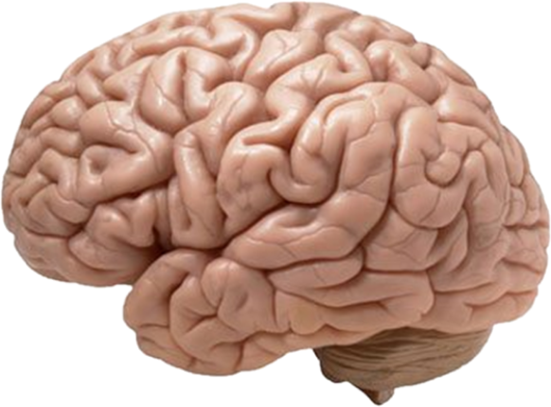
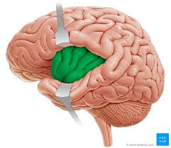
The lobes

Slide 10
Fissures vs sulci:
Tȟɛɼɛ’s
ª
ᶑỉꞘꞘɛɼɛꞃçɛ ??
What’s
the
difference?

Slide 11
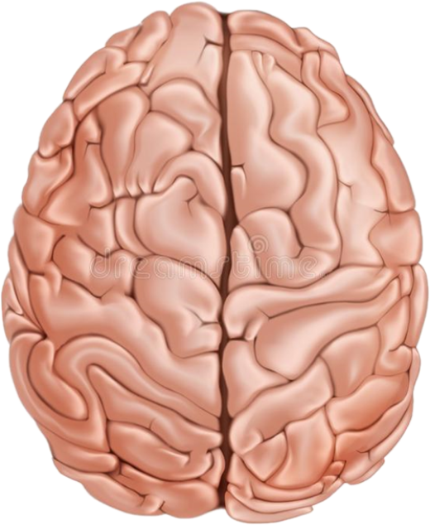
The fissures
Longitudinal fissure
Sylvian fissure

Slide 12
The sulci
Intraparietal suclus
Parieto-occipital suclus
(Sylvian)
Calcarine suclus

Slide 13
The gyri
Intraparietal suclus
angular gyrus
(Sylvian)
Calcarine suclus

Slide 14
The gyri
Intraparietal suclus
angular gyrus
(Sylvian)
Calcarine suclus

Slide 15
The gyri
Intraparietal suclus
Intraparietal suclus
angular gyrus
(Sylvian)
Calcarine suclus

Slide 16
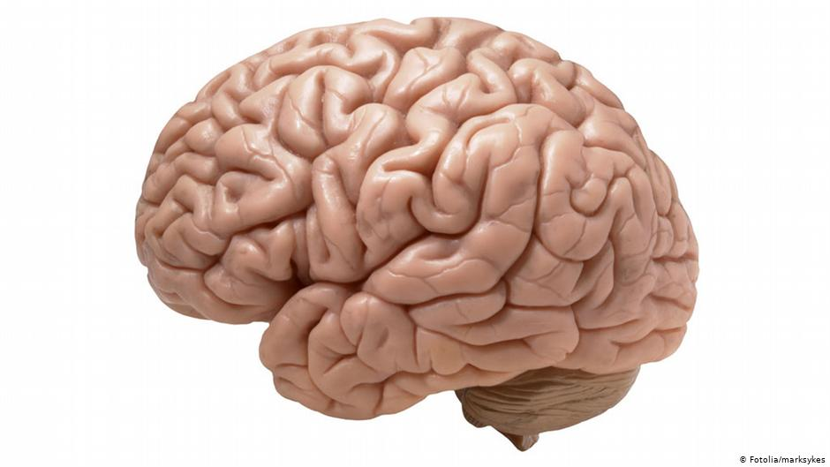
Primary areas

Slide 17
Motor areas
Planning of internally generated movements
Supplementary motor area (SMA)
Planning of externally guided movements
Premotor area (PMA)
Primary motor area (M1)
Initiation of movement
Selection of one action over the others
Organization of movements

Slide 18
Other important areas
Self-control and inhibition
Attention control
Planning
Decision making
Problem solving
Working memory

Slide 19
Other important areas

Slide 20
…all together now

Slide 21
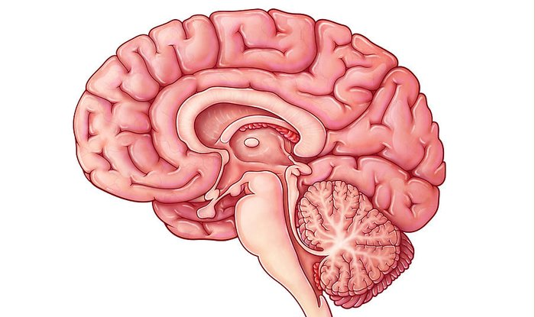
The cingulate cortex

Slide 22
This video contains sensitive content which some people may find disturbing

Slide 24
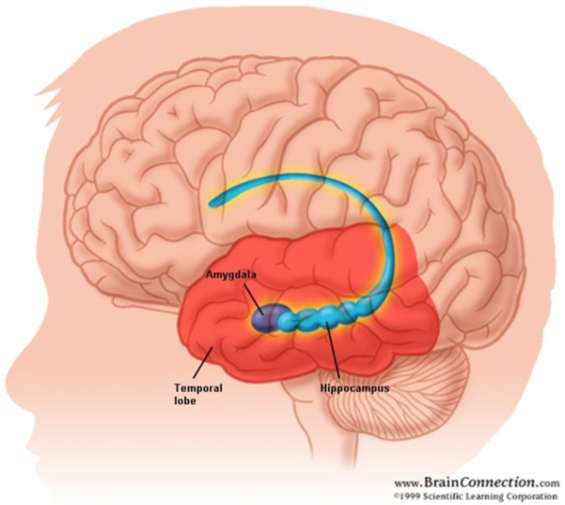
The hippocampus
&
The amygdala

Slide 25
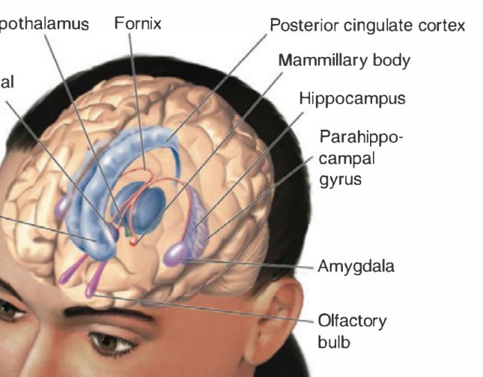
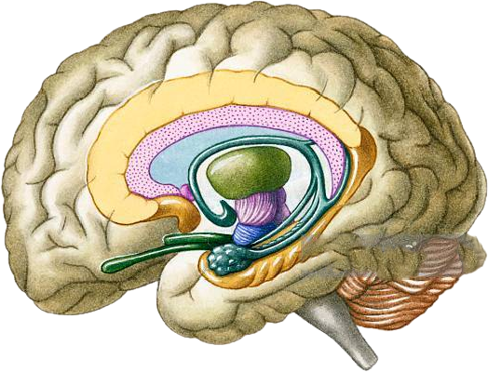

Slide 26
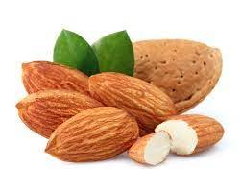
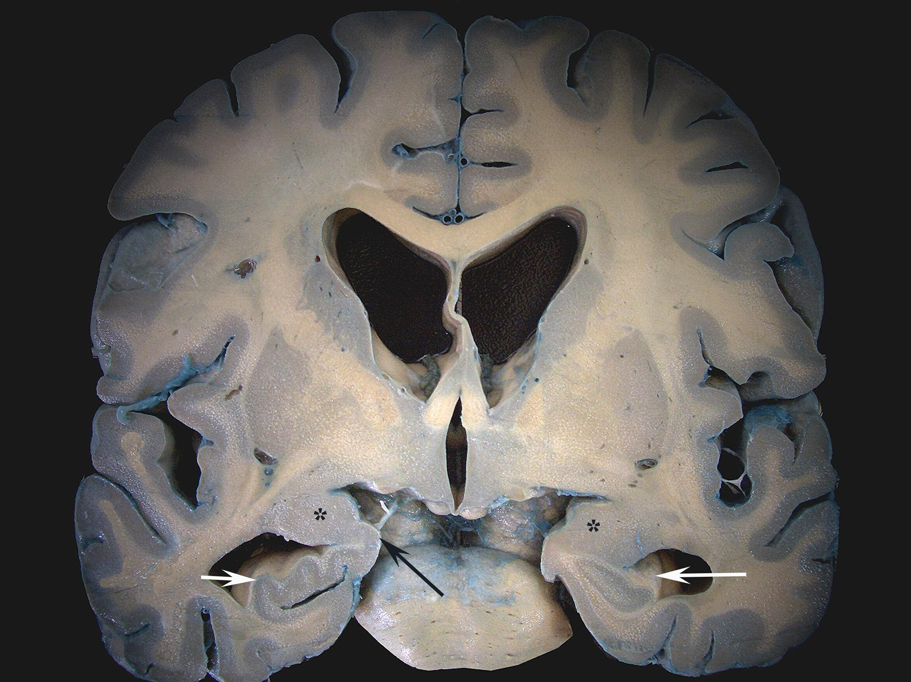
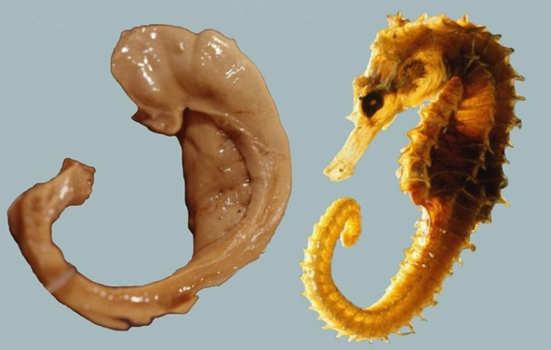
Amygdala = ‘almond’
Hippocampus = ‘seahorse’

Slide 28
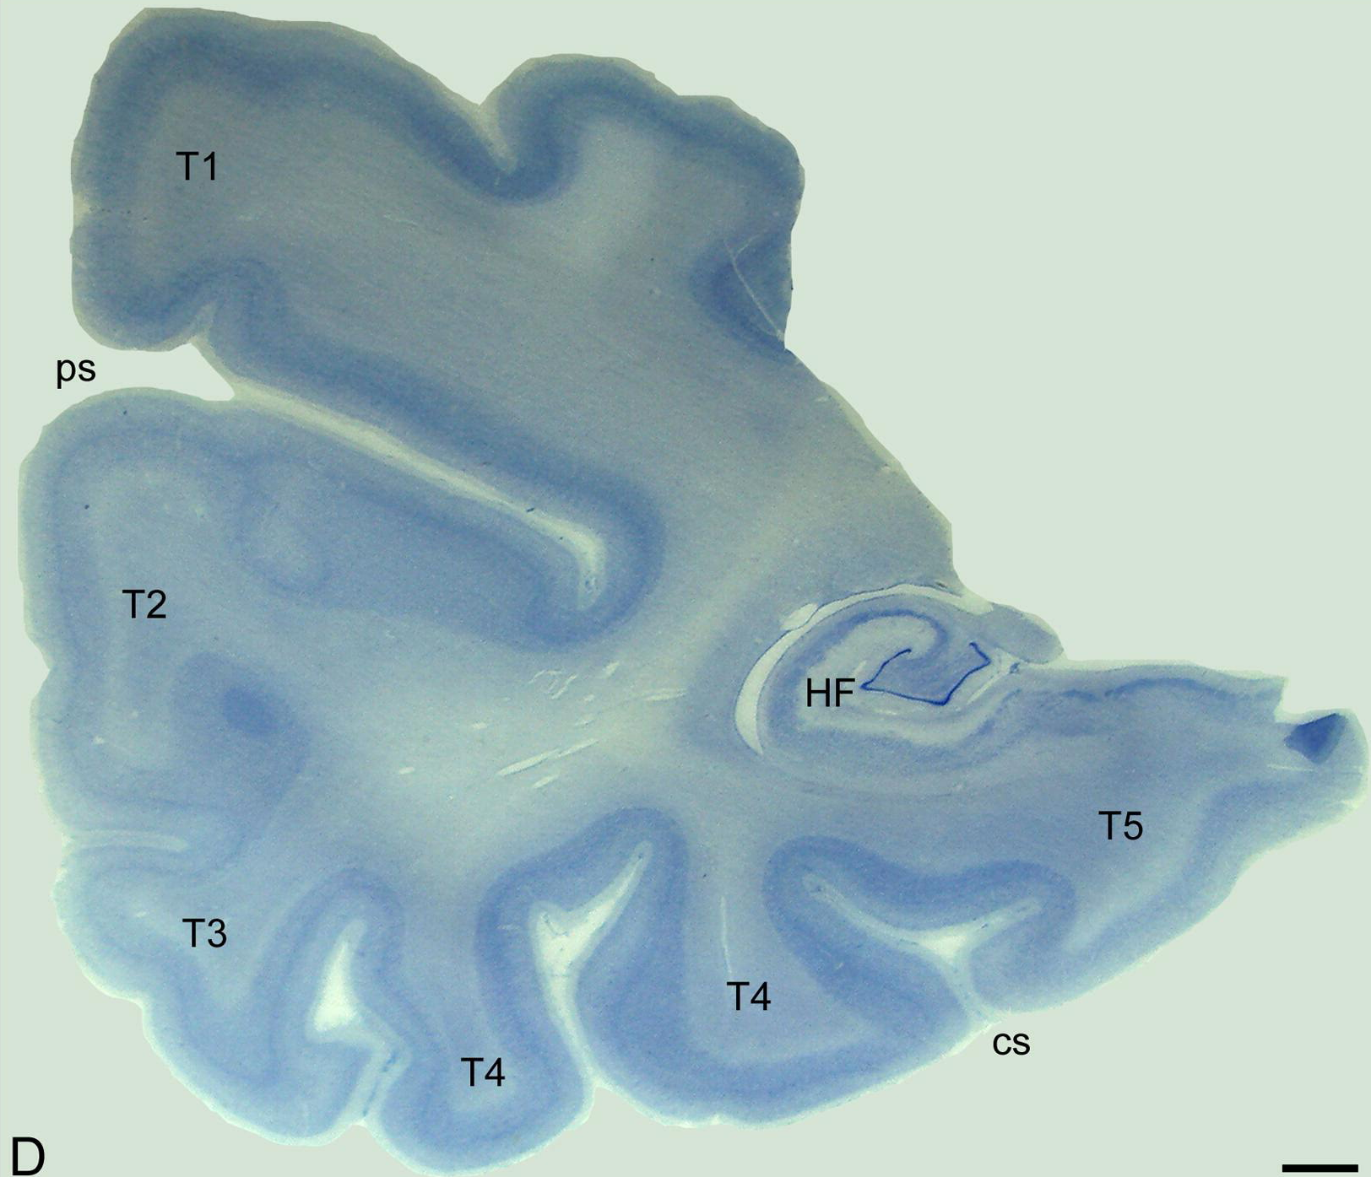

Slide 29
This video contains sensitive content which some people may find disturbing

Slide 31
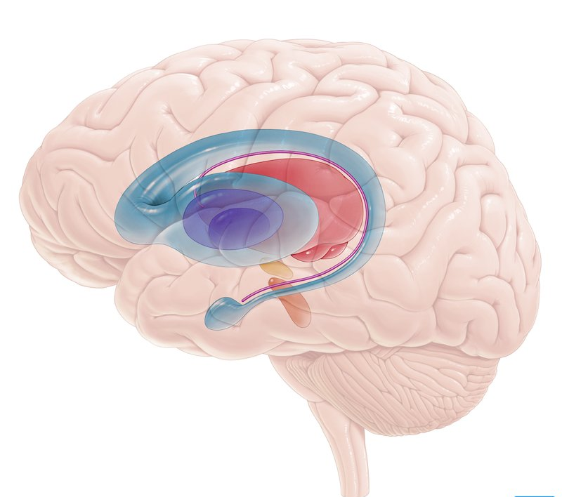
The basal ganglia

Slide 32
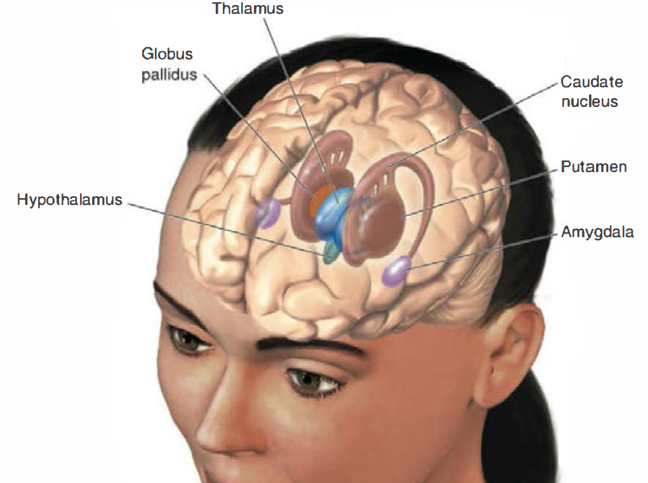
Movement initiation
+ nucleus accumbens
Reward
+ subthalmic nucleus
Procedural memory
+ substantia nigra

Slide 34
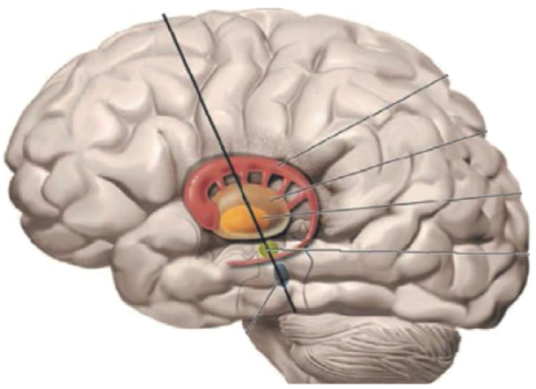
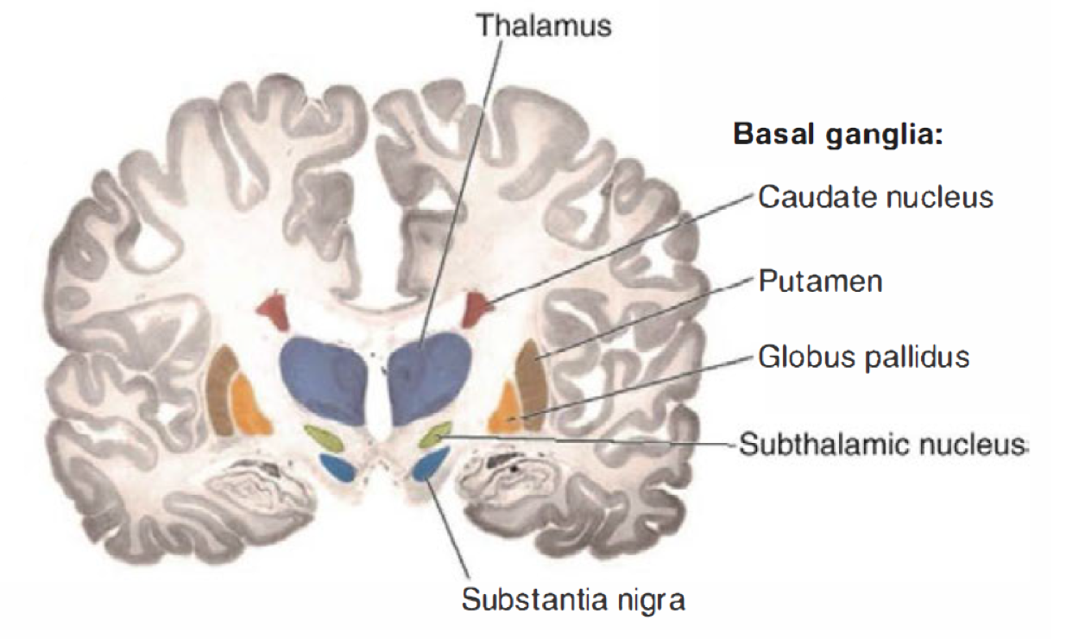
Striatum
+ Nucleus accumbens

Slide 35
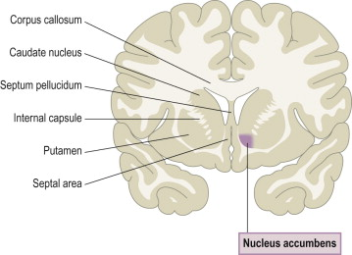

Slide 36
Striatum
+ Nucleus accumbens

Slide 37
This video contains sensitive content which some people may find disturbing

Slide 38
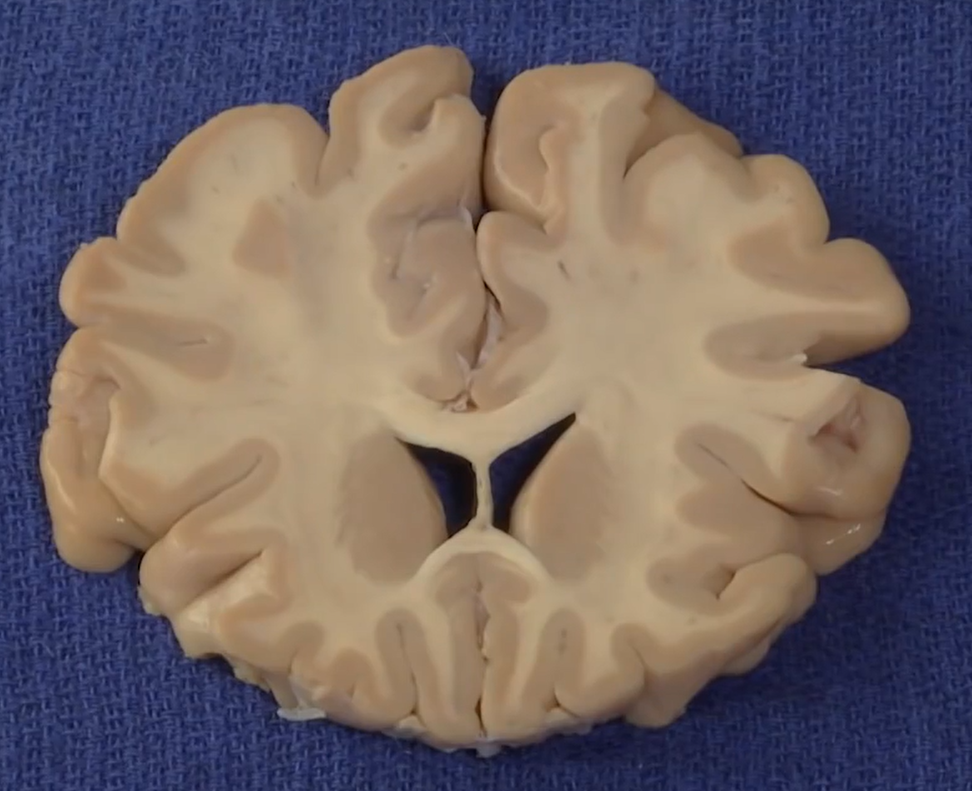
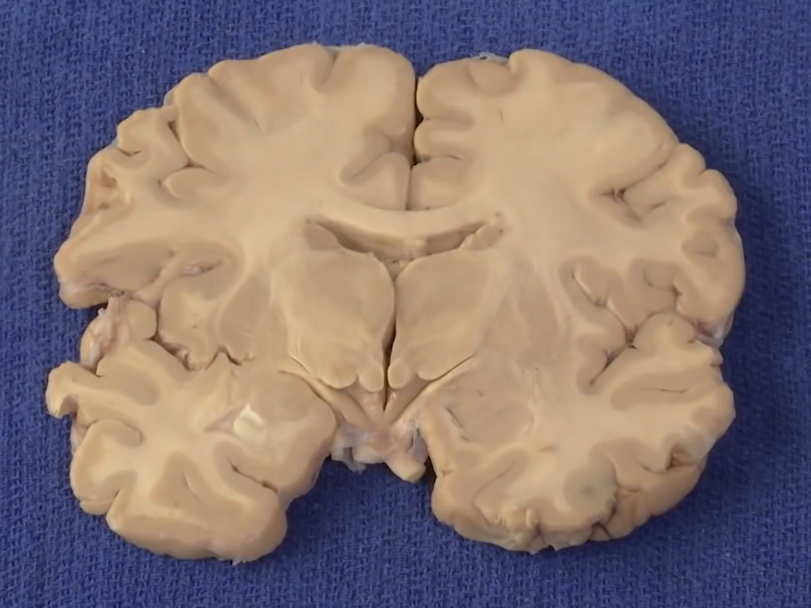
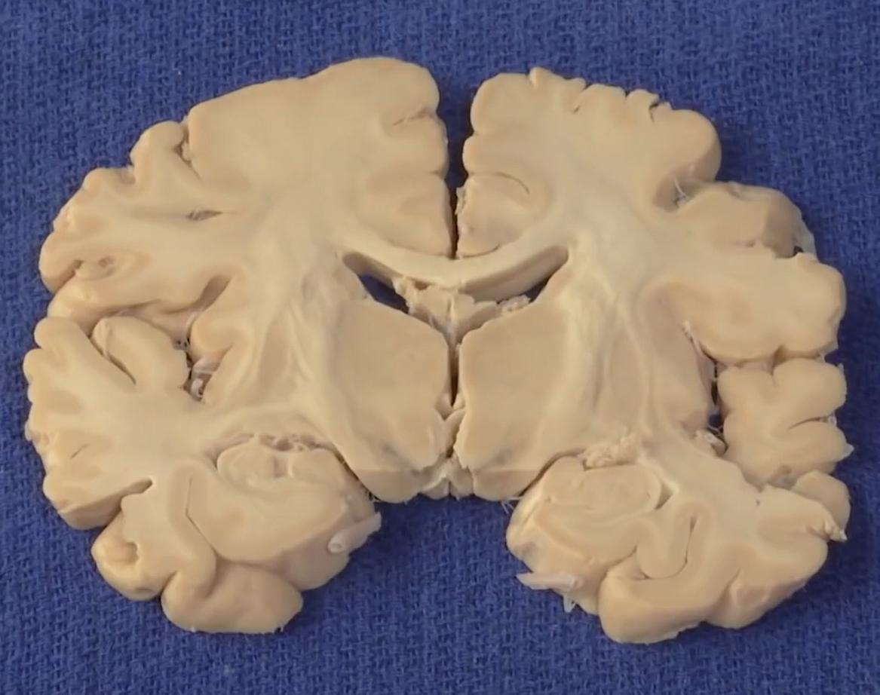
1 a)
2 a)
3
1 b)
2 b)
4

Slide 39
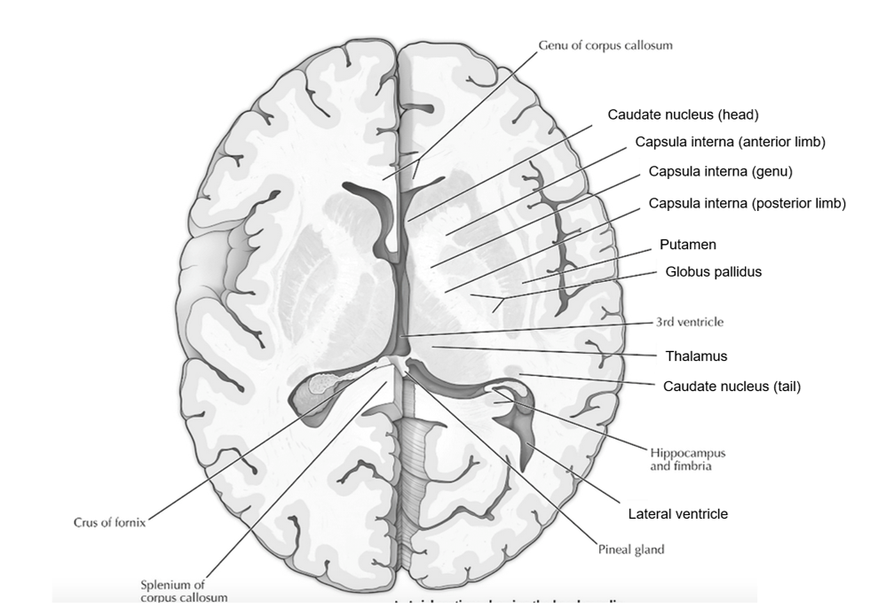

Slide 42
It’s
time

