Slide 1
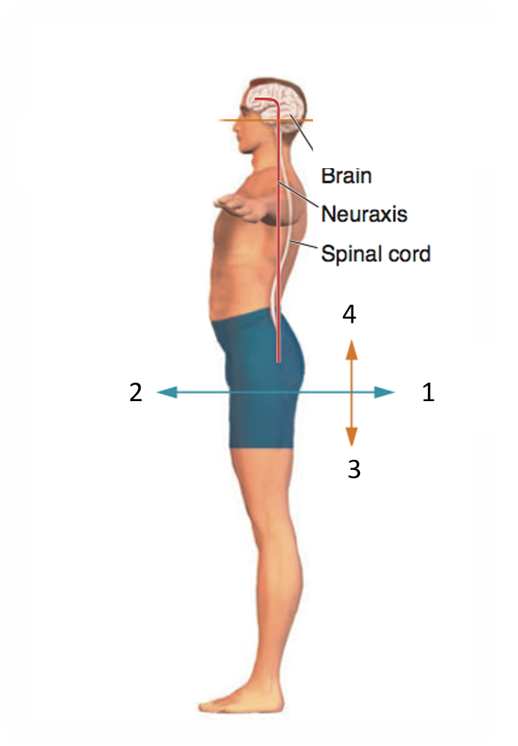
Associate to each number the correct term (choose from ventral, dorsal, caudal, rostral).
1
2
3
4

Slide 2
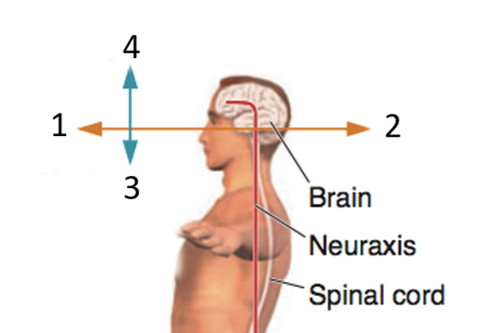
Associate to each number the correct term (choose from ventral, dorsal, caudal, rostral).
1
2
3
4

Slide 3
Fill in the blank
(use the term medial, lateral, proximal, distal)
The knee is ........ to the hip.
The wrist is ........ to the fingers.
The mouth is ........ to the nose.
The ears are …….. to the nose.
The thumb is …….. to the ring finger.
…… and …… compose the diencephalon.

Slide 4
Choose the correct anser.
The brainstem is composed of:
Medulla, cerebellum, pons
Medulla and pons
Medulla and cerebellum
Medulla, pons, tectum, tegmentum
The hindbrain is composed of:
Medulla, cerebellum, pons
Medulla and pons
Medulla, pons, mesencephalon
Pons and cerebellum

Slide 5
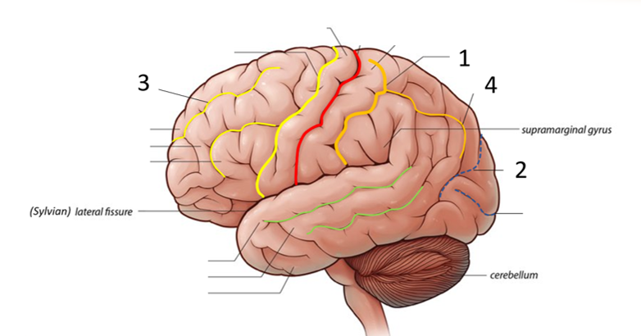
Associate to each number the correct structure.
Options:
Parieto-occipital sulcus
Calcarine sulcus
Intraparietal sulcus
Posterior sulcus
Postcentral sulcus
Central sulcus
Precentral sulcus
Superior frontal sulcus
Superior temporal sulcus
Inferior frontal sulcus
1
2
3
4

Slide 6
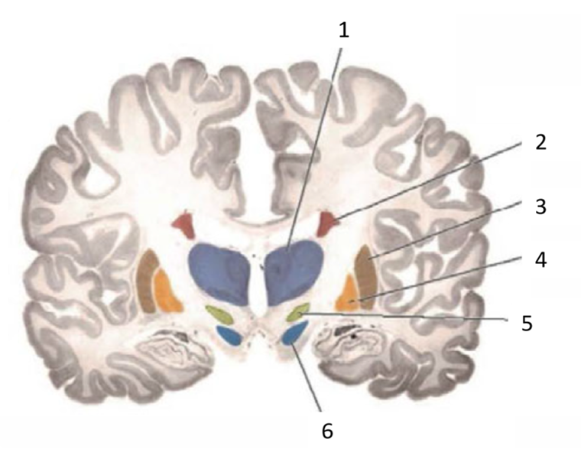
Associate to each number the correct structure.
Options:
Subthalamic nucleus
Globus pallidus
Amygdala
Caudate nucleus
Striatum
Putamen
Nucleus accumbens
Thalamus
Substantia nigra
Insula
Hippocampus
1
2
3
4
5
6

Slide 7
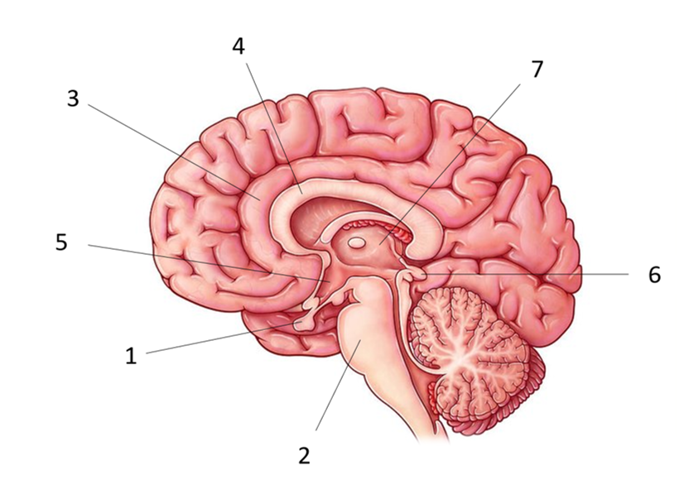
Associate to each number the correct structure.
Options:
Cerebellum
Corpus callosum
Third ventricle
Amygdala
Hypothalamus
Pineal gland
Pons
Midbrain
Thalamus
Insula
Pituitary gland
Hippocampus
Cingulate cortex
1
2
3
4
5
6
7

Slide 8
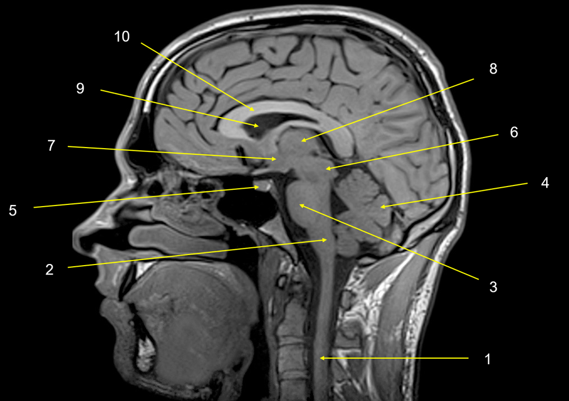
Associate to each number the correct structure.
Options:
Cerebellum
Spinal cord
Corpus callosum
Third ventricle
Amygdala
Hypothalamus
Pineal gland
Medulla oblongata
Pons
Midbrain
Thalamus
Insula
Pituitary gland
Hippocampus
Lateral ventricle
1
2
3
4
5
6
7
8
9
10

Slide 9
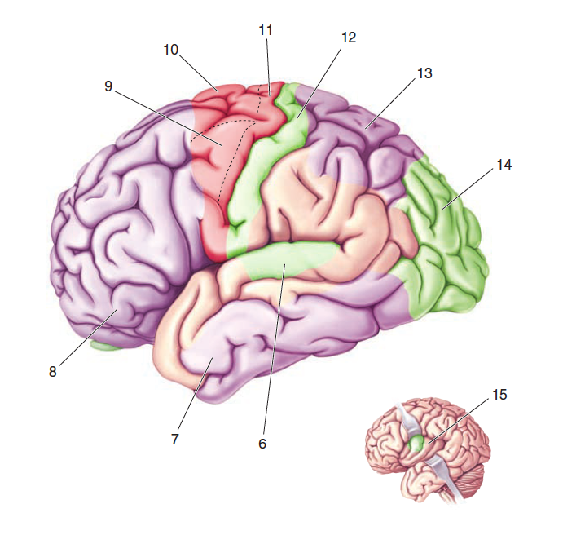
Associate to each number the correct structure.
Options:
Supplementary motor area
Premotor area
Wernicke area
Primary motor area
Middle temporal gyrus
Inferior temporal gyrus
Orbitofrontal cortex
Primary auditory cortex
Supramarginal gyrus
Insula
Primary sensorimotor cortex
Broca area
Posterior parietal cortex
6
8
9
10
11
12
15
Visual
cortex
Infero-temporal cortex

Slide 10
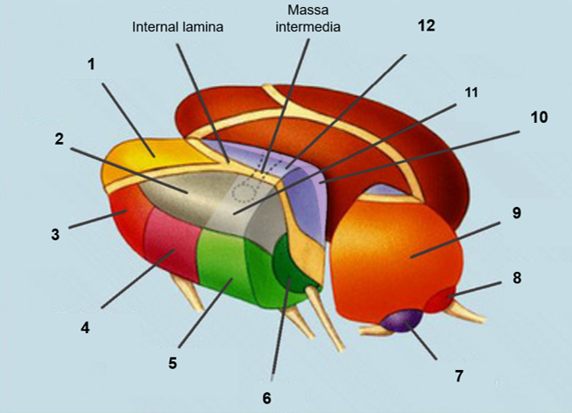
Associate to each number the correct structure.
1
2
3
4
5
6
7
8
9
10
11
12
Options:
Ventral posterior medial nucleus
Lateral geniculate nucleus
Ventro-lateral nucleus
Lateral posterior nucleus
Pulvinar
Ventral posterior lateral nucleus
Anterior nucleus
Medial geniculate nucleus
Midline nucleus
Medial nucleus
Lateral dorsal nucleus
Vental anterior nucleus

Slide 11
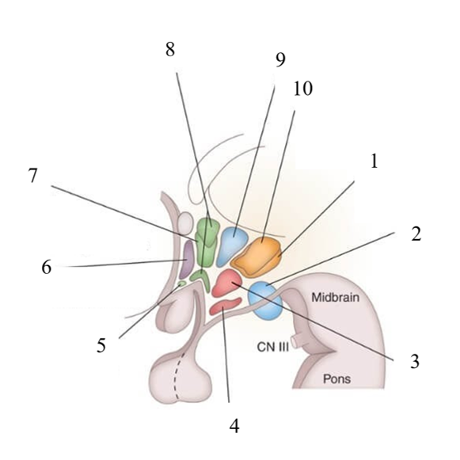
Associate to each number the correct structure.
Options:
Preoptic area
Dorsomedial nucleus
Posterior nucleus
Mamillary bodies
Suprachiasmatic nucleus
Anterior nucleus
Ventromedial nucleus
Arcuate nucleus
Lateral nucleus
Supraoptic and paraventricular nuclei
1
2
3
4
5
6
7
8
9
10

Slide 12
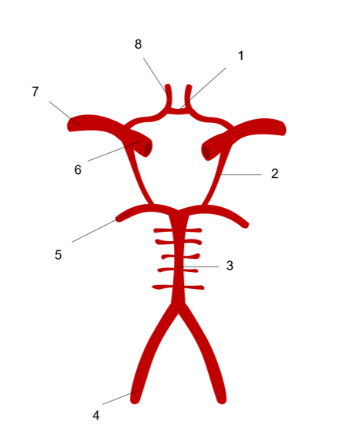
Associate to each number the correct structure.
Options:
Posterior cerebral artery
Anterior communicating artery
Basilar artery
Internal carotid artery
Posterior communicating artery
Middle cerebral artery
Vertebral artery
Anterior cerebral artery
1
2
3
4
5
6
7
8

Slide 13
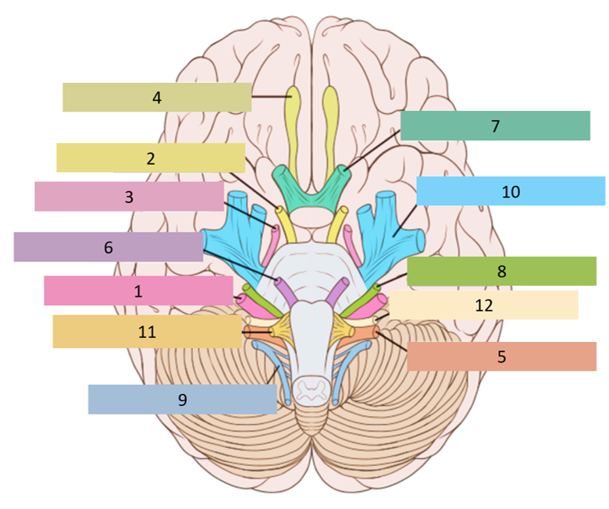
Associate to each number the correct structure.
Options:
Abducens nerve
Glossopharyngeal nerve
Oculomotor nerve
Trigeminal nerve
Vestibulochoclear nerve
Accessory nerve
Hypoglossal
Olfactory nerve
Facial nerve
Optic nerve
Vagal
Trochlear nerve
1
2
3
4
5
6
7
8
9
10
11
12

Slide 14
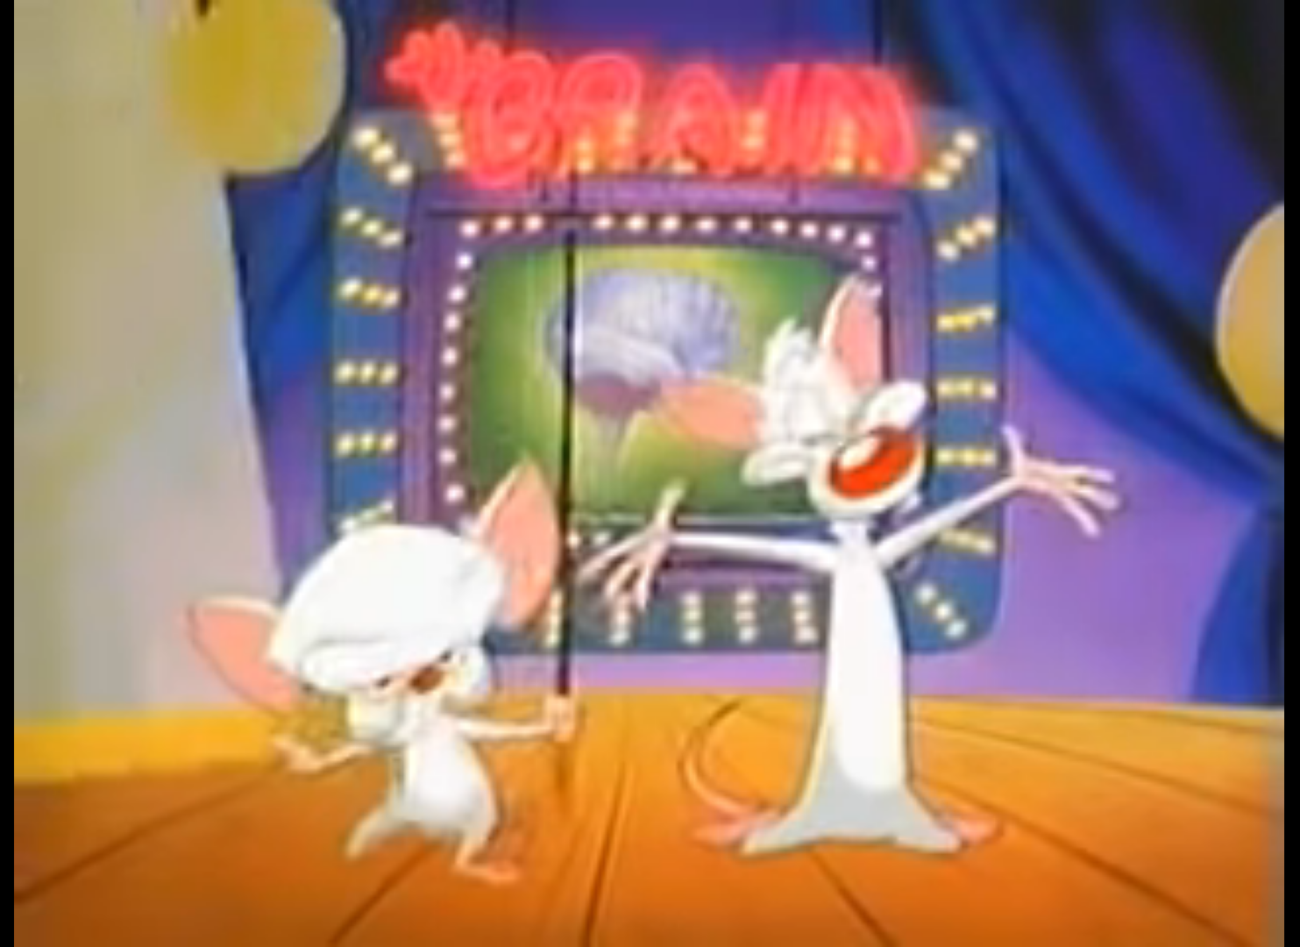
Good luck\

